Slide 1


Room for everyone's talent
Towards a new balance in the
recognition and rewards of academics
Kim Huijpen, Programme Manager
Recognition & Rewards
@RecogRewards #RecognitionRewards

Slide 2
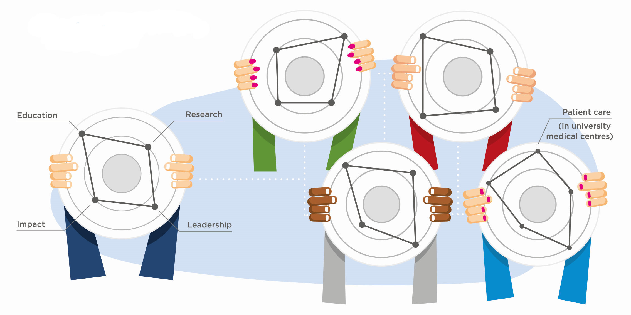
Our ambition
We aim for a healthy and inspiring environment for our academic staff. Where all talents are valued: Teaching, research, impact, patient care and good leadership in academia
Not only in The Netherlands
But all over the world!

Slide 3

Your ambition
Take 1 minute to think about the following question:
In Switzerland we aim for …
Take 2 minutes to speak with your neighbor
about your ambition for Switzerland
Take 2 minutes to speak about
your neighbor’s ambition for Switzerland

Slide 4
Your ambition
Take 1 minute to think about the following question:
In Switzerland we aim for …
Take 2 minutes to speak with your neighbor
about your ambition for Switzerland
Take 2 minutes to speak about
your neighbor’s ambition for Switzerland

Slide 5
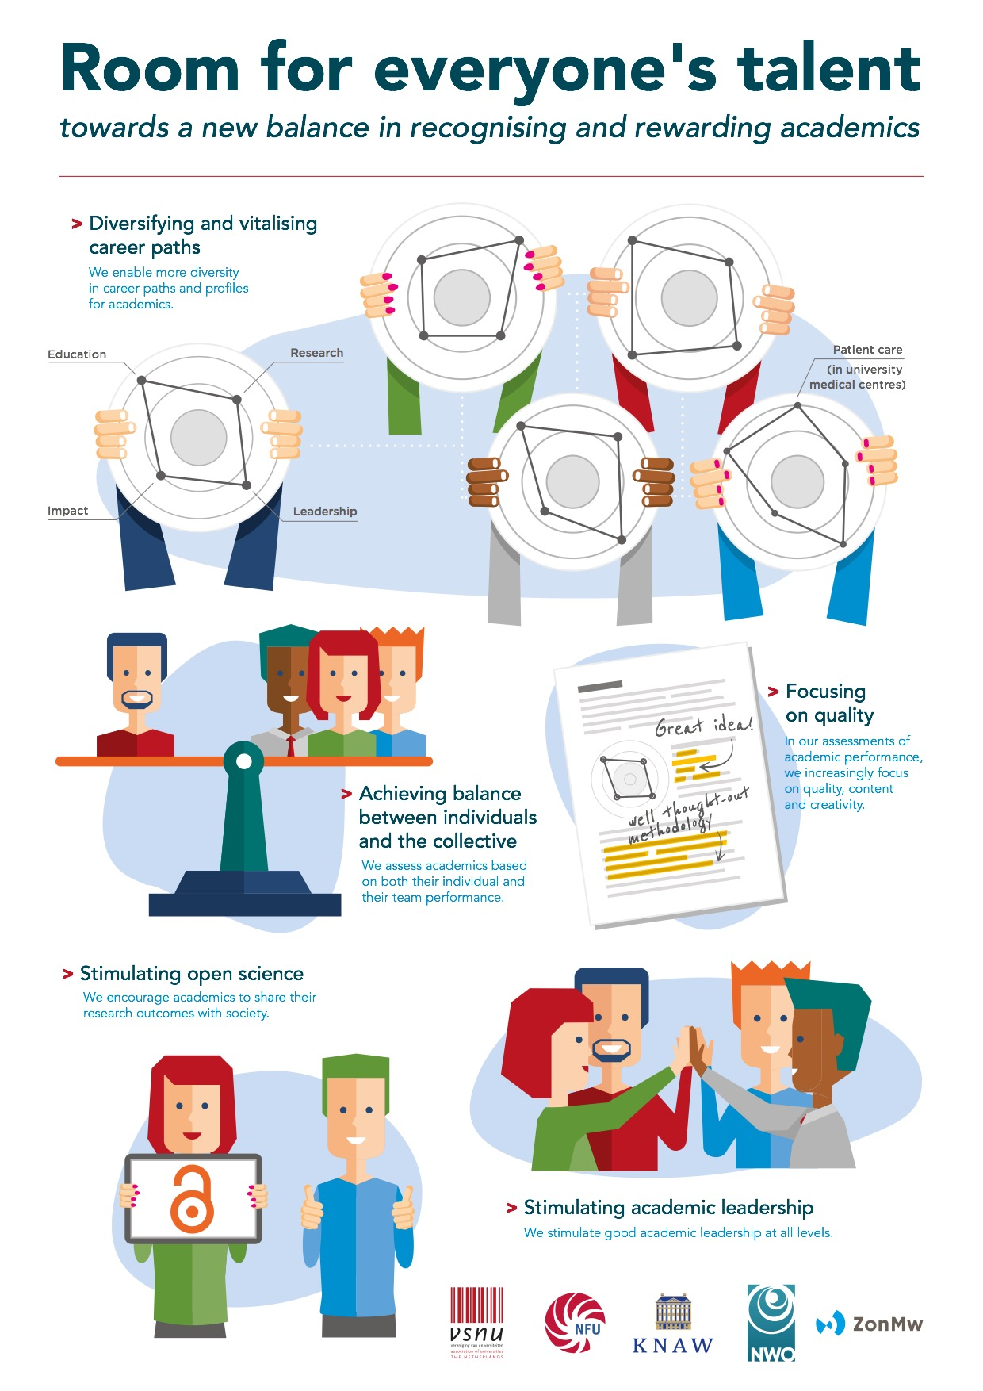
Outline
Why do we need a change in recognition and rewards?
What do we want to change?
How do we achieve this change?
How can I contribute?
Conclusion

Slide 6

Why do we need a change in recognition and rewards?

Slide 7
Why a change is needed
What we reward
What we aim for
Notes:
We see a mismatch between what we deem important in academic work and what we reward academic staff for.
Careers depend heavily on research performance, being measured by a limited number of criteria.
We need a better balance in how we recognize and reward academics to help us achieve excellent education, research, impact and leadership, as well as the highest level of patient care in our university hospitals

Slide 8
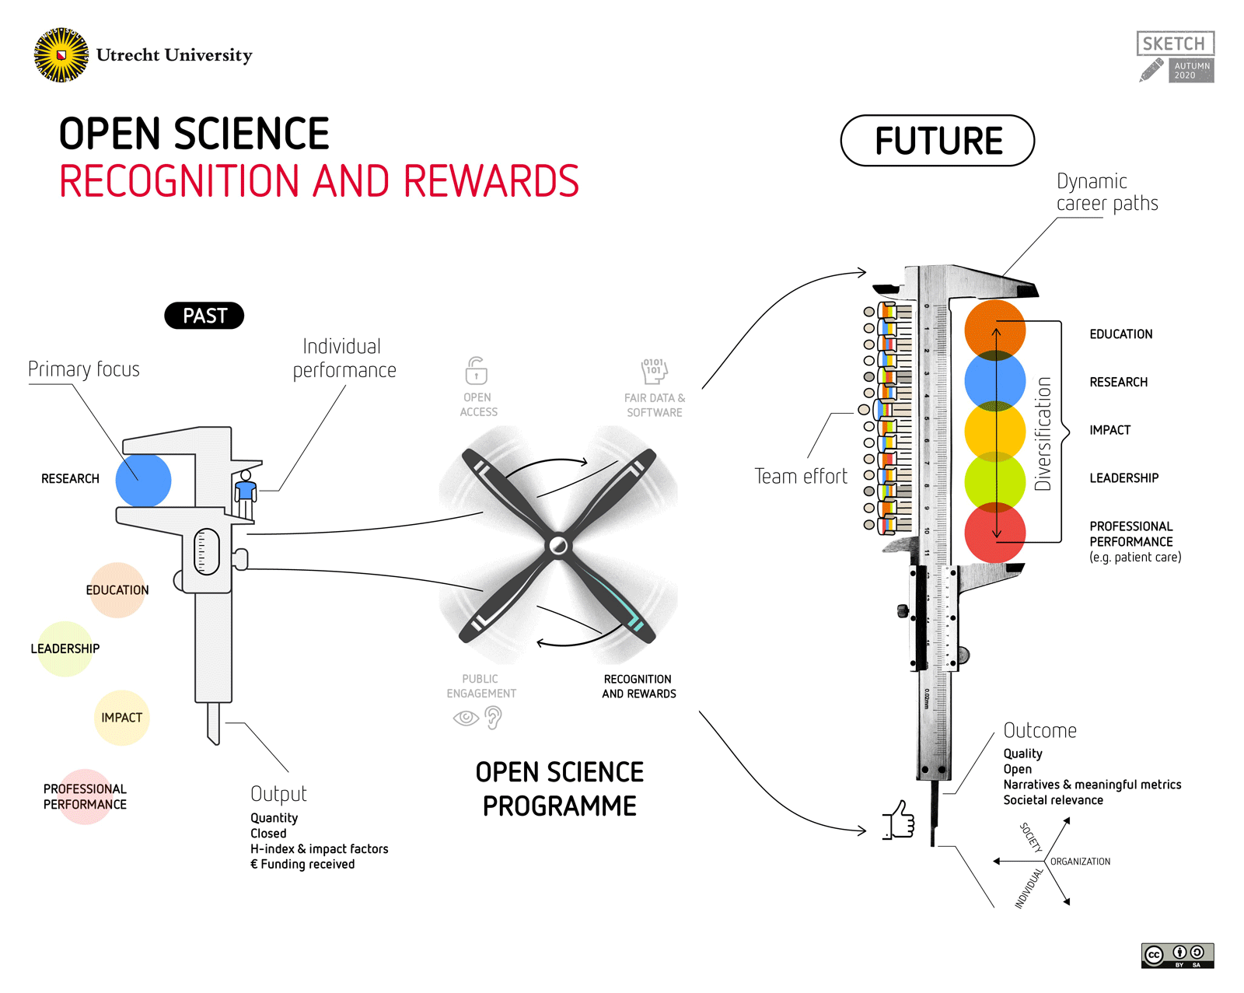

Slide 9
What do we want to change?

Slide 10
What we want to change
Diversifying and vitalising career paths
Achieving balance between individuals and the collective
Focusing on quality
Stimulating open science
Stimulating leadership in academia

Slide 11
Diversifying and vitalising career paths
1. Enable diversification and vitalisation of career paths, thereby promoting excellence in each of the key areas (education, research, impact, leadership and patient care)
11

Slide 12
Balance between individual & team
2. A better balance between individual
and team performance:
Recognition of teamwork and
team spirit
Inspire cooperation between
organizations, disciplines and
within teams (Team Science)

Slide 13
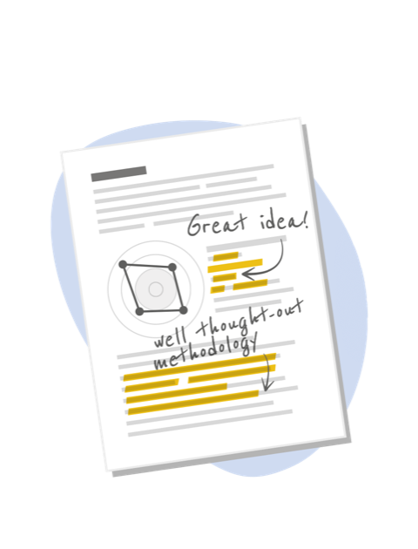
More focus on quality of work
3. More focus on quality of work over quantitative results:
Good scientific research increases scientific knowledge and makes a contribution to solving societal challenges

Slide 14

Stimulating Open Science
4. Open Science becomes the norm
and stimulates interaction between scientists and society:
Stimulating Open Science means recognizing and rewarding other aspects of research (in addition to publications), such as datasets or software, as important research outputs

Slide 15

Stimulating leadership in academia
5. More emphasis on the value of high-quality leadership in academia to set the course in research and education, to achieve impact, and to ensure that teams of academics can do their work as well as possible

Slide 16

What happened before publishing our position paper?

Slide 17



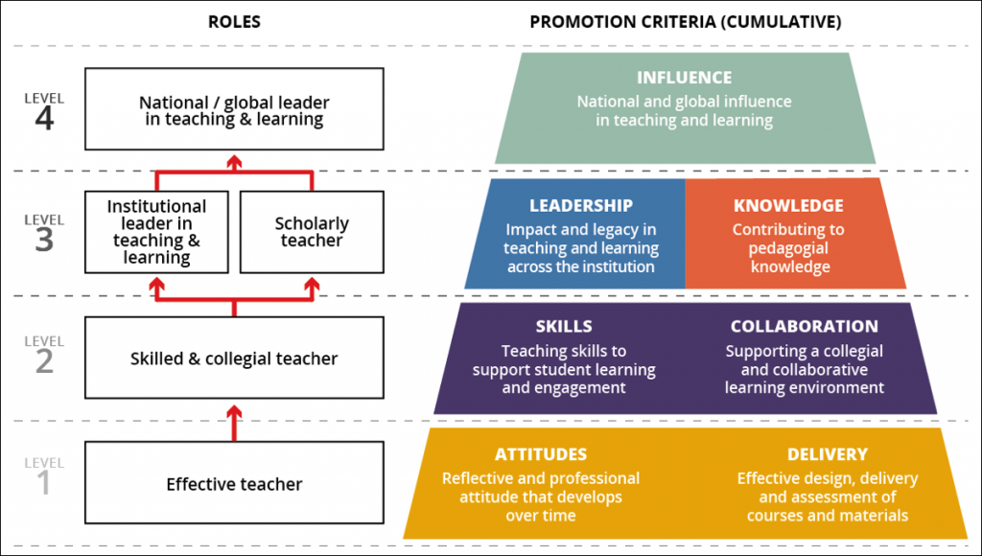
The Dutch context: converging agenda’s
Ambitious Open Science Agenda
Science in Transition movement
Concerns over work pressure /
pressure on system
Career tracks with emphasis on teaching
Notes:
national program driven by all stakeholders collaborative way. Is the result of four agenda’s / policy debates coming together:
NLS has had a very ambitous Open Science agenda. At least from 2013. Generally acknowledged that this requires reform of assessment practices
Very active debate about the misuse of metrics in assessment and how “science goes wrong” (not serving the goals it should).
More recently also heated debate about academic culture in general. Low succesrates, high dependency for carreer progression, need to rebalance way we reward different academic tasks (education versus research versus outreach) to get a healthy and inspiring working environment.
the Royal Academy of Engineering (UK) launched the teaching framework that enables universities to implement career emphasis on education. The four level picture indicates how academic teachers can develop themselves. Similar approaches from all Dutch universities can make implementation easier and would then allow academics to transfer ‘educational achievements’ when moving from one university to another. As many domains are international, the link to the international group of universities is beneficial as well. Discussions are now ongoing how to monitor implementations and impact.

Slide 18
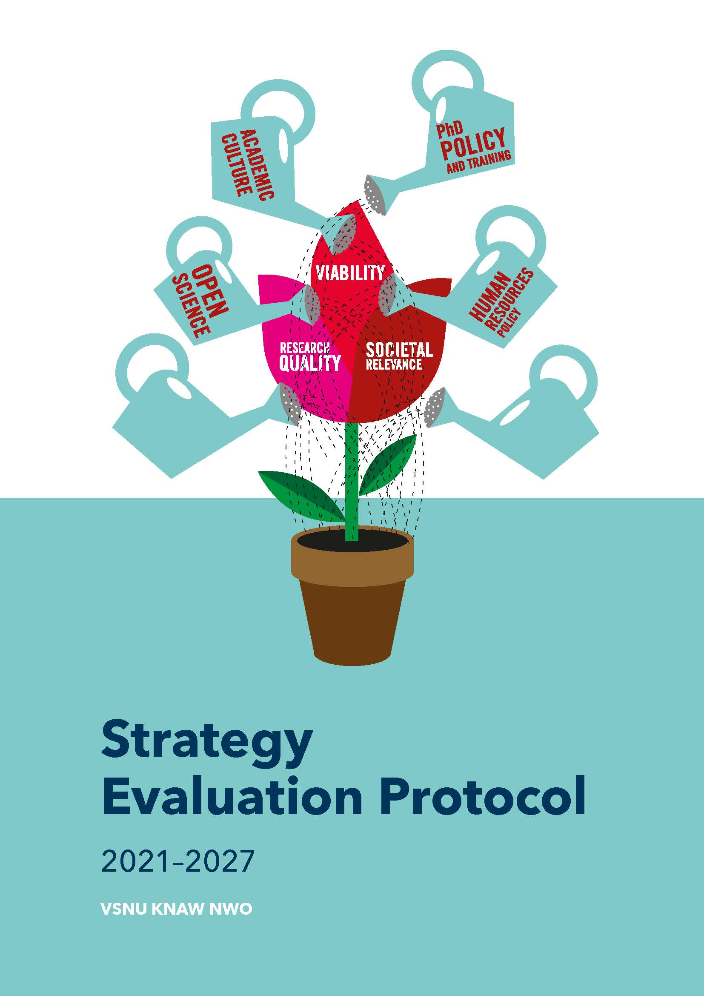
Steps before start of national programme
Nov 2018
Statement VSNU, NWO, NFU and ZonMw on Recognition and reward of academics
April 2019
KNAW, NWO & ZonMw sign DORA
(UNL already did)
May 2019
ZonMW & NWO conference Scientist 2030:
Evolution or Revolution
Nov 2019
Postion paper: Room for everyone’s Talent
VSNU - EUA Recognition & Rewards Conference
March 2020
New Strategy Evaluation Protocol

Slide 20
Strategy Evaluation Protocol (SEP 2021 - 2027)
Strategic goals of a research unit, Open Science, and Recognition & Rewards important basis for new research evaluation protocol
Key focus on goals and strategy rather than numerical evaluations
This protocol is based on a quality assurance system incorporating strategic thinking and action
3 minute movie on new SEP

Slide 21
How do we achieve this change?

Slide 22
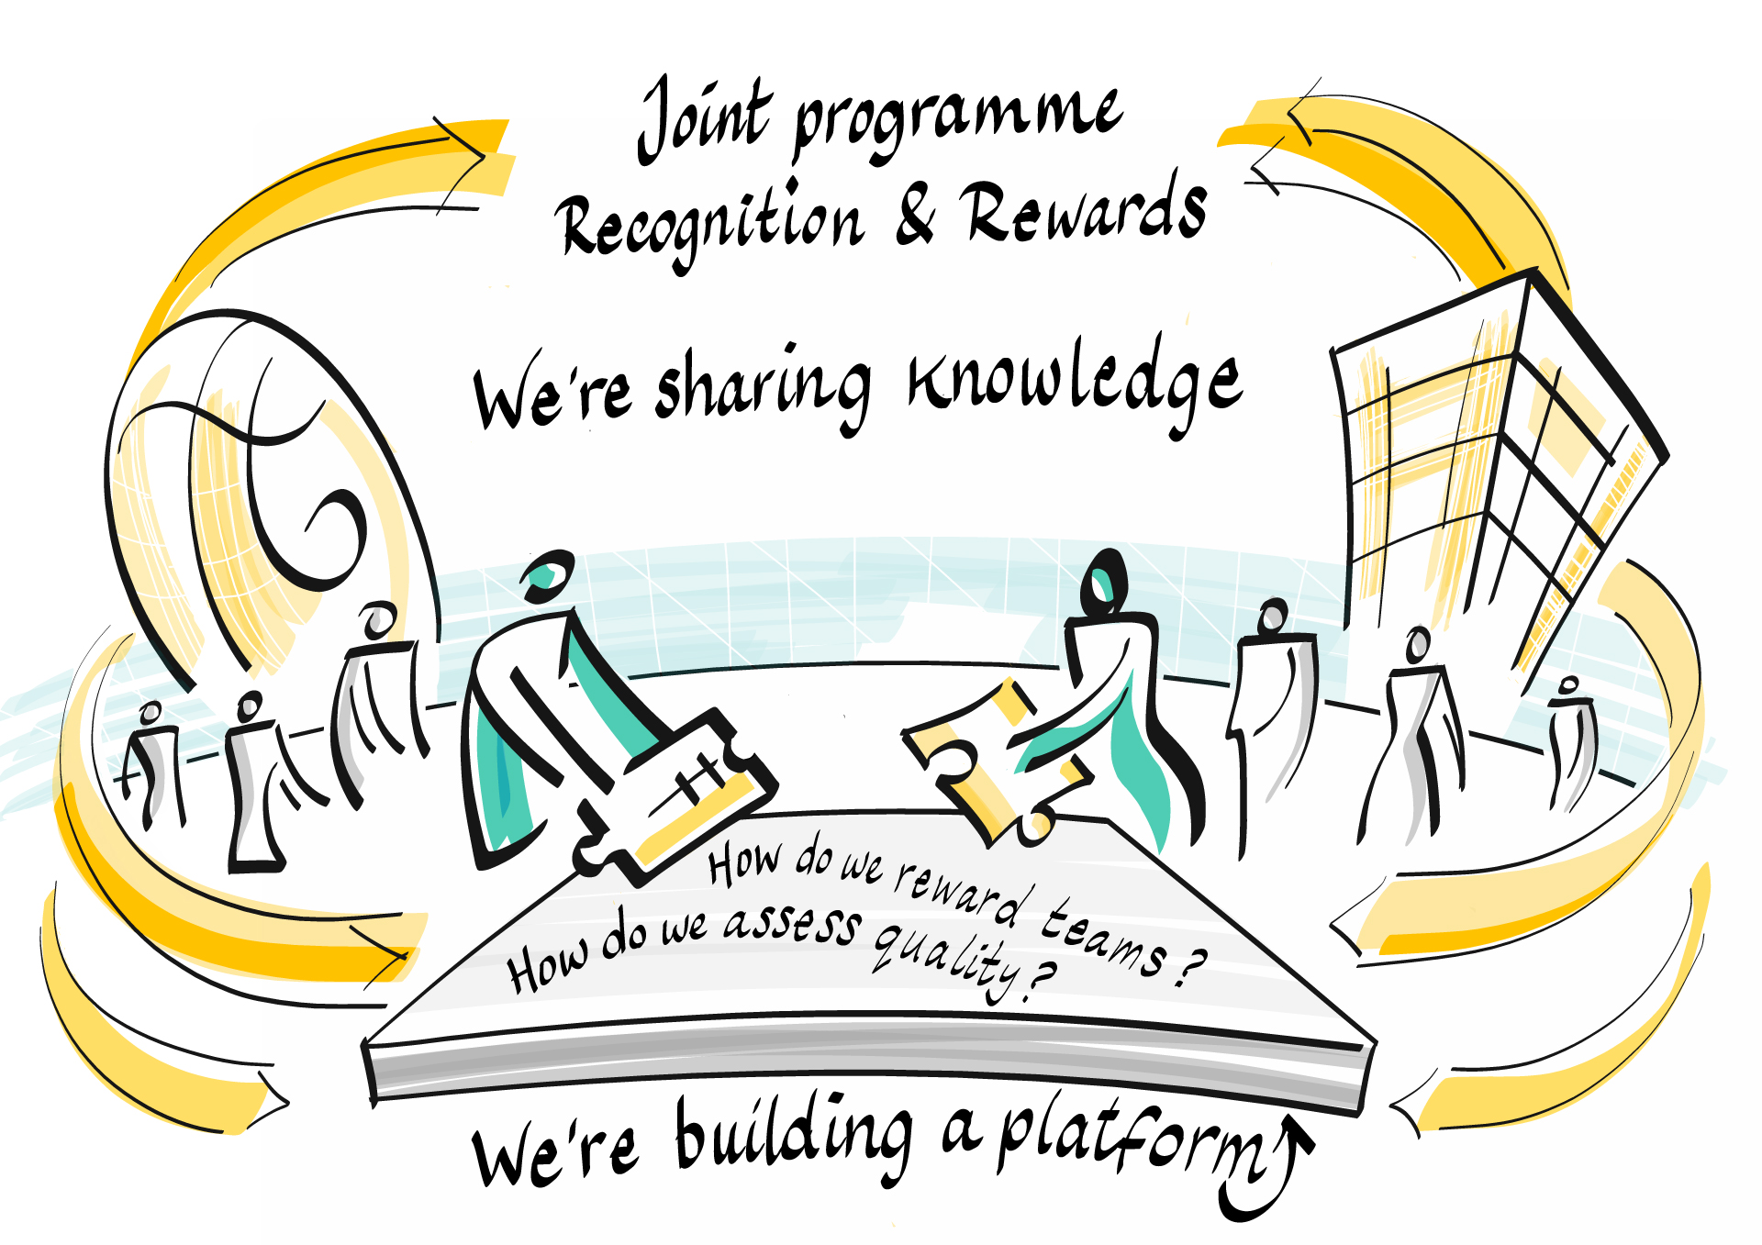

Slide 23
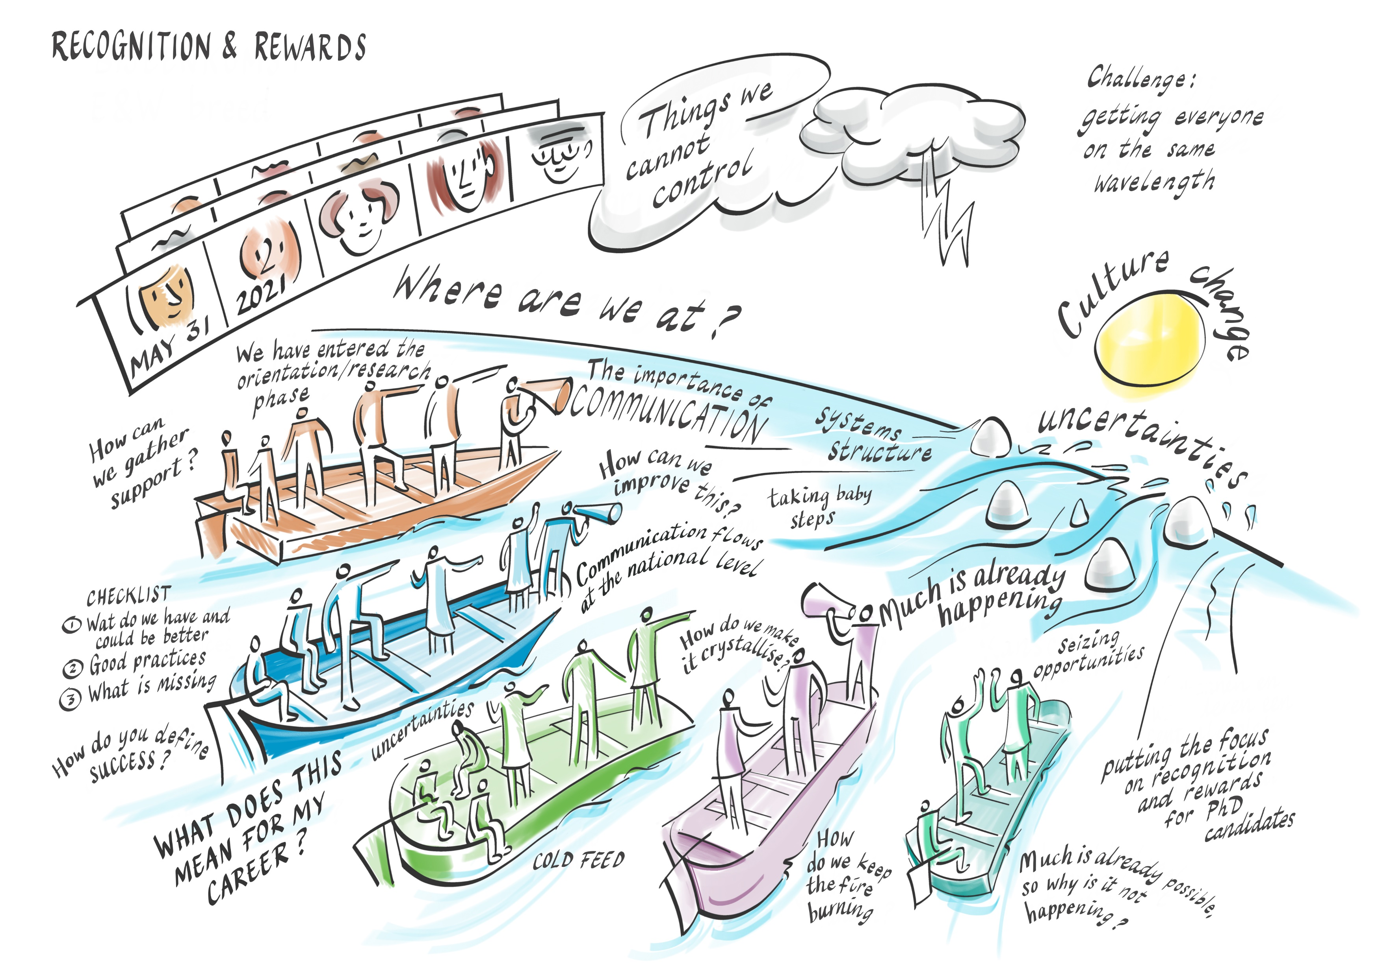

Slide 24
Change approach in 6 phases
Committees translate position paper to own context and organize dialogue
1
6
Researching & formulating a vision
Adding meaning
Specifying and developing
Implementing
Consolidating
2
3
Increasing power of imagination & experimenting
4
5
Investigating and increasing confidence in new opportunities
Active steps towards implementing vision within own organisation
Development of supporting products and criteria
New systems become embedded in daily actions, thoughts & considerations
Ensure that new behaviour becomes ingrained
Notes:
Researching and formulating a vision
Committees translate position paper to their own context and organize dialogue with fellow academics
Increasing the power of imagination and experimenting
Actions will be focused on investigating and increasing confidence in new opportunities
Adding meaning
Groups take active steps towards implementing the vision within their own organisation
Specifying and developing
Development of supporting products and criteria for a modernized recognition and rewards system
Implementing
New support systems will become embedded in daily actions, thoughts and considerations
Consolidating
An effort to ensure that the new behaviour becomes ingrained

Slide 25
Our approach
18 Recognition & Rewards committees from all 14 research universities, research institutes and funders
Committees stimulate intended culture change at institutional level
There is a great and inspiring diversity of approaches
Inspiring, experimenting, co-creation, sharing good practices and mutual learning are central to the joint programme
We stimulate this with regular (online) meetings, Recognition & Rewards Festival and we develop an online community platform

Slide 26





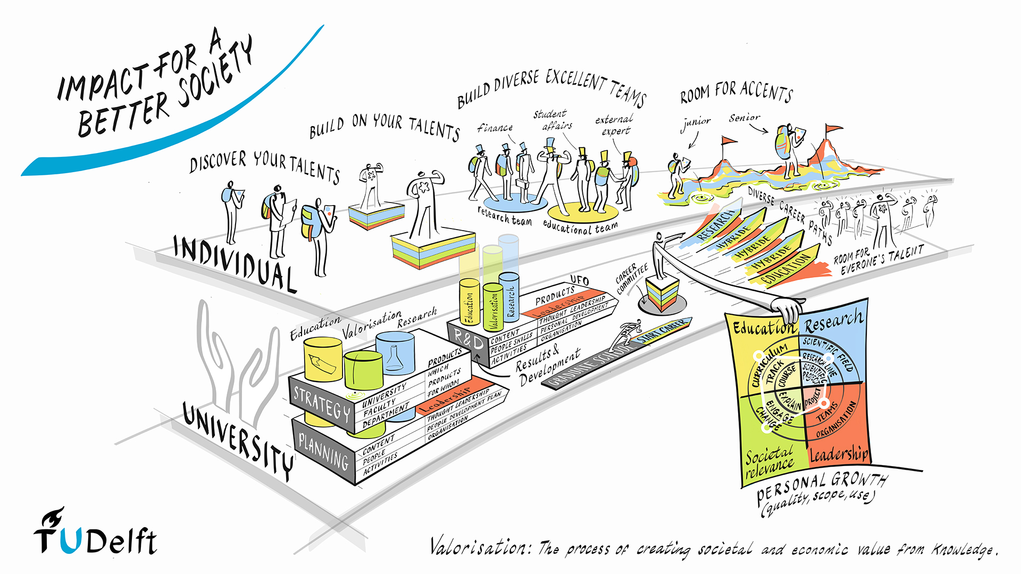
Institutions translate position paper to own organisation

Slide 27


Slide 28


Bottom-up & Top-down
National steering group is responsible for monitoring cohesion and encouraging parties to be mutually consistent and show courage
A broad dialogue in academia is important: Scientists should be able to discuss recognition & rewards and influence how they are assessed

Slide 29
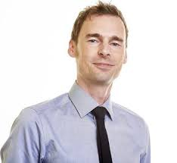
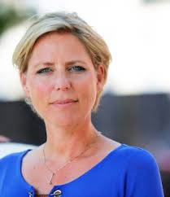
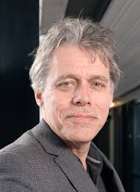
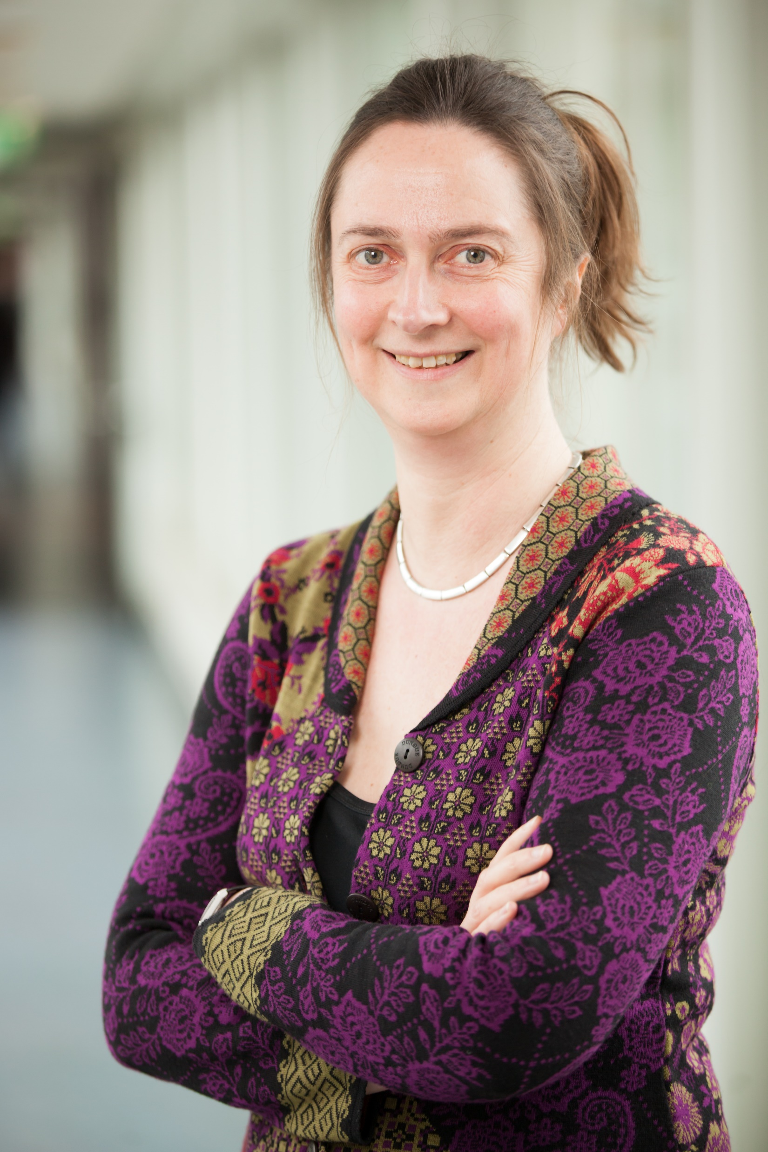
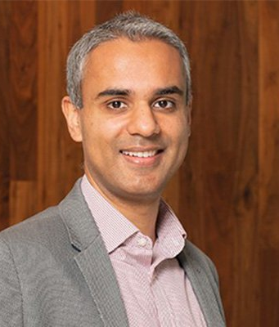

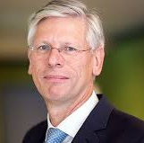
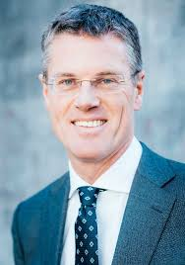

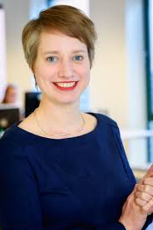

























Co-chairs
Recognition & Rewards steering group
Recognition & Rewards committees
Programme team

Slide 30
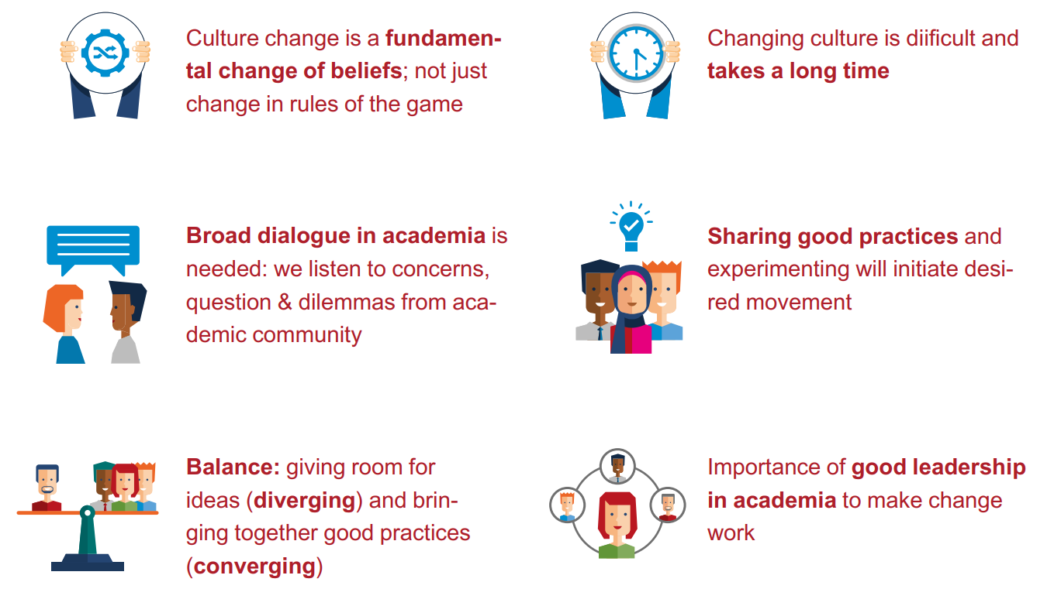
Guiding principles
Culture change is a fundamental change of beliefs; not just change in rules of the game
Changing culture is difficult and takes a long time
Broad dialogue in academia is needed: we listen to concerns, questions & dilemmas from academic community
Sharing good practices and experimenting will initiate desired movement
Balance: giving room for ideas (diverging) and bringing together good practices (converging)
Importance of good leadership in academia to make change work

Slide 31
Dialogue & Debate

Slide 32

Stimulating dialogue key in our approach
The Recognition & Rewards programme involves a paradigm shift
That can only take place if we also change our daily conversations; if we truly change the way we talk about research, education, talent development and leadership
That will, first and foremost, require an inquisitive mindset and genuine curiosity
about each other’s perspectives

Slide 33
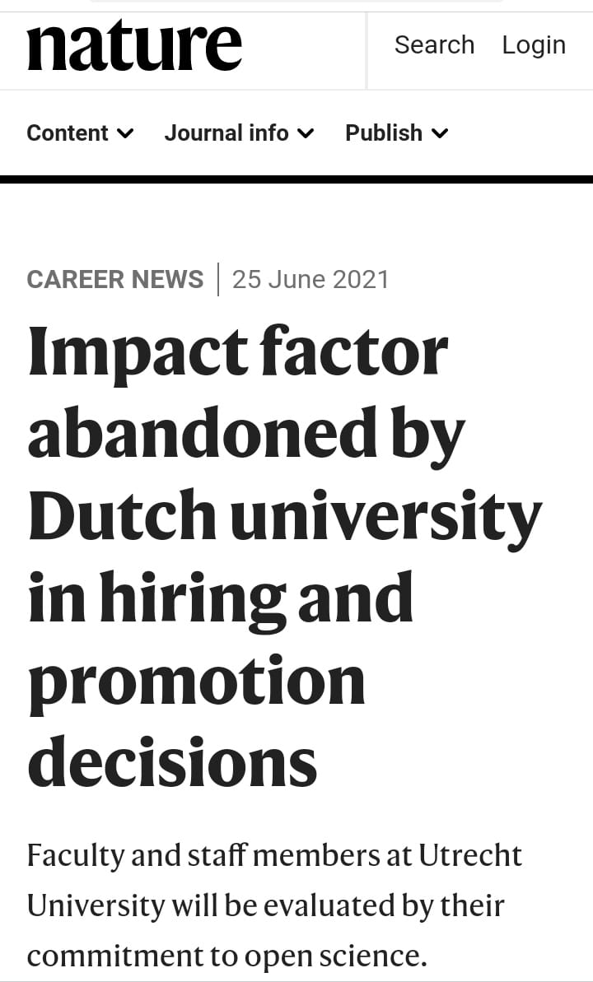

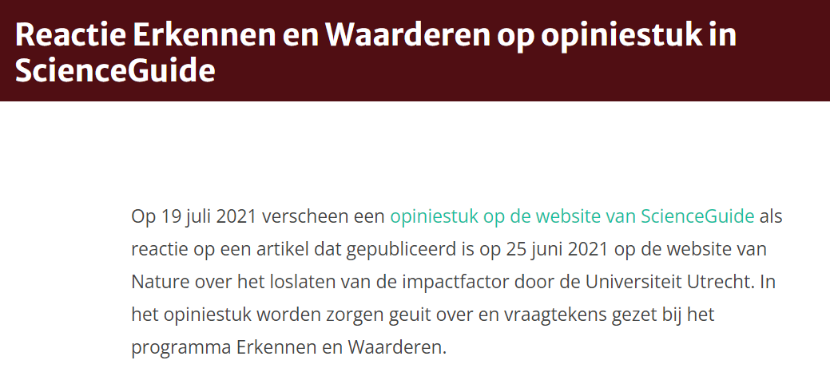
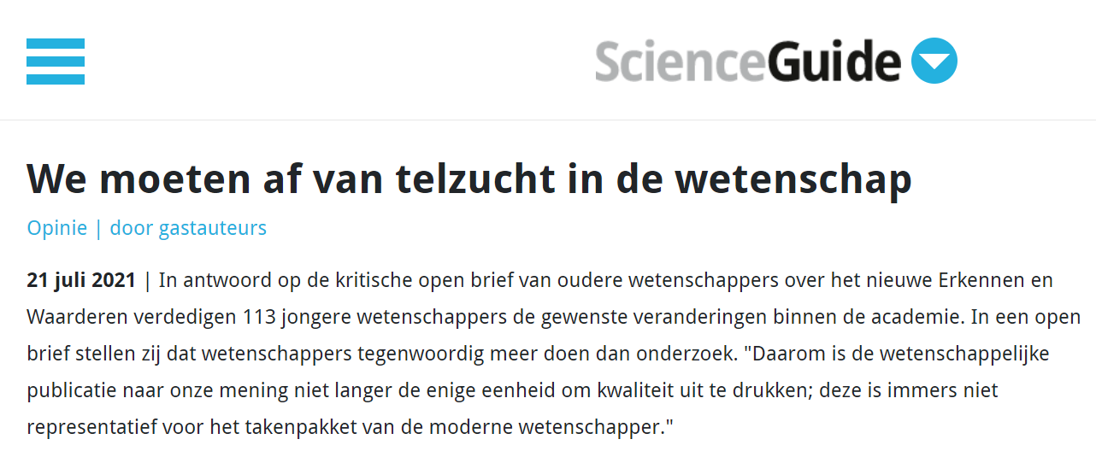

https://www.nature.com/articles/d41586-021-01759-5
https://www.scienceguide.nl/2021/07/nieuwe-erkennen-en-waarderen-schaadt-nederlandse-wetenschap/
https://recognitionrewards.nl/2021/07/19/reactie-erkennen-en-waarderen-op-opiniestuk-in-scienceguide/
https://www.scienceguide.nl/2021/07/we-moeten-af-van-telzucht-in-de-wetenschap/
https://recognitionrewards.nl/2021/08/03/why-the-new-recognition-rewards-actually-boosts-excellent-science/

Slide 34

Public debate with open letters
In July 2021 a group of 171 scientists warns in an open letter that the new Recognition and Rewards system is harming Dutch science
They write that especially the medical, exact and life sciences are at risk of losing their top international position
We appreciated academics expressing concerns
We were happy to respond to the questions raised
But preferably we would like to engage in a dialogue to work together to find a new balance in recognising and rewarding the talents of academics

Slide 35
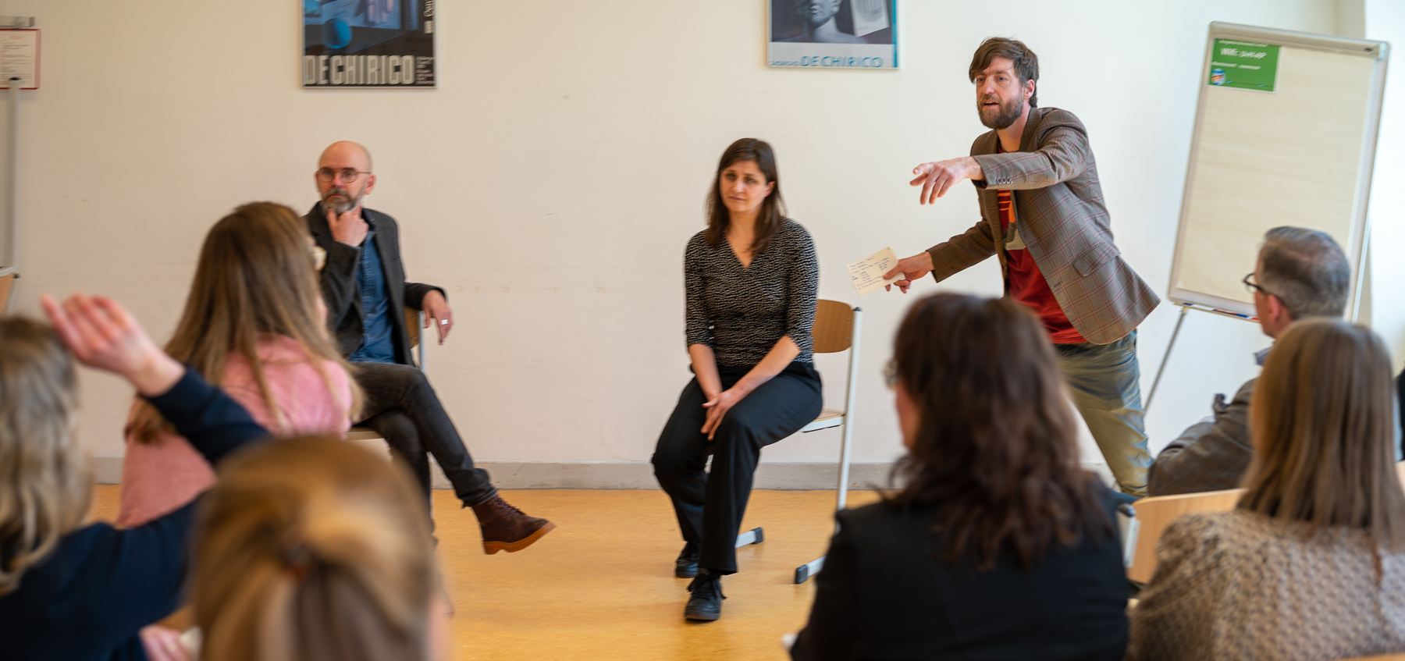

Slide 36

How can I contribute?

Slide 37
Get involved!
Start small
Start the dialogue – with your peers next door and worldwide
Share your ideas, dilemmas and concerns
Listen to concerns, questions and dilemmas from your peers
Start your own (small) experiment in modernizing career assessment
Share good practices and experiments

Slide 38
Conclusion

Slide 39
Conclusion
We need a better balance in how we recognize and reward academics to help us achieve excellent education, research, impact and leadership, as well as the highest level of patient care in our university hospitals
We cannot change academic career assessment on our own. We need to work together on a global level to change the recognition and rewards of academics
So…….

Slide 40
Let’s move together!

Slide 41

Thank you for your attention!
More information: Kim Huijpen, Programme Manager huijpen@unl.nl recognitionrewards.nl
@RecogRewards @KimHuijpen www.linkedin.com/company/recognition-rewards/

Slide 42
Some interesting references
Position paper ‘Room for everyone’s talent: towards a new balance in the recognition and rewards for academics’,
E-Magazine Recognition & Rewards autumn 2022
Strategy Evaluation Protocol (SEP) 2021 – 2027
A recap of the Recognition & Rewards Festival (February 2022)
A Toolkit for Dialogue
Webinars on rewarding teaching (November 2020)
Video Strategy Evaluation Protocol (SEP) 2021-2027
‘Three perspectives on Open Science in research assessment’ slide deck
Youtube playlist Recognition & rewards
Summary of Career Framework for University Teaching (Ruth Graham)
Video’s showcasing five countries reforming university reward and recognition systems
The Dutch Recognition & Rewards Programme in DORA Repository
Illustrations by Mark van Huystee and Things to Make and Do

Slide 43
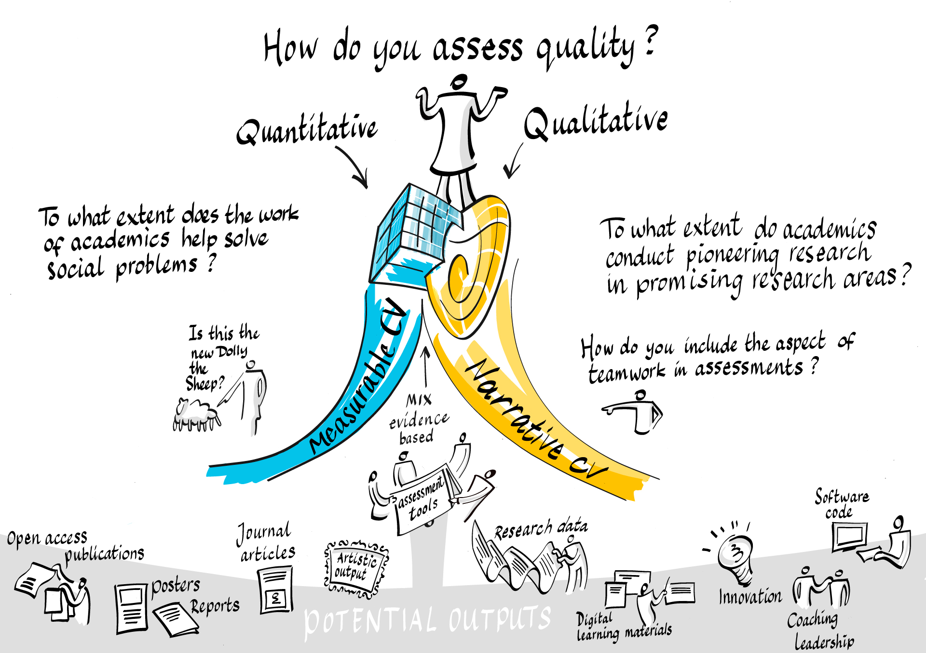

Slide 44
