Slide 1


Making room for everyone's talent
International developments
Kim Huijpen, Programme Manager
Recognition & Rewards
@RecogRewards #RecognitionRewards

Slide 2

Reforming Research Assessment
Scientific organizations from Europe and beyond jointly declare the need to reform assessment of research; 350+ organisations from 40+ countries expressed interest
Major boost for Recognition & Rewards;
it gives our academics confidence that this is an international movement
Other countries are looking to the Netherlands as a pioneer in this cultural change
We like to share the lessons we’ve learned so far

Slide 3
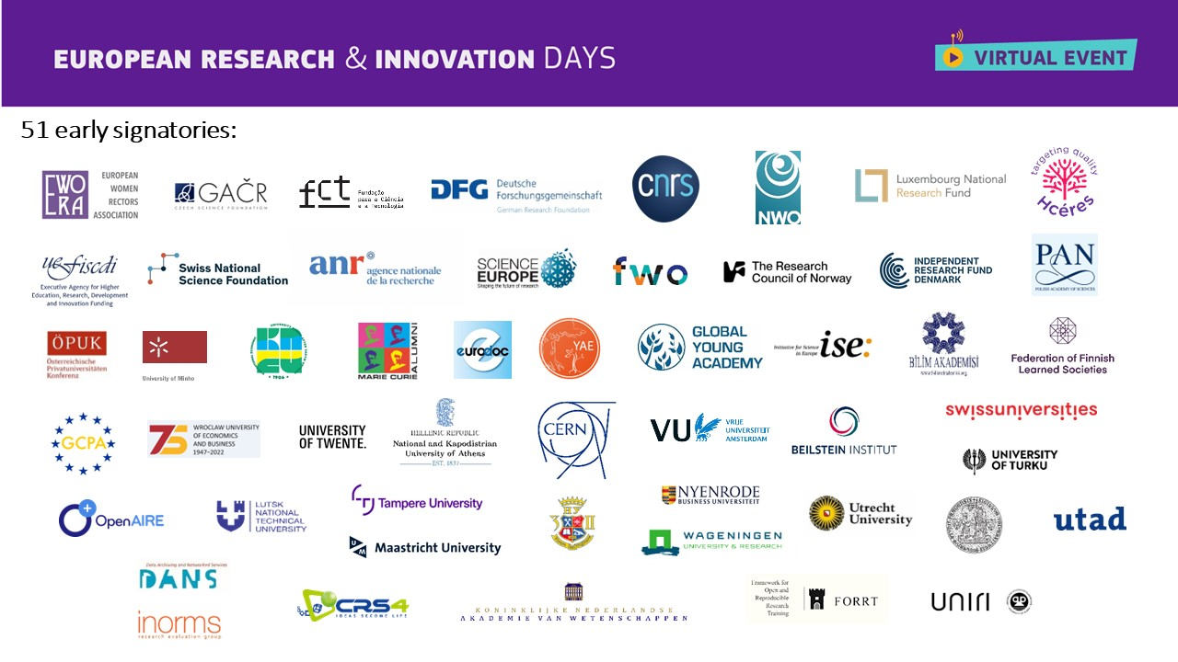

Slide 4
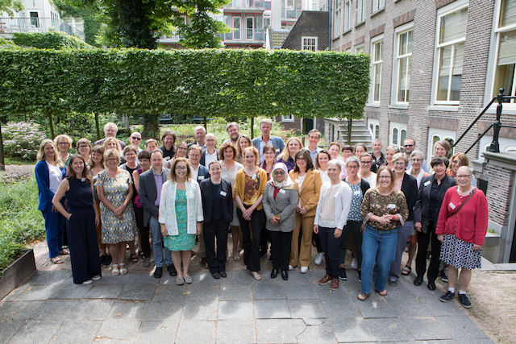
Advancing Teaching
Advancing Teaching is a global initiative to improve support, reward and recognition of teaching and learning at universities across the world
A global network of university
leaders, change makers &
experts in teaching and learning
Activities include development of
Career Framework for University
Teaching, a Teaching Cultures
Survey and annual meetings that
bring together this global network

Slide 5


Teaching
Cultures
Survey 2022

Slide 6

11,614 participants
All 2022
8
countries
17 universities

Slide 7
Academics experiences and priorities: promotion to full professorship
“How important would you like each of the following activities to be for promotion to full professor at your university (for a typical academic on a research/teaching contract)?”
Not important
Somewhat important
Very important
It depends on the academic
Don’t know

Slide 8
… respondents who report each activity currently is very important

Slide 9
Most continue to want priority on UT to increase (All 2022)
”How do you anticipate the priority given to university teaching in academic promotions will change at your institution in the next five years?”
↗︎ increase
↘︎ decrease
= stay the same
? don’t know

Slide 10
Most continue to want priority on UT to increase (All 2022)
”How would you like the priority given to university teaching in academic promotions to change at your institution in the next five years?”
↗︎ increase
↘︎ decrease
= stay the same
? don’t know

Slide 11
11,614 participants
All 2022
8
countries
17 universities

Slide 12
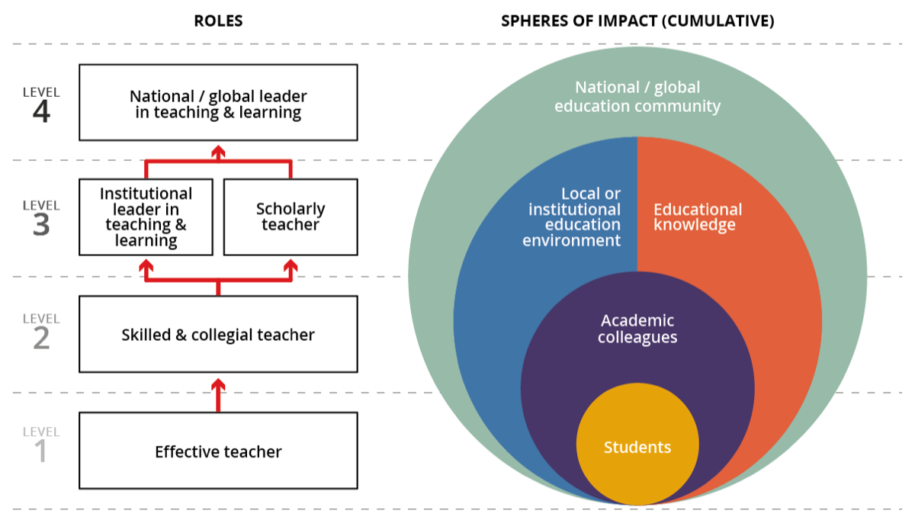

Slide 13
