Slide 1
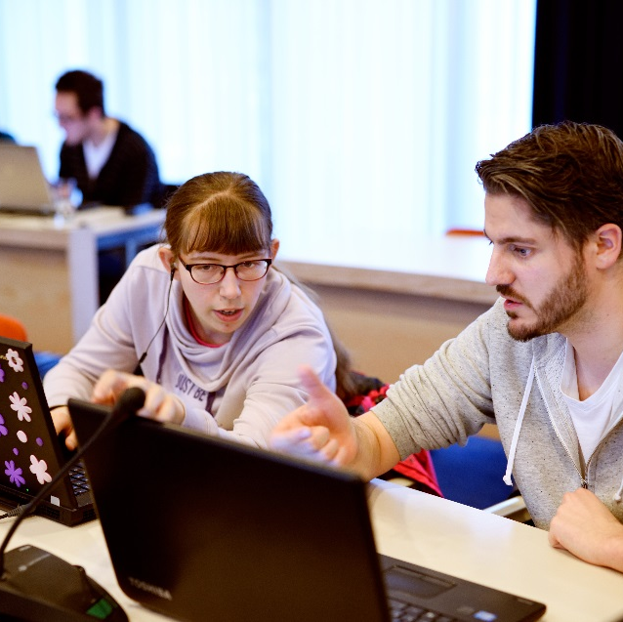



Teacher learning in the context of educational innovation
Room for everyone’s educational talent
Perry den Brok, 10 October, 2024
Perry.denbrok@wur.nl

Slide 2
Topics
Configurations of innovations, professional development and teacher learning (The teachers2learn project)
The relevance of conditions and guidelines for effective teacher learning in the context of educational innovation:
  Professional learning communities
  Innovation calls
Some conclusions and discussion points

Slide 3
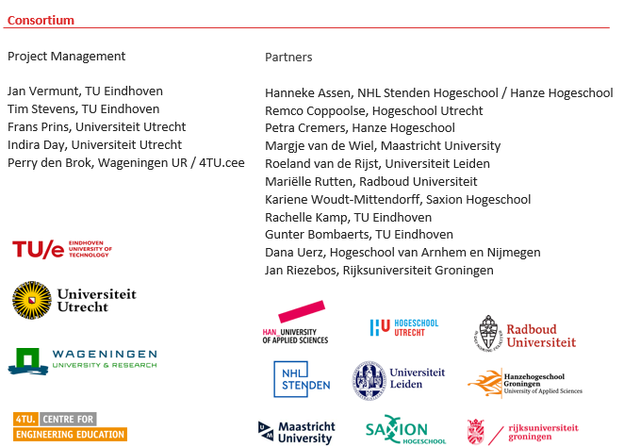
The Teachers 2 Learn project
Funded by the Netherlands Initiative for Education Research (NRO) (2020-2024)
Consortium of 20 Research Universities and Universities of Applied Sciences
Educational Researchers, Teacher-Researchers, Education Practitioners, Visionaries, Students

Slide 4
Teachers2Learn - project
Main Research question: Do various approaches to teacher professional learning and development work for different innovations, contexts and populations? How and why do they work (or not)?
Approach: Literature Review, Case Review, In-depth case studies
Main concepts studied:
  Innovation: Introduces a new aspect to the educational environment
  Professional Development: Formally organized activities
  Learning Activities: Activities undertaken by teachers (can be formal & informal!)

Slide 5
Findings literature review
Large variety of PDI’s and Learning Activities
  Mainly external PD and application activities
  Often clusters of different activities
Often no detailed descriptions of PDI’s
Unclear why and how different PDI’s have led to positive outcomes
Some authors (22 %) present possible mechanisms
  Examples: congruence, connecting with colleagues
Congruence: Similar or same pedagogies in PD as intended in innovation (for example: problem based)

Slide 6
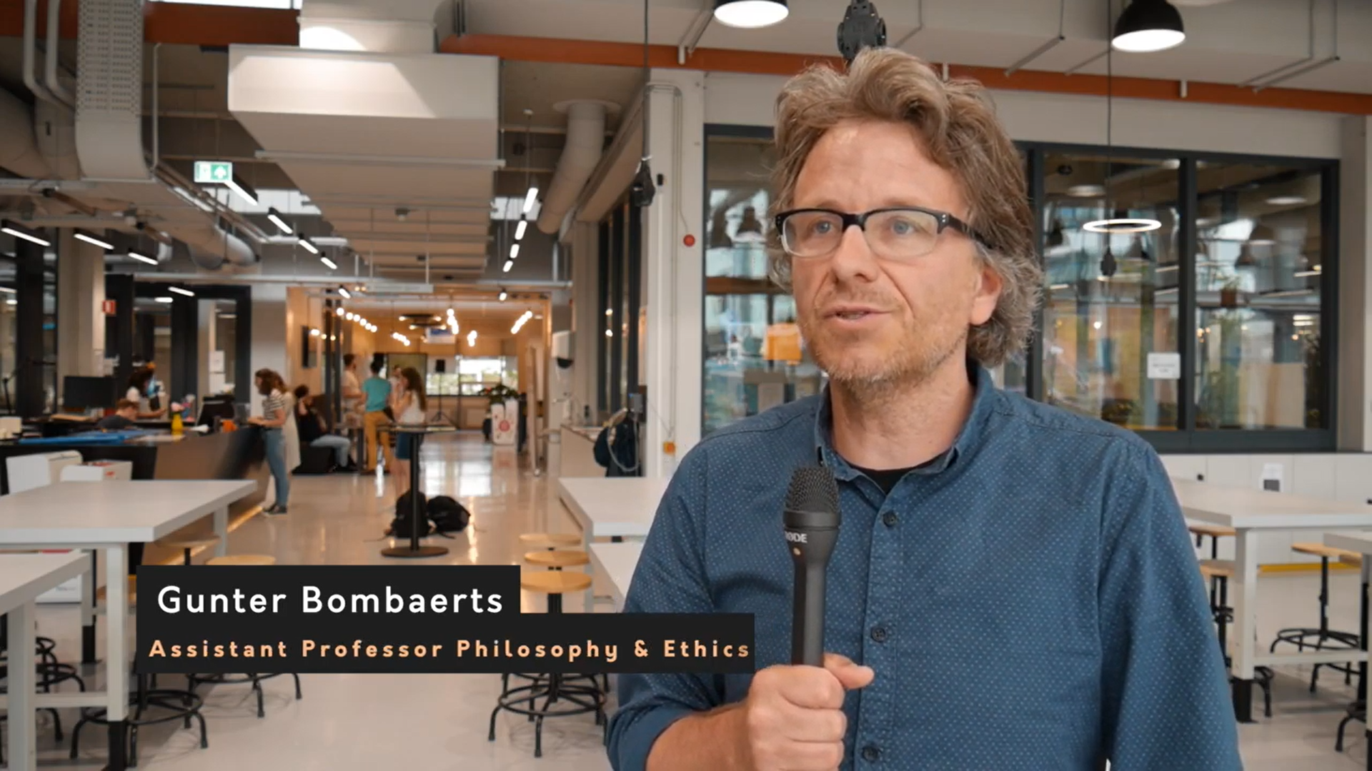
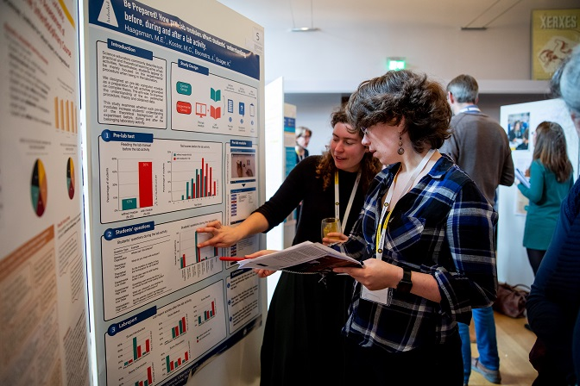
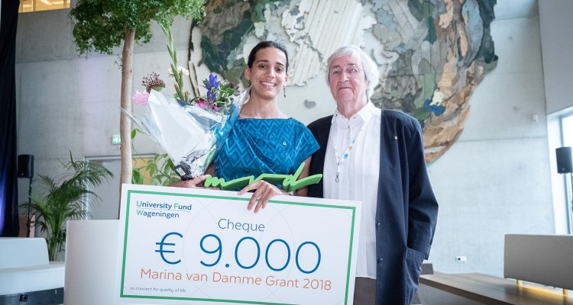
Findings comparative case study (32 cases) – 3 configurations
Implementing a new form of education; teacher learning is used as a means
Supporting teachers’ professional learning; innovations are spin-offs
Stimulating innovations; teacher learning is a side-effect
TU/e – CBL pilot course
Special Interest Groups
Innovation Grants

Slide 7
The 3 configurations in a table
Configuration type | Innovation | Expertise | Participcants | Participation | Intensity | PD support | Learning
Implementing a new form of education | Predefined | New way of teaching (teaching role in relation to students) | A course, study program, or faculty (junior, medior) | Mandatory or open subscription | Low (20-100 hours, less than a year) | Education support and personal coaching | Externally regulated Application-oriented
Supporting Teachers’ PLD | Open | New way of working (role in relation to colleagues in education) | Institution or multiple institutions (senior) | Voluntary but selection of participants | High (>100 hours, 1 year or more | Personal coaching, no education support | Co-regulated Research-based
Stimulating innovations | Open or conditions are defined | New way of working and teaching | Institution (medior, senior) | Voluntary but selection based on proposals | Medium – high (20-100 hours, 1 year or less) | Education support, no personal coaching | Self-regulated Implicit and indirect
Senior teachers?!

Slide 8
Professional learning communities (NRO ‘leidraad’ – den Brok & Poortman )
What is it?
  Joint focus to learn as group
  Ultimate goal is to contribute to learning/wellbeing of students
  Regular and structured joint activities as group (evidence-informed or based on data/literature)
  Reflective approach aimed at improvement
What is it not?
  Simple exchange or talking about organizational issues

Slide 9
Types of professional learning communities
Lesson study team
Community of inquiry / research community
Data team
Community of practice
Learning network
Within institutes/departments vs across institutes/departments (network PLCs)

Slide 10
Recommendations for PLC (membership)
Sufficient time/resources
Voluntary participation
Embedded policy and support by management (not: participation by management)
Clear goal/determine type of PLC
Adequate group size (4-8 people – in larger network)
Ensure input of all members, stimulate deeper activities/conversations
Respect & trust within the PLC
Clear roles: facilitator and chair may be helpful
Evaluate and disseminate outcomes

Slide 11
Innovation calls – some lessons from WUR (Tassone, Runhaar, Biemans, den Brok)
Use a framework to help teachers & policy makers to position/map/design projects
Allow for both open themes and pre-determined themes
Ensure underpinning of projects (intuition alone insufficient)
Include an evaluation strategy
Ensure dissemination
In-between exchange between projects and reflection may stimulate learning and project success (consider small PLCs)
Consider scale up for successful projects

Slide 12
Overall trends ?
Research on (senior) teacher learning in HE still in its infancy
Importance of self-directed learning and shared/self regulated professional development
Outcomes go beyond teacher knowledge & behaviour (new ways of working, leadership, organization)
Importance of conditions and setup of PLCs & grants
Importance of deeper learning: structured, evidence-informed, collaborative, evaluation and reflection, dissemination

Slide 13
Some points of discussion / questions
Institutes/universities need to stimulate / incorporate all three configurations?
The configurations ‘Supporting professional development’ and ‘stimulating educational innovation’ more fitting for senior teachers?
When working in configuration 1 (‘implementing new form of education’), congruence in approach may be preferable?
Conditions, but also selection of/characteristics of teachers should be taken more/better into account?

