Slide 1
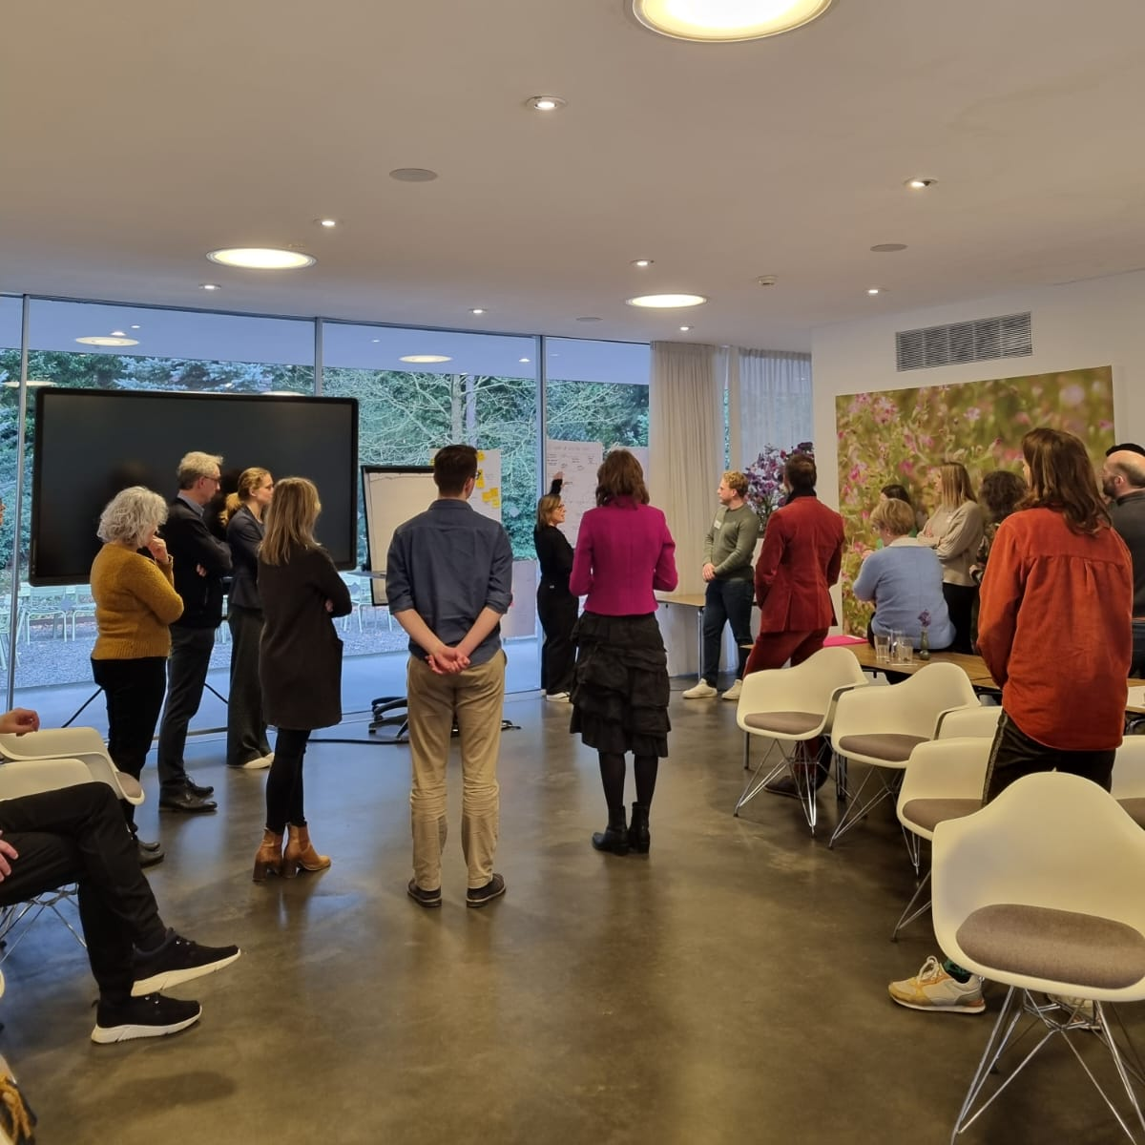
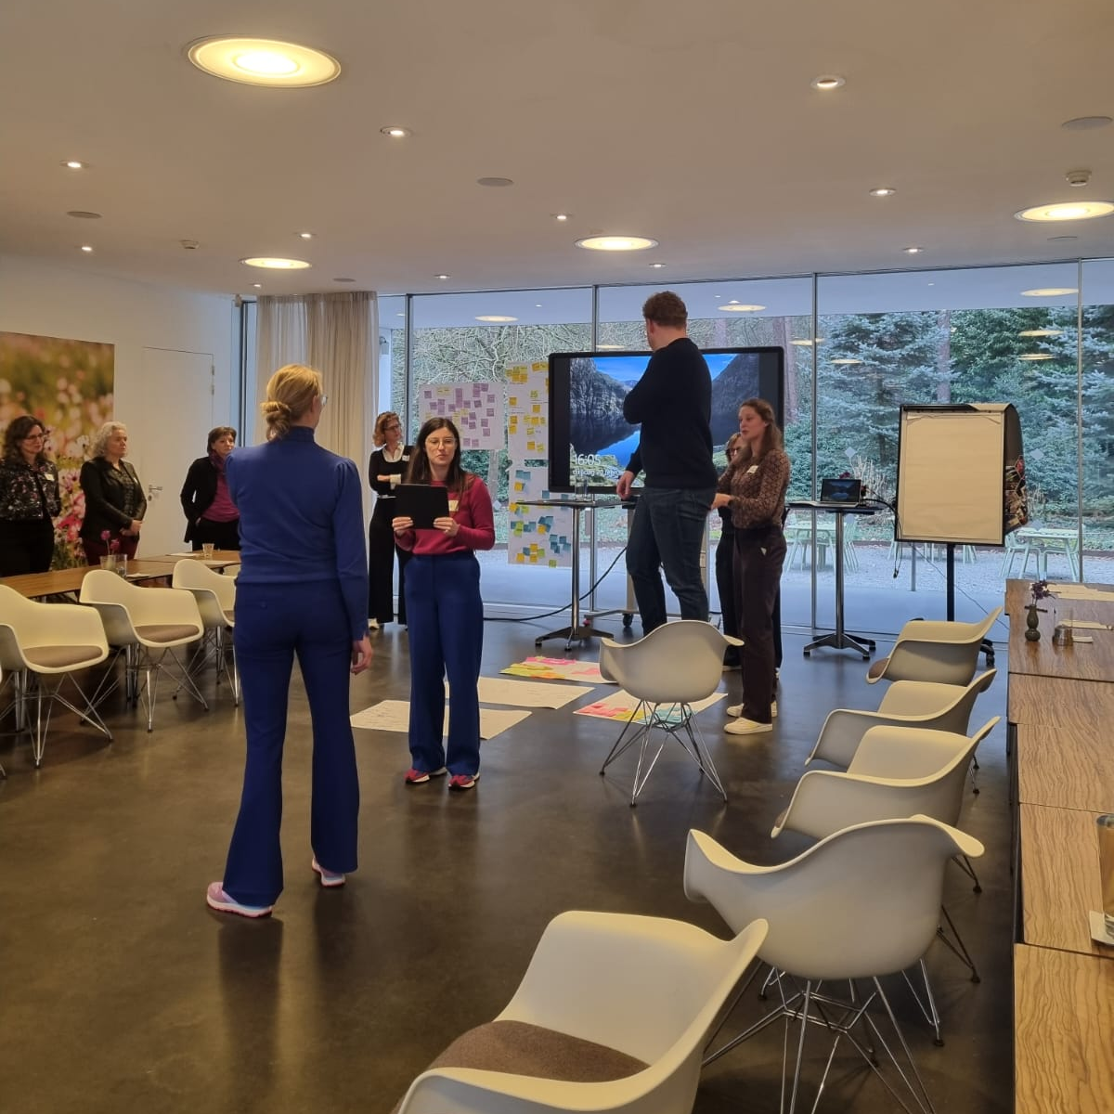

The Dreams and Fears of PhD’s in your team
8th of November 2024

Slide 2
Recognition & Rewards Festival on Developing diversified and talented teams
The workshop
How do you see the young academic?
And what are their dreams and fears?
Share thoughts

Slide 3
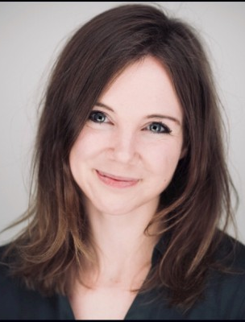
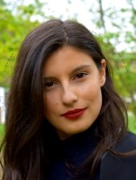
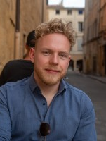
Introductions!

Slide 4
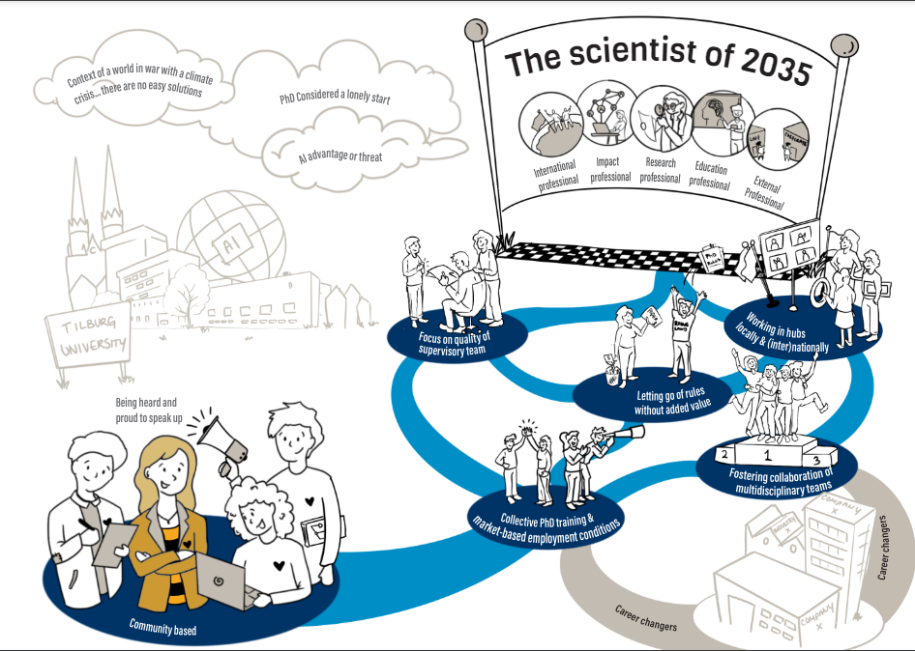
The workshop
Context: challenges and chances in the nearby future of Academia
The current PhD might be the academic of 2035
They are working in your team in a temporary (and therefore potentially vulnerable) position
So what are they dreaming of? What do they fear? What are their needs?

Slide 5

What are the dreams, fears and needs of PhD’s?
  Divide in three groups and interview the PhDs. Change PhD after 15 minutes. Combine your perspective with their perspective and together form an idea of the academic of the future.
  You can ask questions like:
  Reflecting from the future of 2035, how has your career progressed in the past 12 years?
  What have you achieved?
  What are you proud of?
  How has your membership of a team supported you?
  Was there anything holding you back?
  How has your university supported the progress of your career?

