Slide 1

Making room for everyone’s talent
Towards a new balance in the recognition and rewards of academics

Slide 2
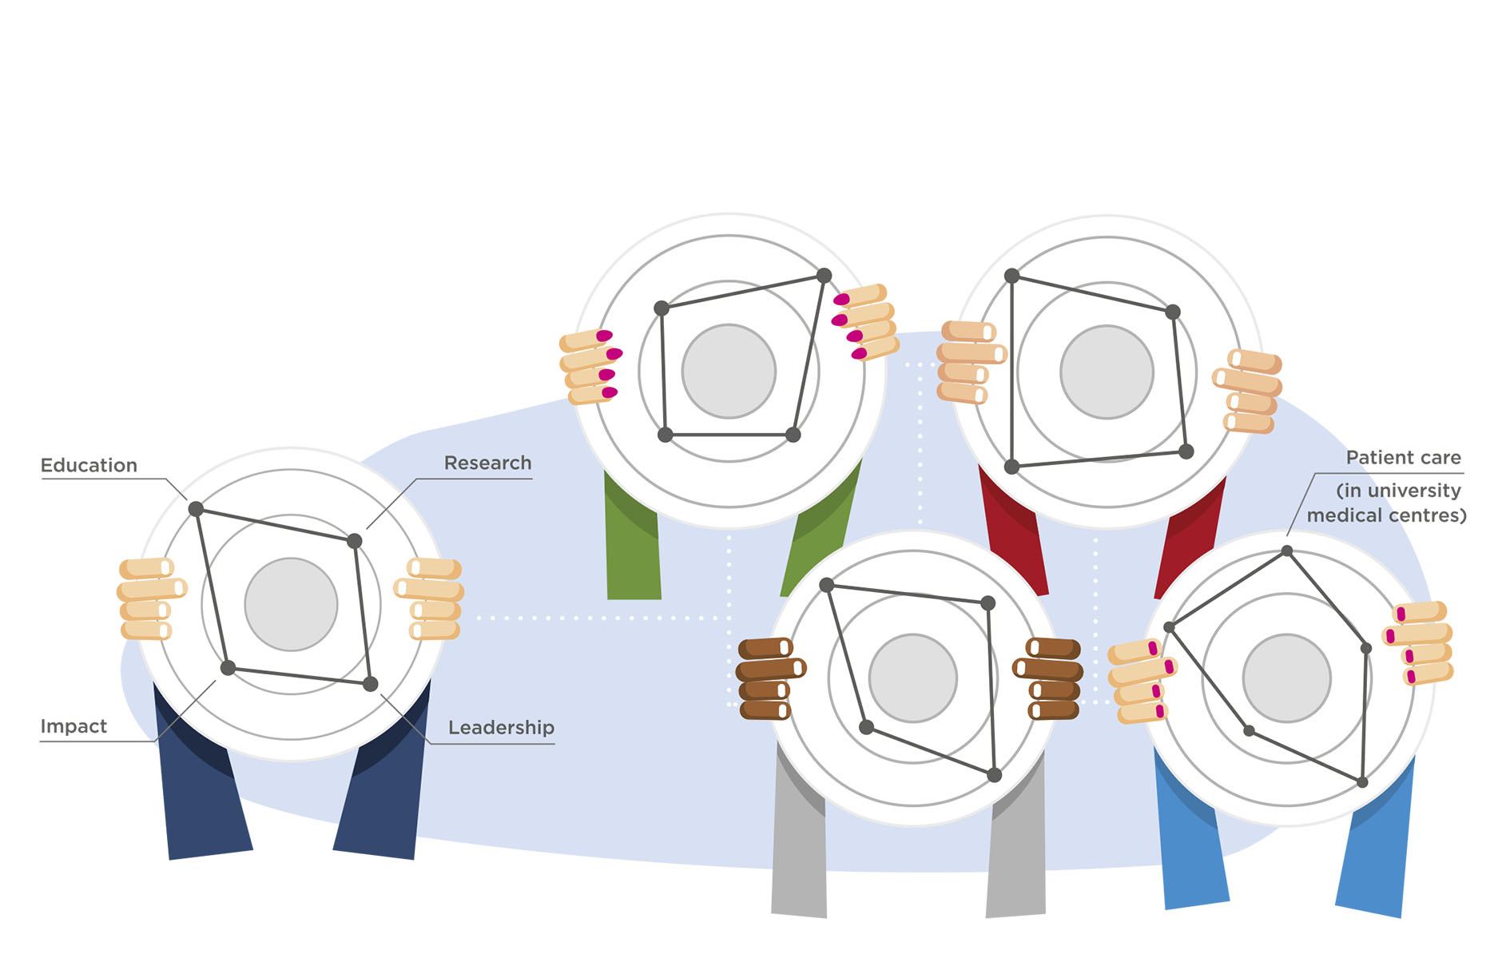
Our ambition
We aim for a healthy and inspiring environment for our academic staff. Where all talents are valued: Teaching, research, impact, patient care and good leadership in academia
Not only in The Netherlands
But all over the world!

Slide 3
Outline
Why do we need a change in recognition and rewards?
What do we want to change?
How do we achieve this change?
How can I contribute?
Conclusion

Slide 4
Why do we need a change in recognition and rewards?

Slide 5
Why a change is needed
WHAT WE REWARD
WHAT WE AIM FOR

Slide 6
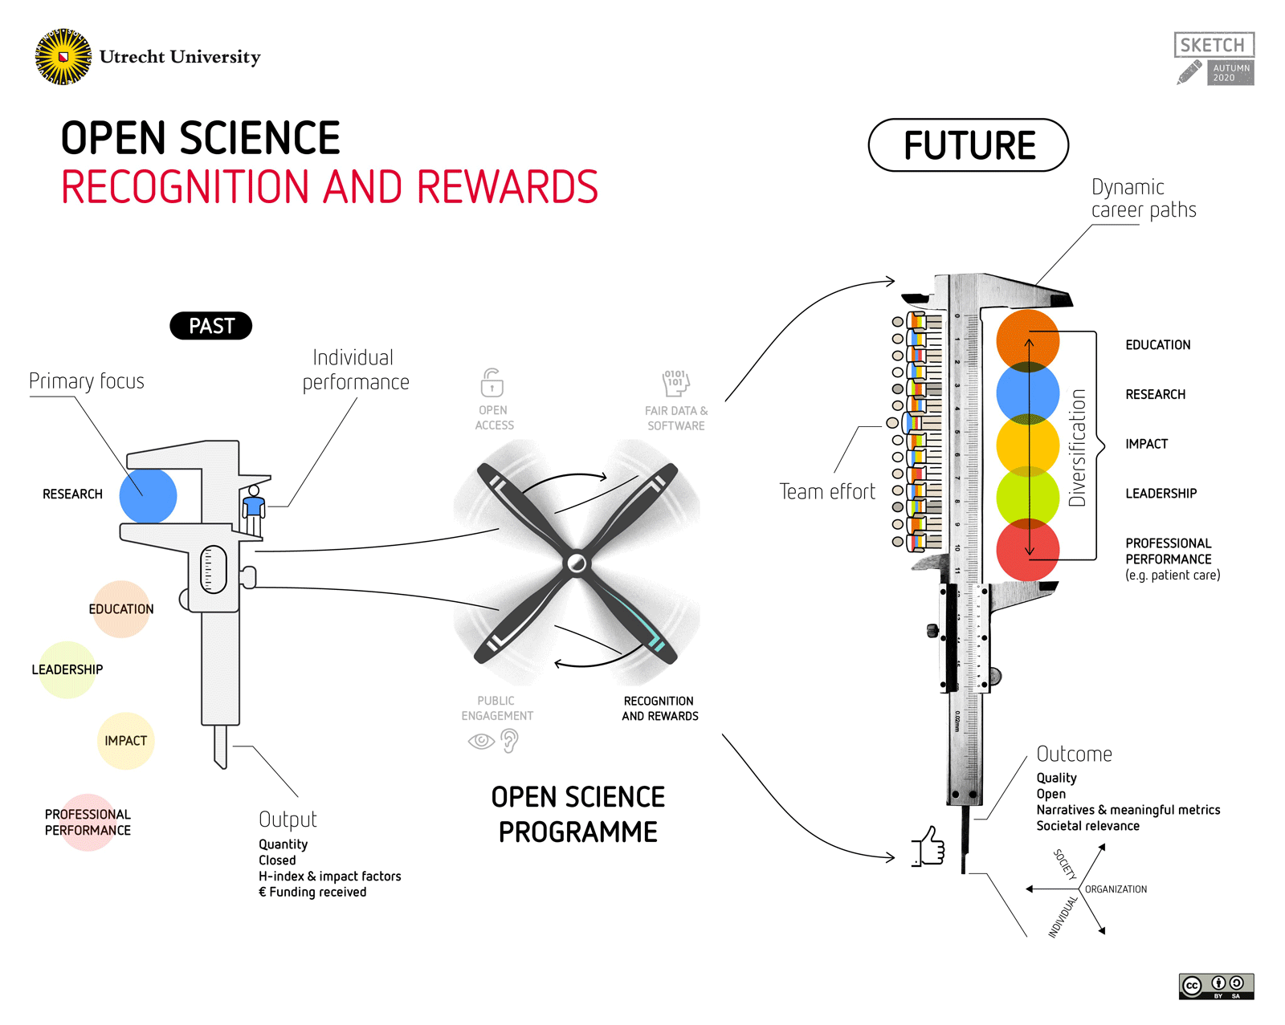

Slide 7
What do we want to change?

Slide 8
What we want to change
Diversifying and vitalising career paths
Achieving balance between individuals and the collective
Focusing on quality
Stimulating open science
Stimulating leadership in academia

Slide 9
1. Diversifying and vitalising career paths
Enable diversification and vitalisation of career paths, thereby promoting excellence in each of the key areas (education, research, impact, leadership and patient care)

Slide 10

2. Balance between individual and team
A better balance between individual and team performance:
Recognition of teamwork and team spirit
Inspire cooperation between organizations,
disciplines and within teams (Team Science)

Slide 11

3. More focus on quality of work
More focus on quality of work over quantitative results:
Good scientific research increases scientific knowledge and makes a contribution to solving societal challenges

Slide 12

4. Stimulating open science
Open Science becomes the norm and stimulates interaction between scientists and society:
Stimulating Open Science means recognizing and rewarding other aspects of research (in addition to publications), such as datasets or software, as important research outputs

Slide 13

5. Stimulating leadership in academia
More emphasis on the value of high-quality leadership in academia to set the course in research and education, to achieve impact, and to ensure that teams of academics can do their work as well as possible

Slide 14
How do we achieve this change?

Slide 15
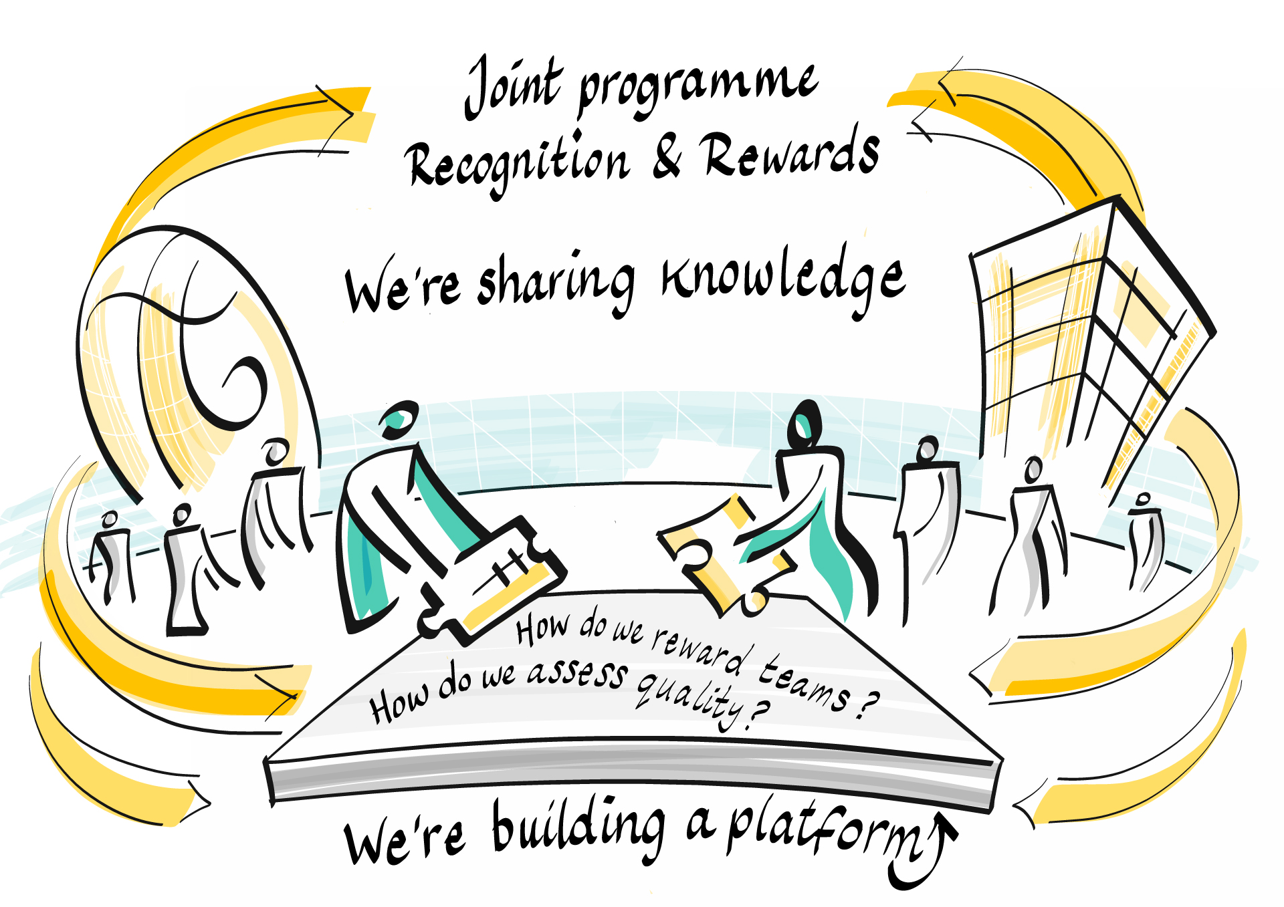

Slide 16
Change approach in 6 phases

Slide 17
Our approach
18 Recognition & Rewards committees from all 14 research universities, research institutes and funders
Committees stimulate intended culture change at institutional level
There is a great and inspiring diversity of approaches
Inspiring, experimenting, co-creation, sharing good practices and mutual learning are central to the joint programme
We stimulate this with regular (online) meetings, Recognition & Rewards Festival and we develop an online community platform

Slide 18

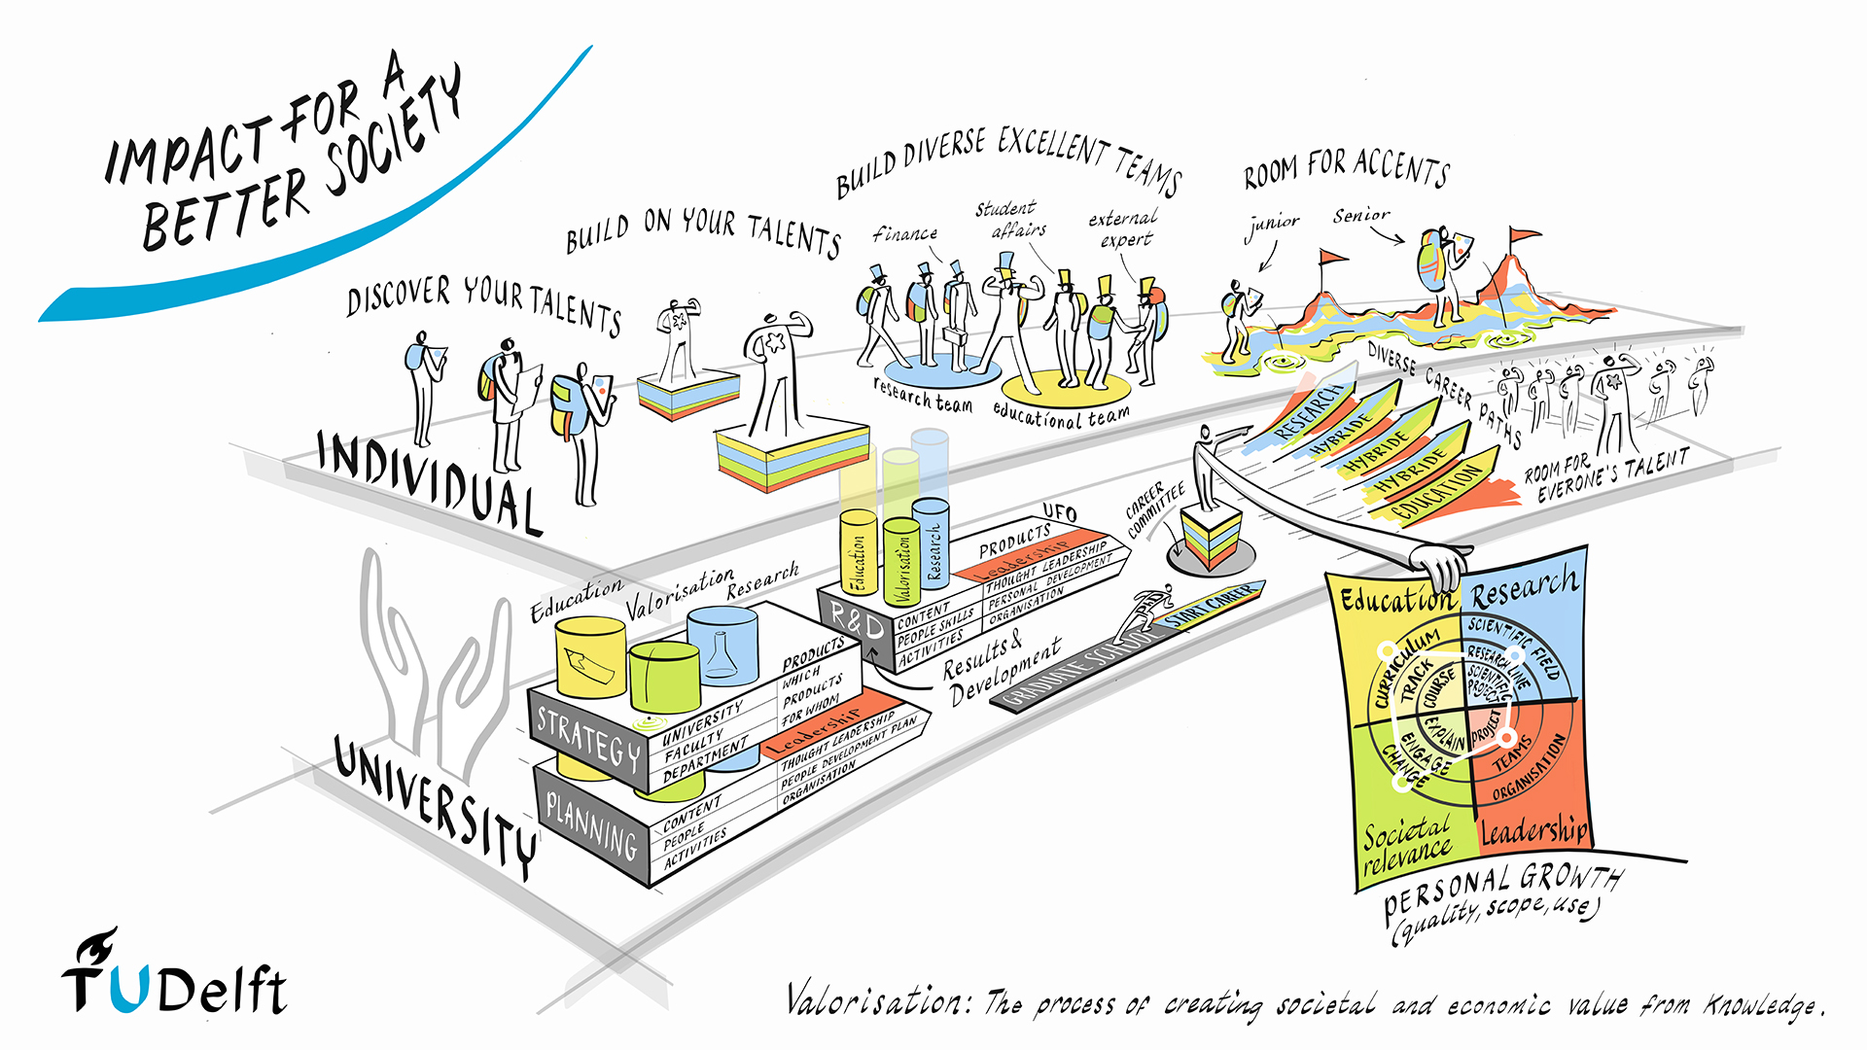




Institutions translate position paper to own organization

Slide 19

Bottom-up & top-down
NATIONAL STEERING GROUP
Responsible for monitoring cohesion and encouraging parties to be mutually consistent and show courage
A BROAD DIALOGUE IN ACADEMIA IS IMPORTANT
Scientists should be able to discuss recognition & rewards and influence how they are assessed

Slide 20
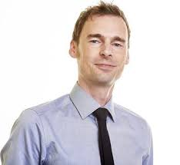
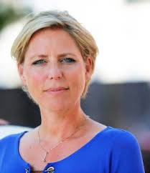
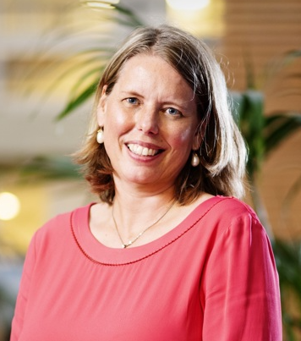
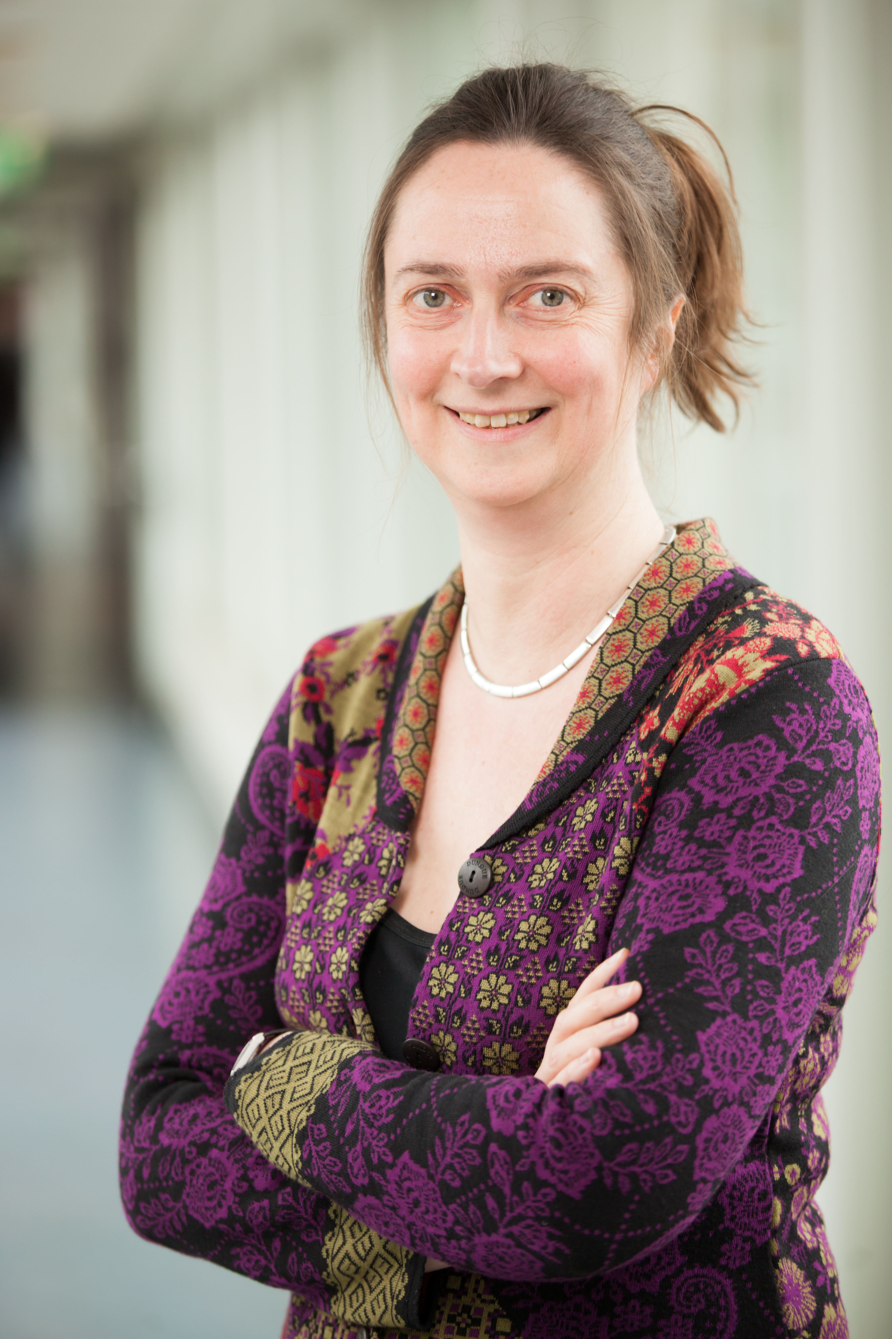
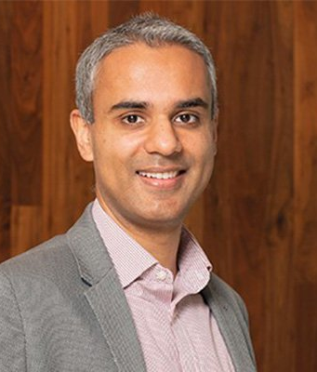

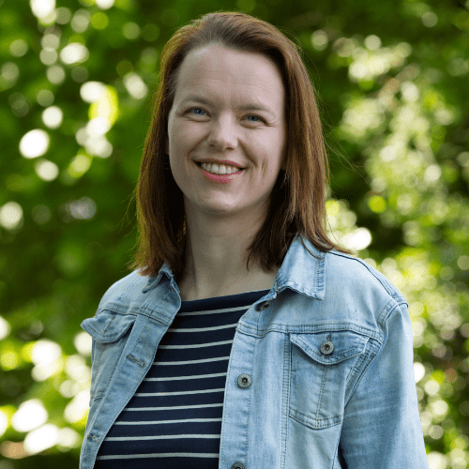
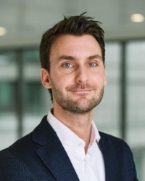





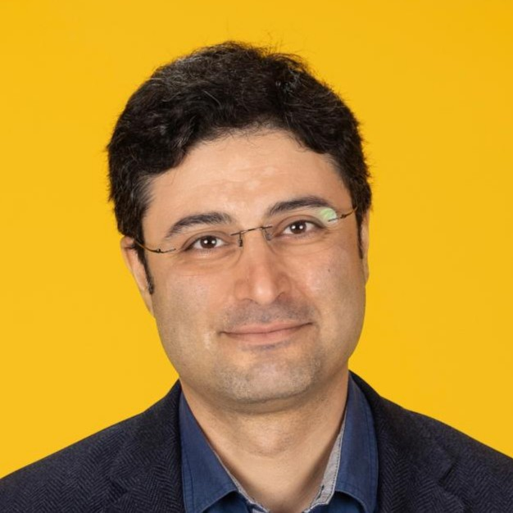





















CO-CHAIRS
RECOGNITION & REWARDS STEERING GROUP
PROGRAMME TEAM
RECOGNITION & REWARDS COMMITTEES

Slide 21






Guiding principles
Culture change is a fundamental change of beliefs; not just change in rules of the game
Changing culture is difficult and takes a long time
Broad dialogue in academia is needed: we listen to concerns, questions & dilemmas from academic community
Sharing good practices and experimenting will initiate desired movement
Balance: giving room for ideas (diverging) and bringing together good practices (converging)
Importance of good leadership in academia to make change work

Slide 22
How can I contribute?

Slide 23
Get involved!
Start small
Start the dialogue – with your peers next door and worldwide
Share your ideas, dilemmas and concerns
Listen to concerns, questions and dilemmas from your peers
Start your own (small) experiment in modernizing career assessment
Share good practices and experiments

Slide 24
Conclusion

Slide 25
Conclusion
We need a better balance in how we recognize and reward academics to help us achieve excellent education, research, impact and leadership, as well as the highest level of patient care in our university hospitals
We cannot change academic career assessment on our own. We need to work together on a global level to change the recognition and rewards of academics
So...

Slide 26
Let’s move together!

Slide 27

Thank you for your attention!
MORE INFORMATION
Sanli Faez, Programme Manager
faez@unl.nl
www.recognitionrewards.nl
www.linkedin.com/company/recognition-rewards

