Slide 1

Recognition & Rewards
Guide to academic career paths
  For academics with an appointment as assistant professor, associate professor or full professor, and their managers

Slide 2

Academic career paths in brief
Whom does it concern?
All academics with an appointment
as assistant professor, associate professor or full professor.
What is the idea?
With your manager, agree on a focus in one of the core domains: education, research or impact. Whatever your focus may be, combining education and research continues to be the core of any academic career. This combination is and will remain fundamental.
How do you make agreements on this?
In the annual consultation with your manager, based on what suits you best and makes an optimal contribution to the objectives of the collective: your team, department or faculty.
Why are we doing this?
It is neither realistic nor necessary for every academic to excel in all core domains. Many academics are currently experiencing too much emphasis on research performance, which puts pressure on ambitions in education, impact and leadership.
When will this take effect?
In 2025. The annual consultation always takes place between
1 February and 31 December.
More information about this can be found in this guide
Intro
Context
Academic career paths
Responsibilities of academics
Responsibilities of managers

Slide 3

Equal appreciation
At VU Amsterdam, we believe it is important that our academic staff can develop in a direction that suits them and that together they can excel and contribute to the greater whole.
This is why VU is working on appreciating all academic aspects and domains equally, with more attention for qualitative aspects and performance in the areas of education, social impact and leadership, and less emphasis on quantitative indicators.
Intro
Context
Academic career paths
Responsibilities of academics
Responsibilities of managers

Slide 4

Collaboration and complementarity
Instead of striving for excellence in all domains, you mainly focus on what suits you best and makes an optimal contribution to the objectives of the collective (your faculty or department).
A successful academic environment consists of academics with different talents, areas of expertise and interests.
If each team member develops specific expertise and engages in collaboration, the collective becomes better than any individual academic can be on their own.
‘It takes diversity and the interplay of talents and skills to make for a good team’
Intro
Context
Academic career paths
Responsibilities of academics
Responsibilities of managers
Notes:
Alle aspecten van WS
berdere waraderen O,O en I waarnbij he niet alels hoeft et doen
LG stemt met MDW af waar eiamdn focus op legt omdat niet alels hoeft et kunenn

Slide 5
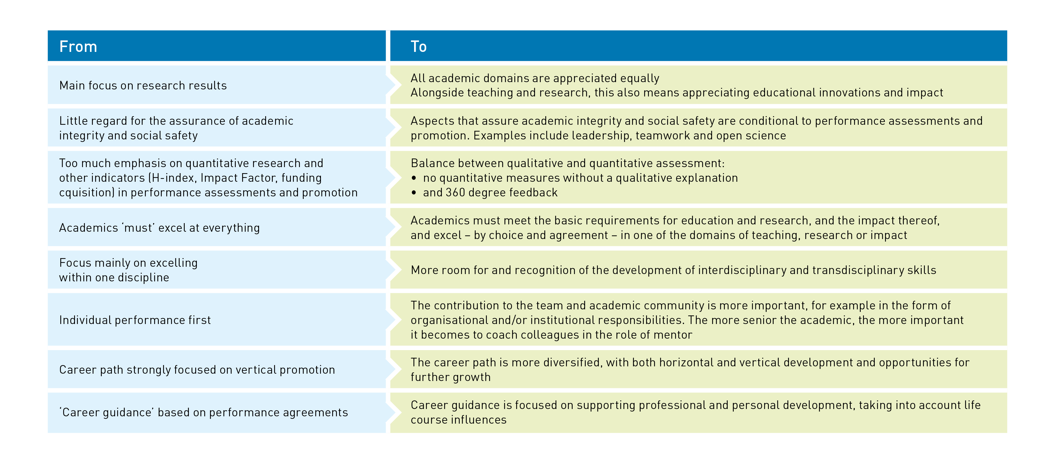
Recognition & Rewards: what will change?
Intro
Context
Academic career paths
Responsibilities of academics
Responsibilities of managers

Slide 6
What concrete changes will be made to academic career paths?
As of 2025, all academics with an appointment as assistant professor, associate professor or full professor will make agreements with their manager on a focus in one of the core domains: education, research or impact.
This way, you determine the emphasis within your career, by agreement and within the scope available. You also agree on the period during which this applies. Switching focus domains is possible (especially at the start of your career). You always continue to work and develop in the dual domains of education and research, as this combination is and will remain fundamental.
In your annual consultation, you agree how you can continue to develop in this core domain. Every year, you discuss how your development in this domain is going.
Intro
Context
Academic career paths
Responsibilities of academics
Responsibilities of managers

Slide 7
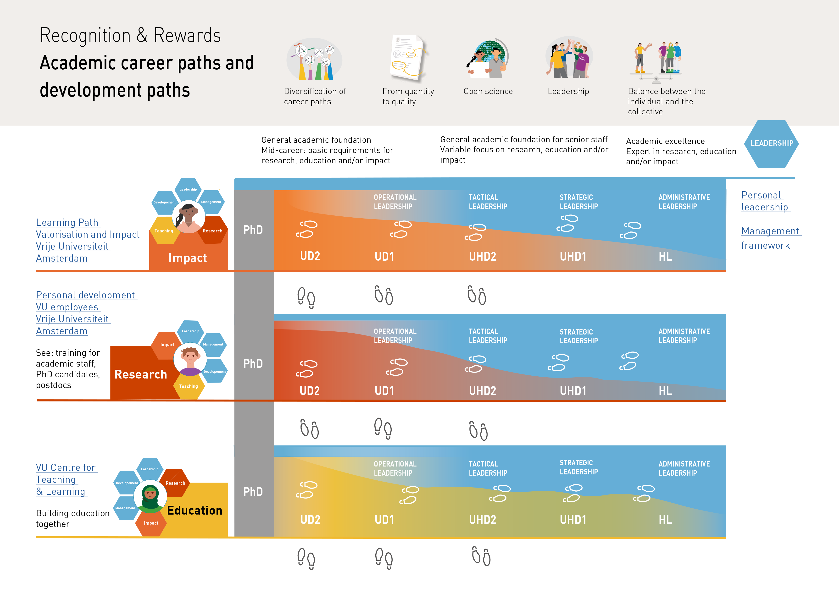
Career paths and development scope
Horizontal steps offer opportunities for growth by shifting the focus to another domain, a supporting or management position or outside the academic context. In this case, the organisational responsibility stays the same.
A vertical career step means more responsibility within the organisational unit, university, academic discipline or in society.
Personal
leadership
Learning Path Valorisation and Impact Vrije Universiteit Amsterdam
Management
framework
Personal development
VU employees
Vrije Universiteit Amsterdam
VU Centre for
Teaching
& Learning
Intro
Context
Academic career paths
Responsibilities of academics
Responsibilities of managers

Slide 8
As of 2025, this is how it will work
As an academic with an assistant professor/
associate professor/full professor profile:
You consult the departmental or faculty strategy and faculty criteria for the focus domains
You reflect on your own career path (The academic path reflection questions will be helpful in this regard)
You discuss this path and your development need with your direct manager
You make agreements with your manager on a focus on one of the core domains
As a manager:
You share the departmental or faculty strategy
You explore the individual development needs of your academic staff
You align all of the team members’ wishes and opportunities with each other and the departmental plan
You give feedback on everyone’s development
Together, you make development agreements
(in the annual consultation)
Intro
Context
Academic career paths
Responsibilities of academics
Responsibilities of managers

Slide 9
Step by step
1
2
3
As an academic, you reflect on:
Basic → Do you meet the basic requirements in the three core domains that are integral to your position? | More seniority? Higher expectations!
Focus → In which core domain do you want to excel in the period ahead?
Leadership → Personal leadership
Collaboration → Your active contribution to team performance and the collective
Manager
prepares:
Match between the academic’s talents and development needs and the scope offered by the departmental plan and strategic personnel planning
Annual consultation:
Together, you discuss the match and make agreements on focus and development
Intro
Context
Academic career paths
Responsibilities of academics
Responsibilities of managers

Slide 10
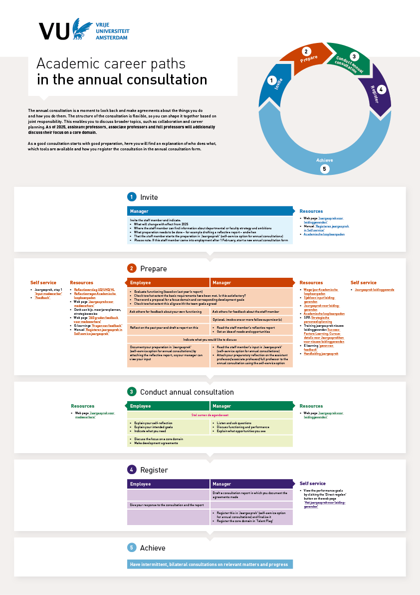
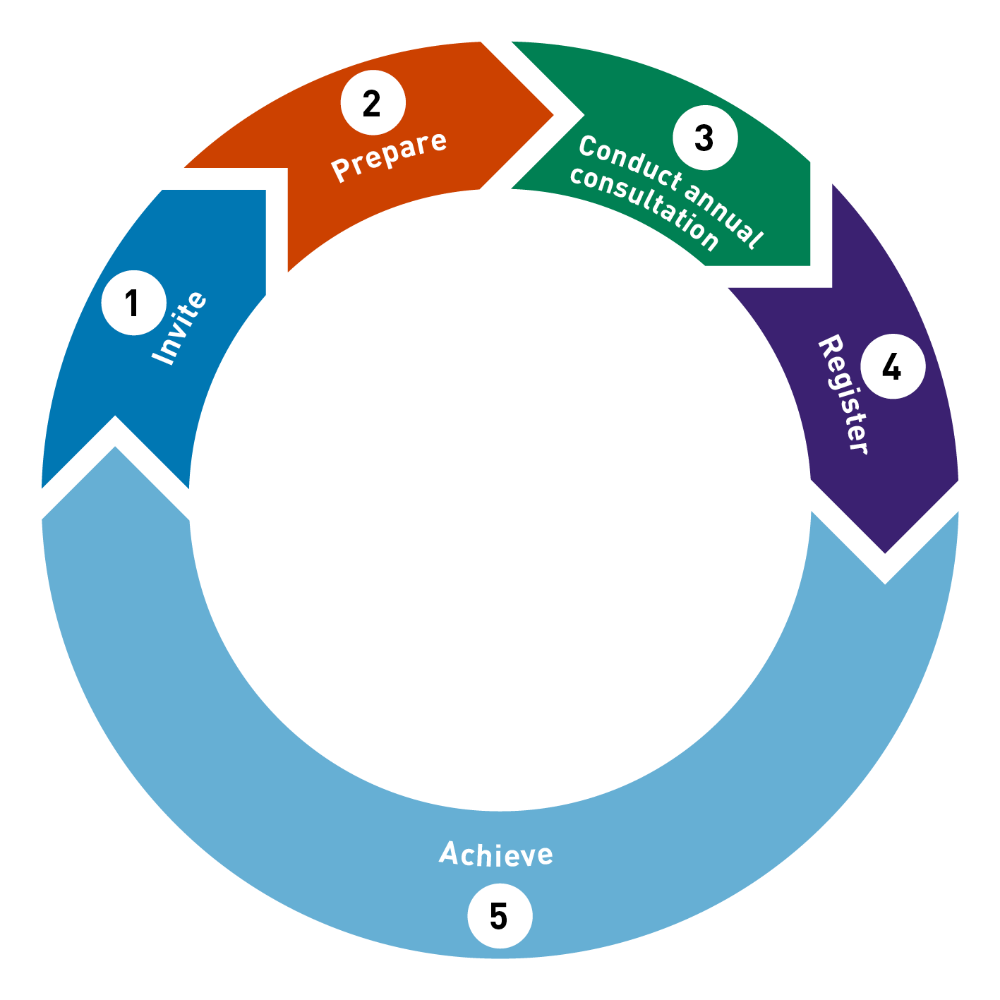
Annual consultation
The annual consultation is a moment to look back and ahead and make agreements about the things you do and how you do them. The structure of the consultation is flexible, so you can shape it together based on joint responsibility. This enables you to discuss broader topics, such as collaboration and career planning. As of 2025, assistant professors, associate professors and full professors will additionally discuss their focus on a core domain.
As a good consultation starts with good preparation, here you will find an explanation of who does what, which tools are available and how you register the consultation in the annual consultation form.
Intro
Context
Academic career paths
Responsibilities of academics
Responsibilities of managers

Slide 11
Career paths for individual academics
The below questions will give you a general idea of how you can discuss career opportunities
Is the scientist an assistant professor/
associate professor/full professor?
no →
An academic career path with an emphasis on a focus domain is not relevant (yet).
Tools for academics
Academic career paths
Reflection questions
Annual consultations
yes →
The academic can explore how their development is going in the context of the academic career paths.
Does the academic have the capacity for self reflection and are they developing in terms of:
no →
A next career step is not possible yet. Make agreements on the required development steps with regard to one or several of these topics
the three aspects of leadership,
management (if applicable),
and training & development in accordance with the position?
yes →
A next career step is possible: horizontal or vertical.
Does the academic meet the
position’s basic requirements when it comes to the core domains (as they apply at the faculty)?
Choosing an emphasis in one of the domains is not yet relevant and the focus is on meeting the basic requirements or progressing to another position (within or outside VU Amsterdam).
no →
yes →
The academic can explore their preferences and wishes with regard to a next step. In an annual consultation with the manager, preferences and scope within the faculty are discussed.
Does the academic see a match between their wish and the scope for focus domains with their faculty/department?
no →
Explore alternatives and make agreements on how to continue.
yes →
Discuss with your manager and make joint career agreements within the scope available.
Intro
Context
Academic career paths
Responsibilities of academics
Responsibilities of managers

Slide 12
Strategic Personnel Plan (SPP) manager
The below steps will give you an insight into your Strategic Personnel Plan (SPP)
1. Needed in the future
Ambition:
Where do we want to go with the faculty/
department and why?
What expertise does this require in the short and long term?
Can you give
a convincing answer
to these questions?
no →
Ensure it is clear what is demanded from your department/faculty. Discuss this with your manager or ask fellow managers for help.
yes →
Go to point 2
2. Already present (staff review)
Where are we:
What expertise is already present (in terms of positions, expertise in core domains, leadership, management skills, etc.)?
What are the academic team’s wishes and opportunities?
Can you give
a convincing answer
to these questions?
no →
Check with other managers within or outside your department how they go about this. Ask for help from the HR Advisor and/or your manager.
yes →
Go to point 3
3. Match between present and future
Bridge/differences:
Where does it and where does it not yet match?
Are you able to make the match (short and long term plan) and explain it to your team?
Can you give
a convincing answer
to these questions?
no →
Make sure you gather knowledge on how to go about this. For example, plan a meeting with your own manager and/or HR.
yes →
Initiate actions that help maintain success
factors and bridge problematic differences.
Intro
Context
Academic career paths
Responsibilities of academics
Responsibilities of managers

Slide 13

Questions?
If you have any questions about faculty-specific applications and routes, please ask them to your manager or the faculty board.
If you have any questions
on VU-wide policies or agreements, please send
an email to erkennenenwaarderen@vu.nl

