Slide 1

Implementing
Recognition and Rewards
@ Maastricht University
15 September 2022

Slide 2
Up for today…
UM’s ambitions
The Academic Profiles
For Assistant and Associate Professors, Teachers and Researchers
The relation between SPP and R&R
Development-centered assessment framework

Slide 3
UM’s ambitions

Slide 4
What do we want to achieve? Points of departure
Diversified career paths (more possibilities)
The profiles should allow you to choose focus, and also switch or expand your focus
A combination of research and education forms the basis of the career paths (from UD level onwards)
Fair and transparent procedures and a change in how we evaluate
An emphasis on personal growth and continuous development
More opportunity and recognition for horizontal development
A balance between individual and organisational needs (SPP)
An inclusive culture
The development of Academic Citizenship, Team Science and Open Science
Professional development of leadership (at all stages of a career)
All contributing to a change in culture…

Slide 5
The Academic Profiles

Slide 6

Assistant, Associate and Full Professors
Modular profiles
Three layers
  UM Core Values

Slide 7

Assistant, Associate and Full Professors
Modular profiles
Three layers
  UM Core Values: academic citizenship, personal/professional leadership, team performance and impact & Open Science
  Core activities:

Slide 8
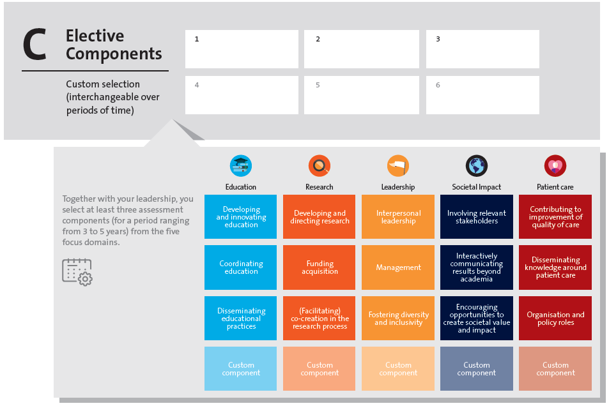
Assistant, Associate and Full Professors
  3. Elective components:

Slide 9
Assistant, Associate and Full Professors
Modular profiles
Three layers
  UM Core Values: academic citizenship, personal/professional leadership, team performance and impact & Open Science
  Core activities: a basis of education + research
  + patient care
  Elective components: focus on education, research, impact, leadership or patient care
One can switch focus (electives) throughout an academic career = diversification and vitalization
Balancing the needs and ambitions of the individual and the needs of the team/faculty

Slide 10
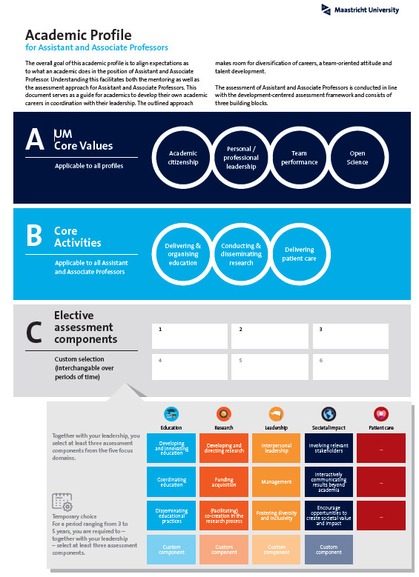
Visual of the UD/UHD profile

Slide 11
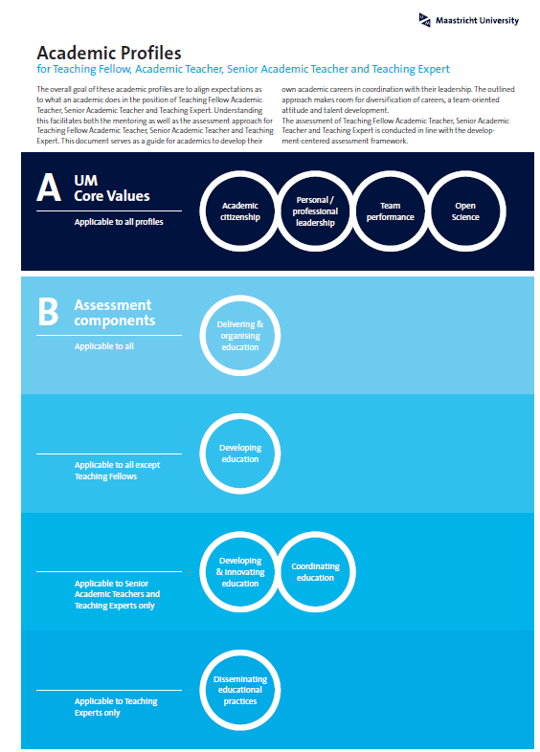
Visual of the Teachers profiles

Slide 12
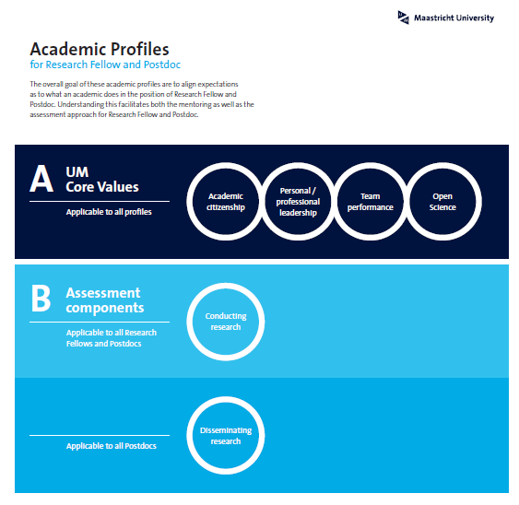
Visual of the Researchers profiles

Slide 13
Overview before and after
Before R&R implementation | After R&R implementation
Academics are often jack of all trades | Room for specialization and vitalization in line with personal talents and organisational needs
Emphasis on individual performance | More (explicit) attention for the functioning of the team and the contributions to the team. Increased importance of SPP
Focus on vertical development | Focus on development in the broadest sense of the word (valuing both vertical career development + more opportunities and recognition for horizontal development)

Slide 14
Overview before and after
Before R&R implementation | After R&R implementation
Limited career prospects for teachers | Increased career prospects for teachers by facilitating development into the mainstream academic career track → more (career) opportunities to combine obtaining a PhD with a positions as a Teacher
In some faculties: no career prospects beyond D4 or R4 without a PhD | Possibility to develop into the position of Academic Teacher without a PhD
Getting stuck in the Researcher-track | Positions as Researchers are (always) temporary positions as we want to facilitate development towards mainstream academic track
Inconsistencies (at least between faculties) between applied salary scales for Researchers | Salary scale 11 applied to all Researchers who hold a PhD

Slide 15
The relationship between R&R and SPP

Slide 16

The importance of Strategic Personnel Plan
In order to make the right fit between our workforce and the various academic profiles we need SPP
Balance between the needs of the team/department/faculty and an individuals’ ambition and capacity

Slide 17
Development-centered assessment framework

Slide 18
Development-centered assessment (from UD level onwards), some principles
Fair and transparant procedures and guidelines
One should have a constructive dialogue on options and recommendations for further vertical and horizontal growth → career development plans
The leadership should no longer be the sole person involved in development talks with an academic
Faculties must facilitate the opportunity for academics to discuss one’s development based on one’s selected profile and profile components
All domains of Recognition & Rewards should be represented in the faculty career committee and the members should be diverse
SPP and regular communication about (im)possibilities

Slide 19
Are there any questions?

