Slide 1
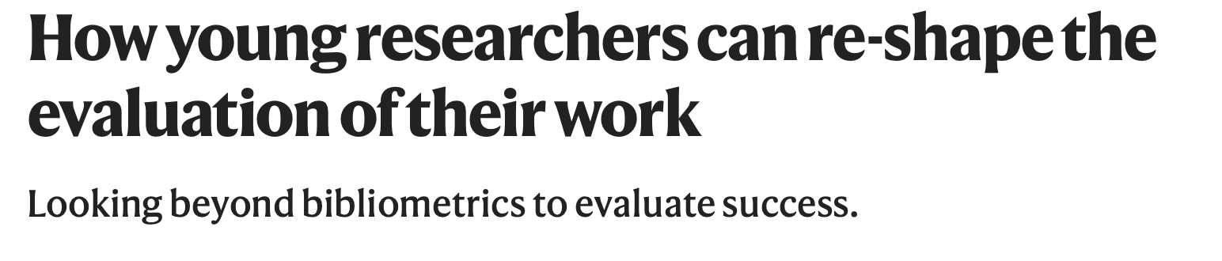
Inez Koopman & Annemijn Algra
On behalf of Young Science in Transition

Slide 2
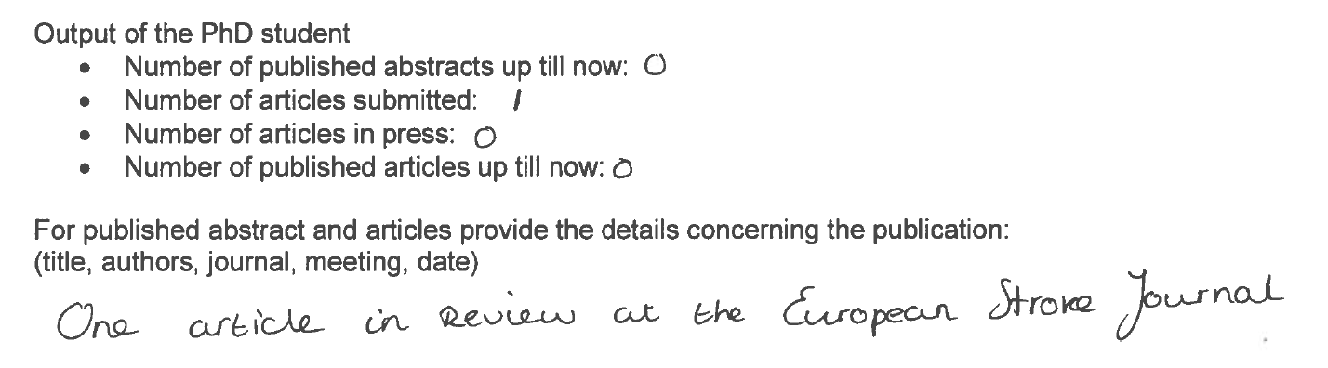
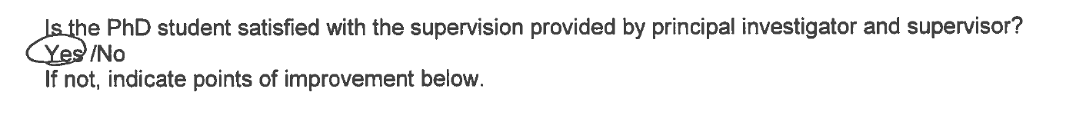
PhD evaluation form ‘old format’

Slide 3

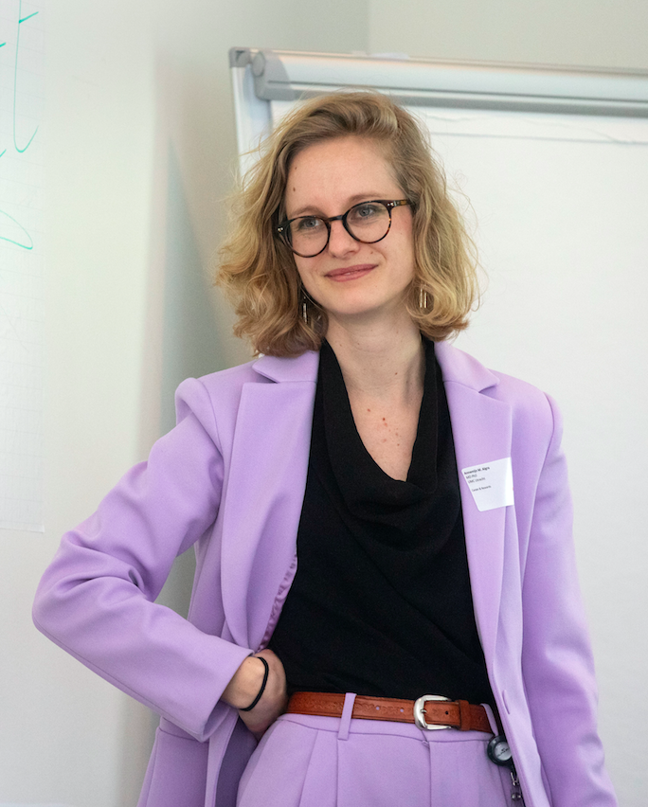
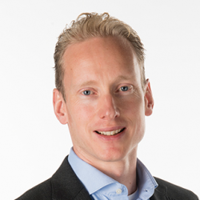
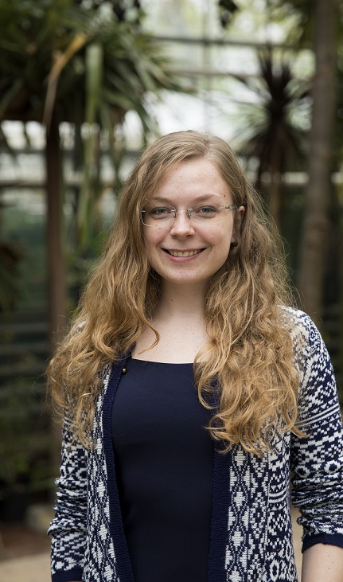
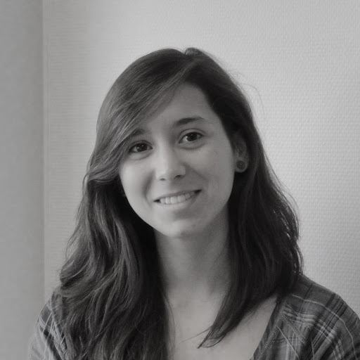
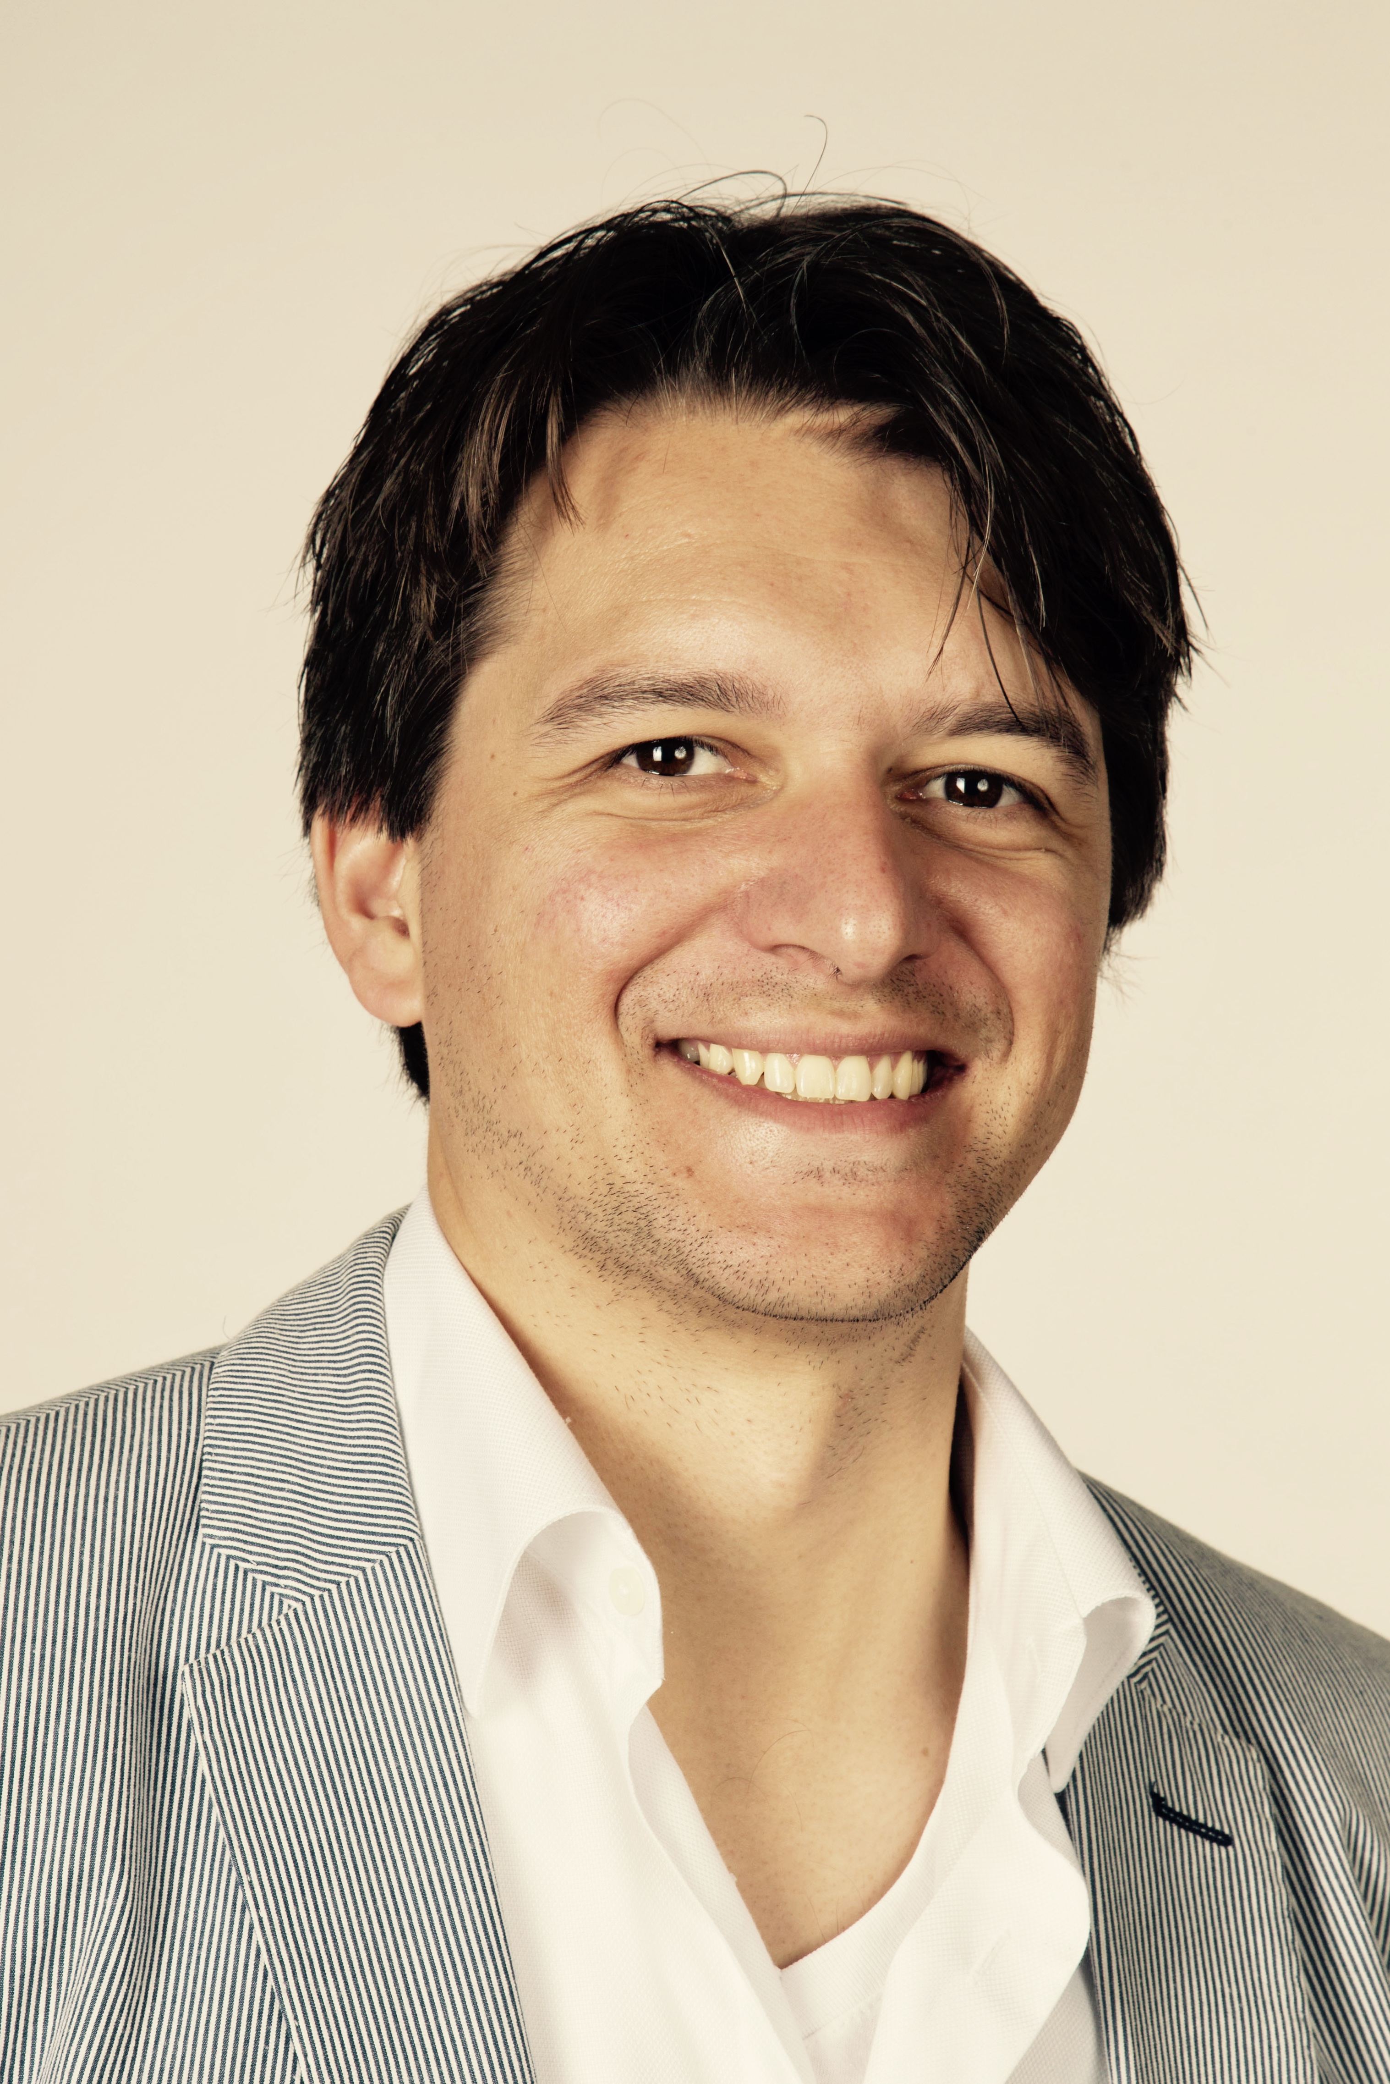
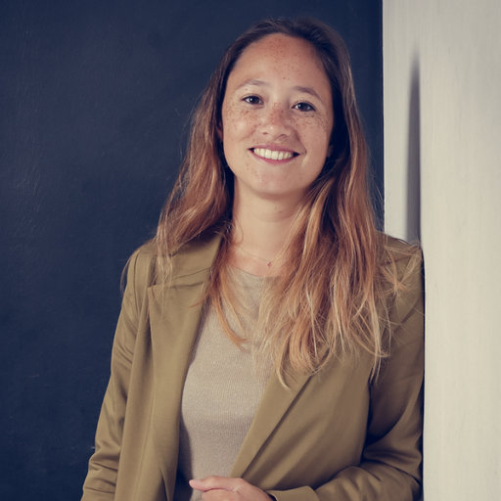
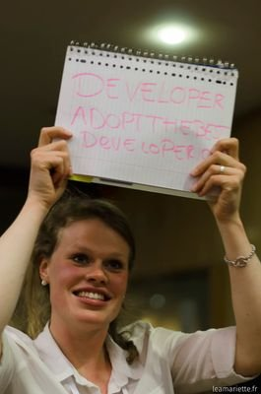
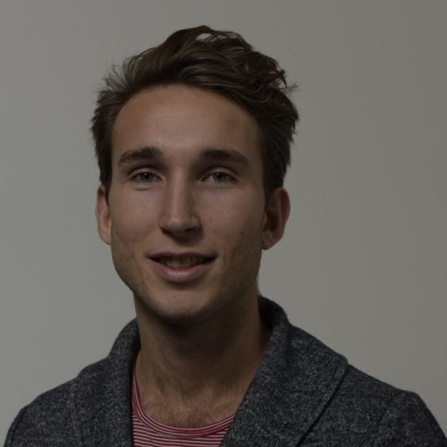
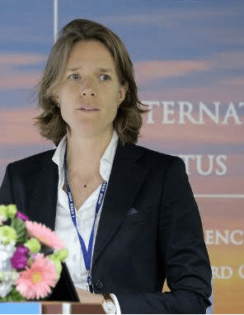
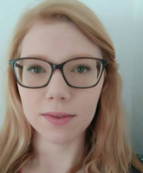
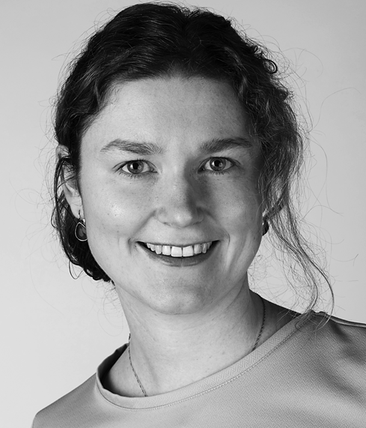
Young Science in Transition
Thinktank 10-15 ERCs with 3 major goals:
Raise awareness regarding
  Open Science
  Team Science
  Recognition & Rewards
Promote engagement of ECRs in shaping the research environment accordingly
Create concrete actions with and for ERCs

Slide 4
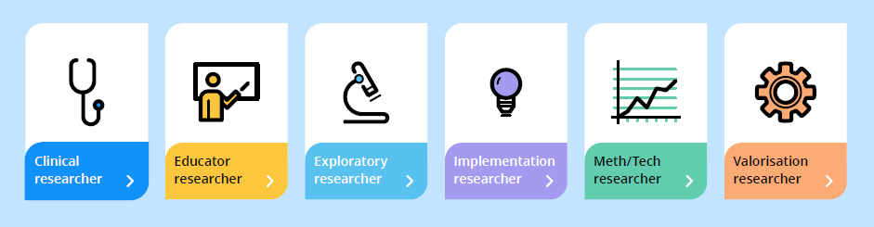
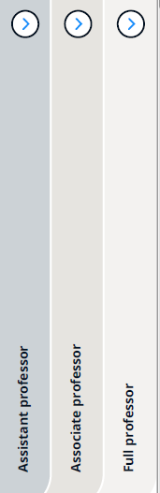
Concrete initiatives
Career profiles UMC Utrecht
PhD candidates
PhD candidates?

Slide 5

PhD candidates
PhDs in academia
Large group with many who leave academia
PhDs do not always feel recognized for the work they do
New evaluation form
Bottom-up initiative
Less focus on bibliometrics
More recognition for the work PhDs do
Image credits: Moving up the academic ladder | Science | AAAS

Slide 6
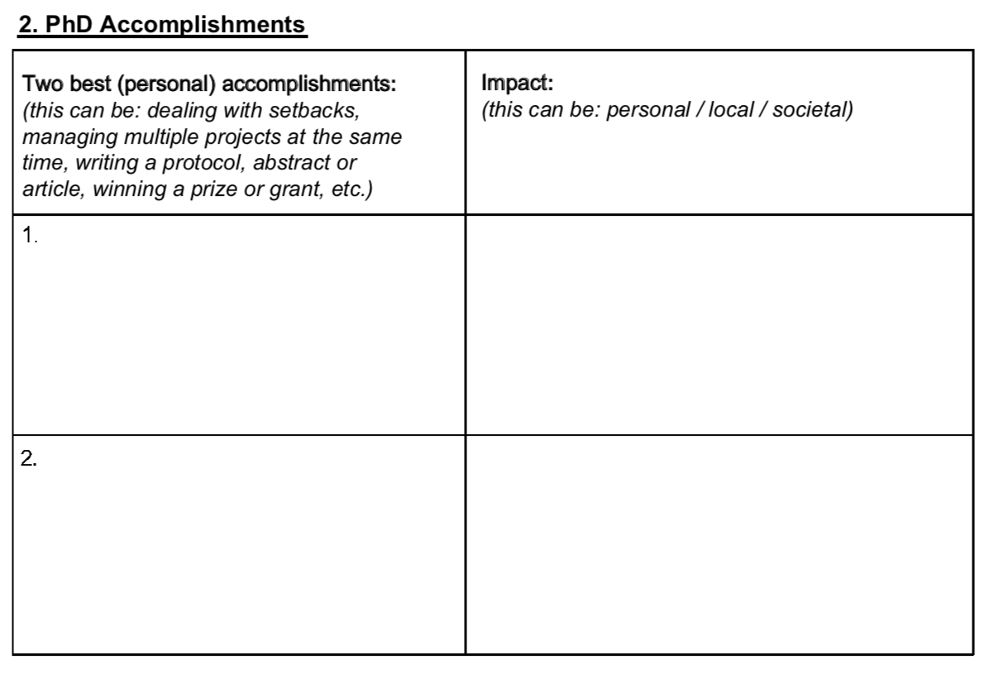


New evaluation form (1)
1. PhD chapters
2. PhD accomplishments

Slide 7
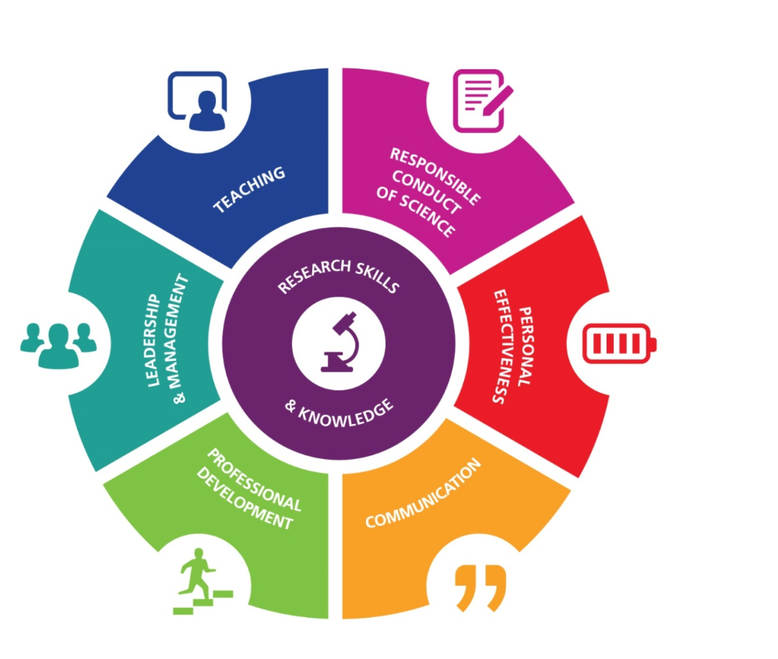
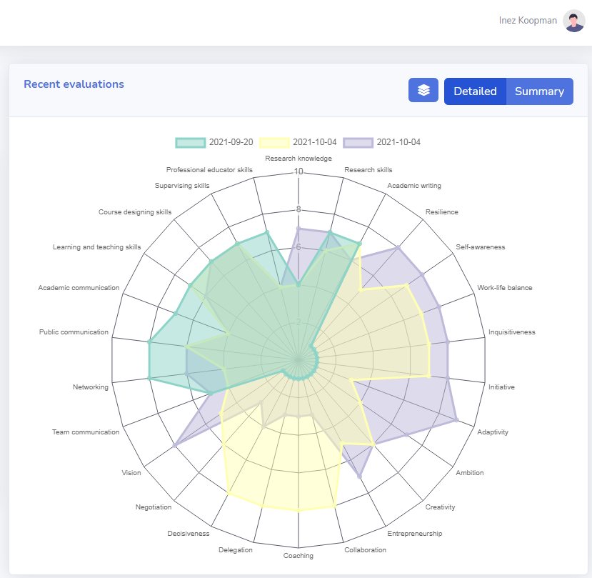
New evaluation form (2)
3. Self-assessment PhD candidate
PhD Competence model
Web-based tool

Slide 8

Grassroots initiative
Implementation in the Graduate School of Life Sciences (+/-1800 PhDs) with feedback and continuous improvement
Modernizing PhD competence tool
First round of feedback
Implementation in a local PhD program +/- 200 PhDs

Slide 9
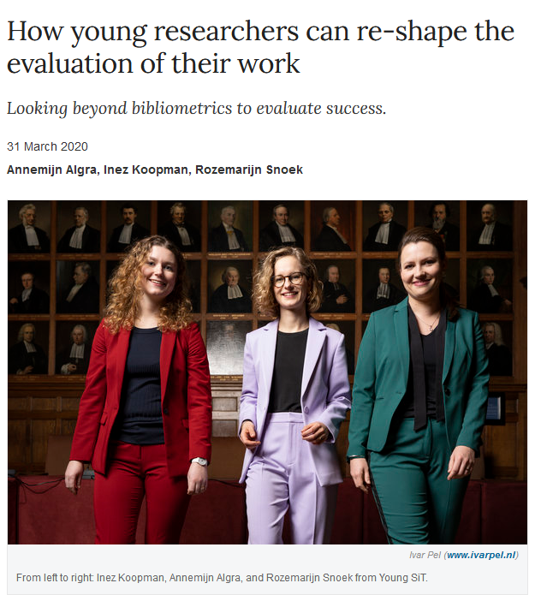
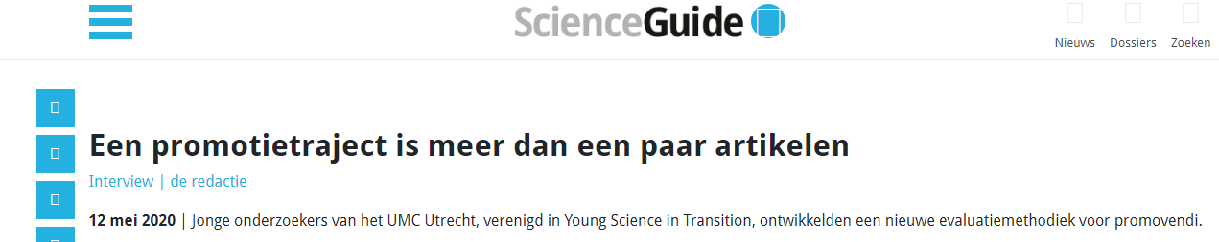
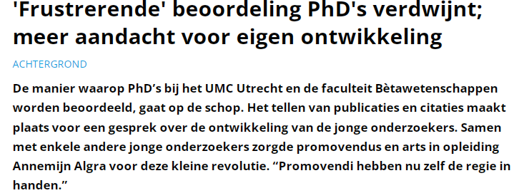
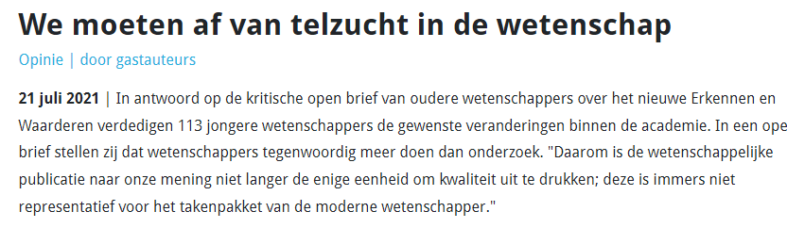
Impact

Slide 10
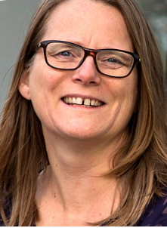
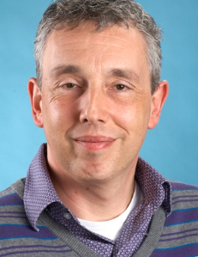
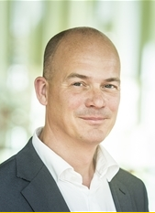
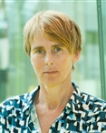
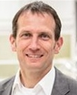
Many thanks to
Rinze Benedictus
Strategic policy advisor UMCU
Elly Hol
Director education CEN
Geert Ramakers
Coordinator CEN
Harold van Rijen
Director GSLS
Saskia Ebeling
Managing director GSLS
Toine Egberts
Director GSLS
Contact: i.koopman-4@umcutrecht.nl; A.M.Algra-2@umcutrecht.nl

Slide 11
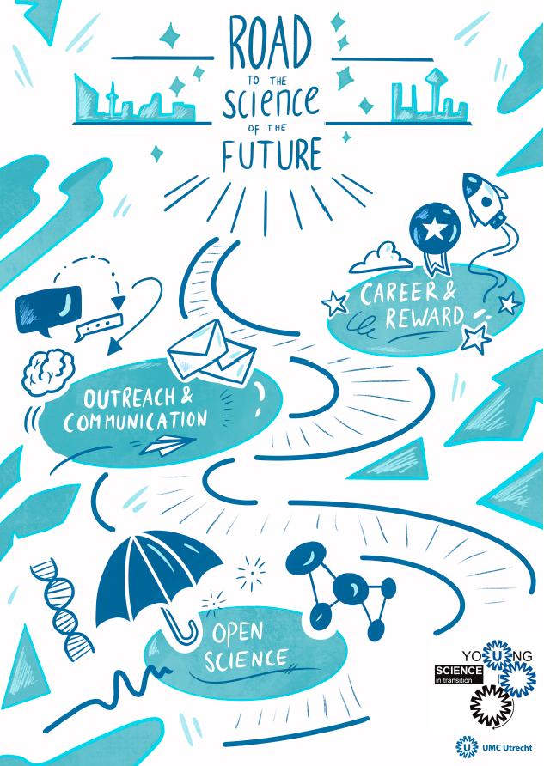
Join us & stay tuned
Want to know more?
Contact
youngsit@umcutrecht.nl
Twitter: @SciTransitYoung

Slide 12
Online demonstration
InSci portal

