Slide 1
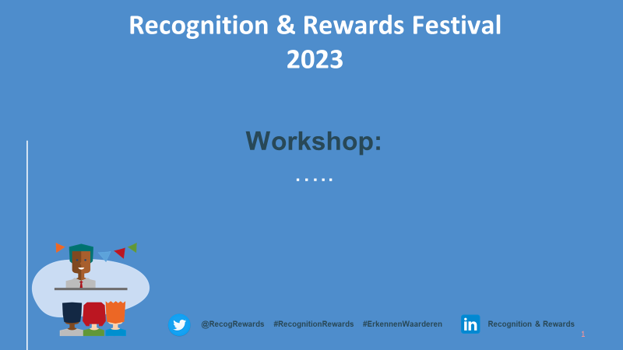
13 April 2023
Enabling Diversity - addressing silent assessment

Slide 2
RECOGNITION AND REWARDS FESTIVAL
Workshop: Enabling diversity - addressing silent assessment
Liorah Hoek, Jacqueline Kool, Alice Schippers and Carolina Suransky
University of Humanistic Studies
13 April 2023
Notes:
Use this slide if you don’t want to use a photo

Slide 3
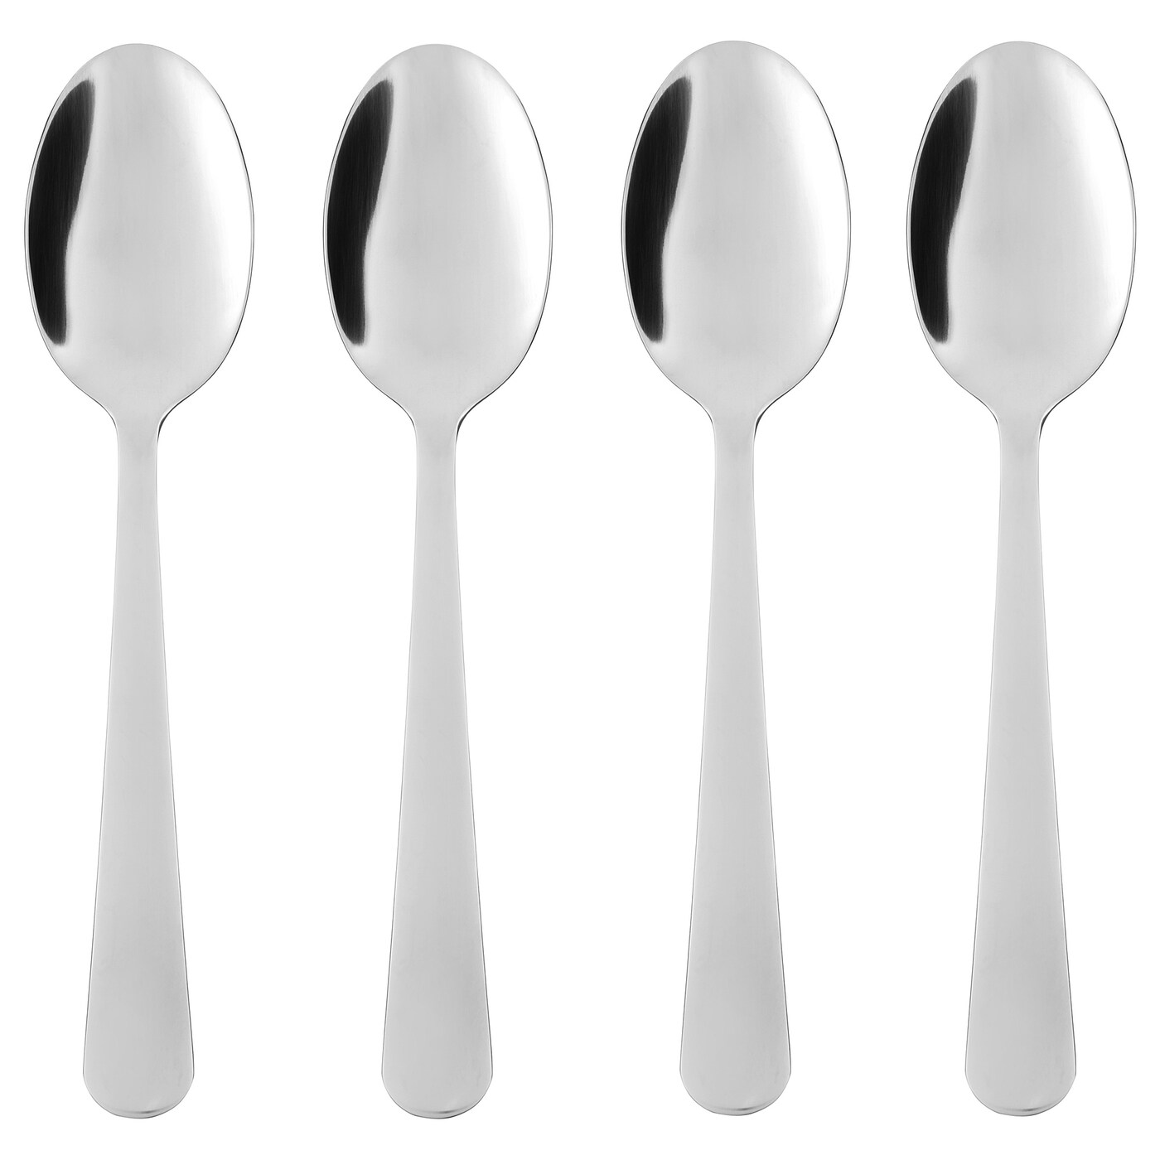
13 April 2023
Spoon theory / Christine Miserandino, 2003
Metaphor for energy when living with a disability or chronic illness​
Less spoons per day (abled-bodied seemingly have limitless spoons)​
Amount of spoons per day can vary​
Tasks cost more spoons​
Many daily tasks must be planned, cost extra spoons​
Inaccessibility costs spoons​
Only way to get extra spoons: rest​
Consequently: choices are part of daily life​

Slide 4
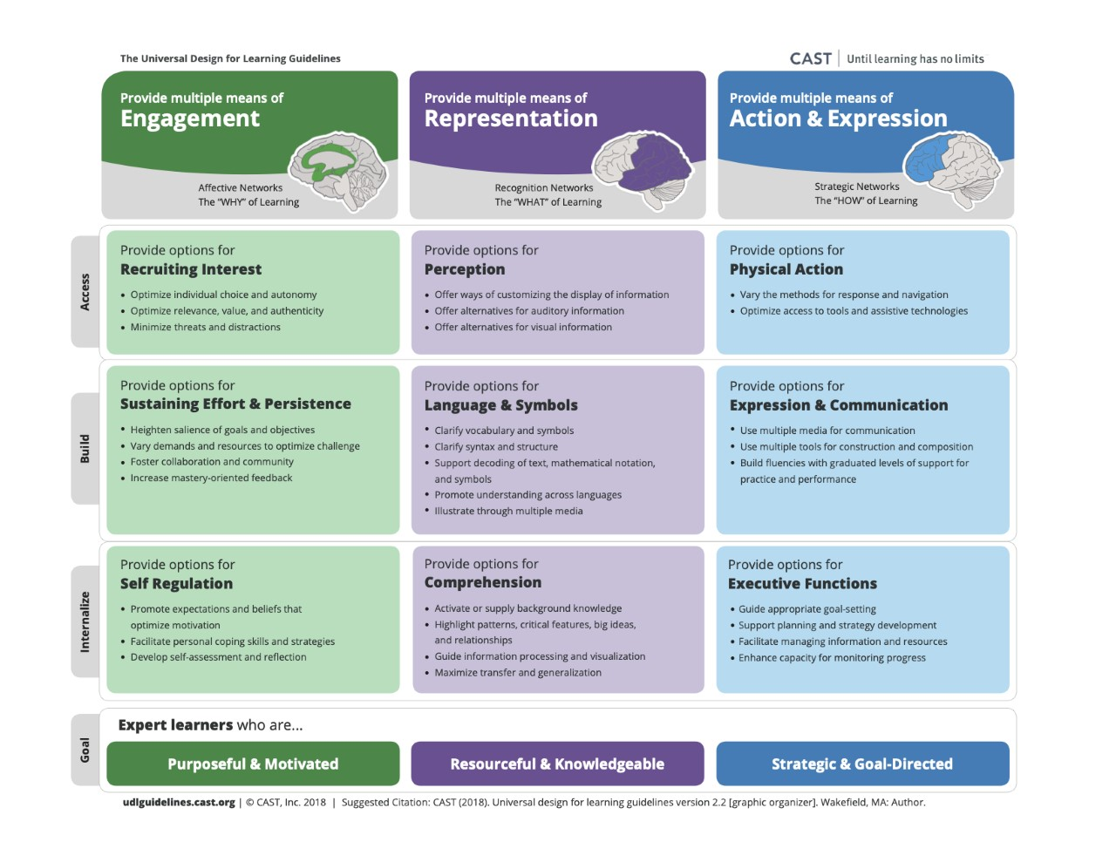

Slide 5
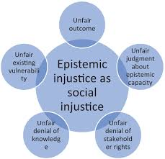
13 April 2023
Epistemic (In)Justice
Pursuing justice related to knowledge.
Which and whose knowledge is privileged or ignored?
Epistemic injustice includes exclusion and silencing; systematic distortion or misrepresentation of one's meanings or contributions; undervaluing of one's status or standing in communicative practices; unfair distinctions in authority; and unwarranted distrust
(Kidd, Ian James, José Medina, Gaile Pohlhaus Jr., eds. The Routledge Handbook of Epistemic Injustice (1st ed.). Routledge
Including multiple voices and paying attention to context and relationships at play (José Medina)

Slide 6
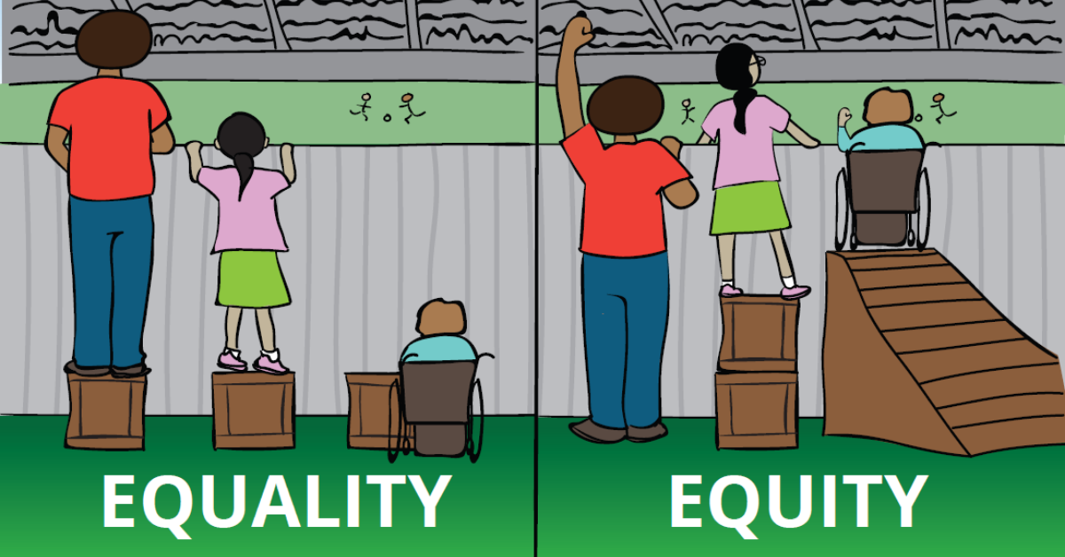
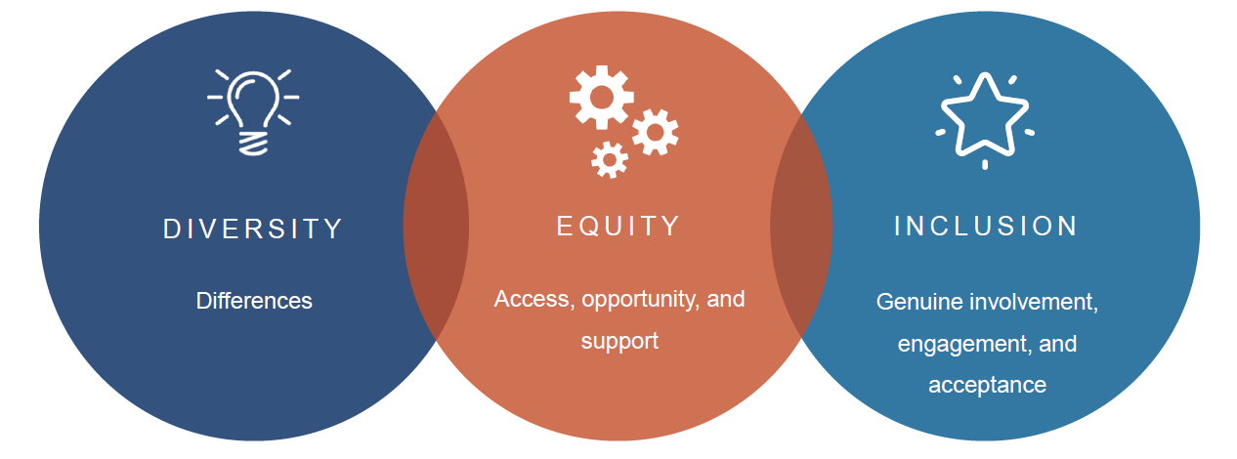
13 April 2023
Diversity, Equity and Inclusion
Diversity: Making room for difference, including skin color, ethnicity, gender (identity), sexual orientation, socioeconomic status, language, culture, national origin, religious/spiritual commitments, age, (dis)ability status and political perspective.
Equity: Actively challenging and responding to inequalities, bias and discrimination in order to create fair opportunities for all
Inclusion: Involvement and empowerment, recognition of the inherent worth and dignity of all. Promoting and sustaining a sense of belonging; valuing and practicing respect for diverse talents, beliefs, backgrounds and ways of living
Kettering College https://kc.edu/diversity-equity-and-inclusion-celebrating-our-differences/

Slide 7
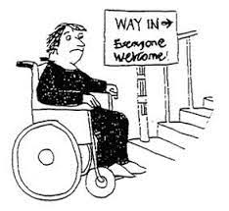
13 April 2023
Ableism
Ableism frames being nondisabled as the ideal and disability as a flaw or abnormality
It is a form of systemic oppression and discrimination
Implicit bias against people with disabilities is extremely common
-> 76% of respondents in large survey
( Nosek, Brian A., Frederick L. Smyth, et al. 2007. Pervasiveness and correlates of implicit attitudes and stereotypes. European Review of Social Psychology 18: 36-88)

Slide 8
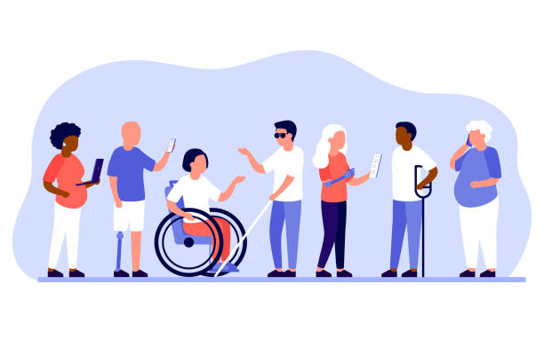
13 April 2023
Disability management
Focus on condition or impairment
  self-care management—a person’s ability to manage everyday self-care given specific conditions or a long-term disability.
Focus on the workplace
  how employers manage disability overall within the workplace, including issues such as preventing disability, returning to work after a disability event, providing reasonable accommodations within the work site
Focus on resources
  right of disabled persons to have access to equitable supportive resources; collective action to change systems, and to improve societal conditions and opportunities for the disability community as a minority group.
(Ref.: Hammel, J. (2018, December 7). Disability management. Encyclopedia Britannica. https://www.britannica.com/topic/disability-management)

Slide 9
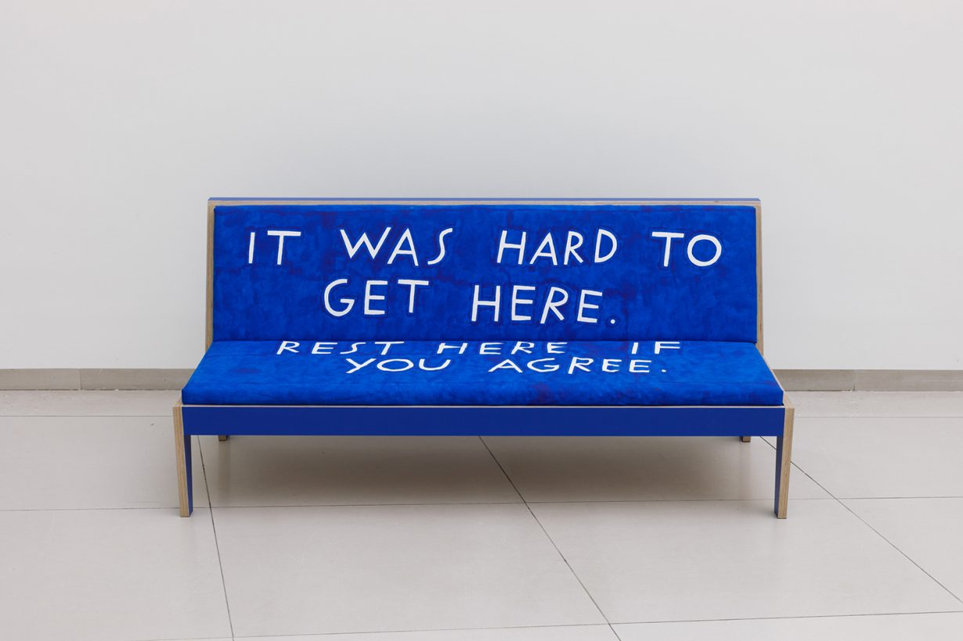
13 april 2023
Crip time
A concept arising from disabled experience that addresses
the ways that disabled/chronically ill and neurodivergent
people experience time (and space) differently than able
bodied and minded people
“For crip time is broken time. It requires us to break in our bodies and minds to new rhythms, new patterns of thinking and feeling and moving through the world. It forces us to take breaks, even when we don't want to, even when we want to keep going, to move ahead. It insists that we listen to our bodyminds so closely, so attentively, in a culture that tells us to divide the two and push the body away from us while also pushing it beyond its limits. Crip time means listening to the broken languages of our bodies, translating them, honoring their words.”
(Ref: Samuels, E., 2017. “Six ways of looking at crip time.” Disability Studies Quarterly 37(3): n.)

Slide 10
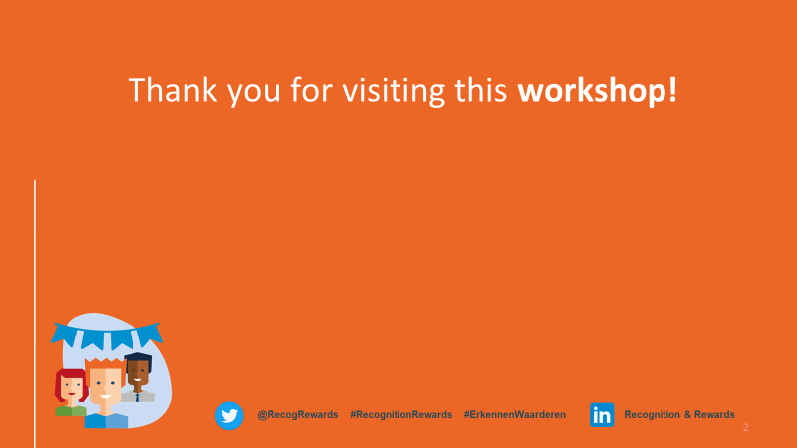
13 April 2023

