Slide 1



Recognition & Rewards Festival
2023
Workshop:
How does leadership become everyone’s
@RecogRewards
#RecognitionRewards
#ErkennenWaarderen
Recognition & Rewards

Slide 2
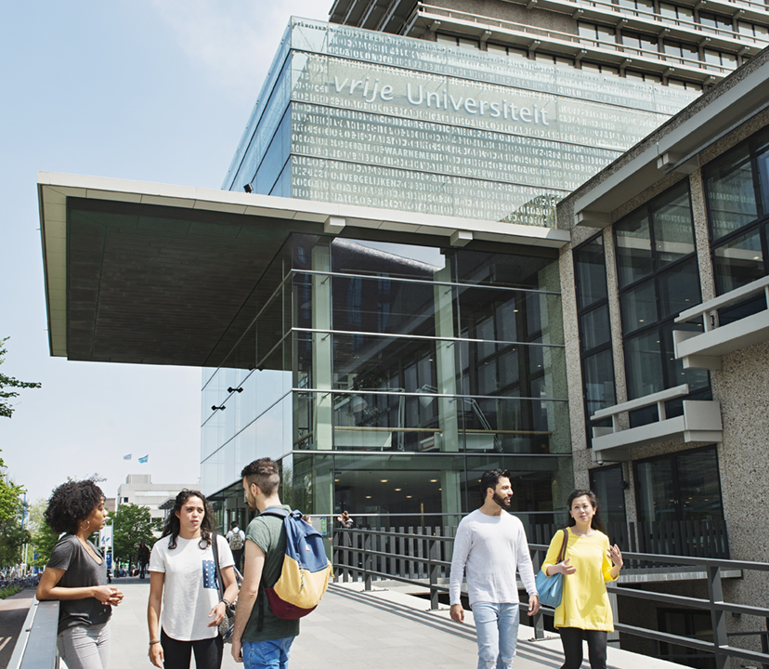
What do we bring today?
Explore leadership versus management
Show our values to bring leadership and teamwork into practice
Tell about some practical tools to support management tasks

Slide 3
Why leadership?
To ensure an academic culture
in which joint responsibility is taken for healthy group dynamics, talent development, social safety and inclusiveness,
leadership and teamwork are crucial.

Slide 4
How we conceptualize leadership and management?
Leadership and management are often used interchangeably.
While we do think the distinction is important:
Management is your hierarchical responsibility for managing
your colleagues
Leadership is your individual responsibility to proactively
contribute to working well with your colleagues to realise
the collective ambition
So, leadership is an attitude and behaviour, while management is a functional role.

Slide 5
Leadership aspects
Leadership has different aspects:
Personal leadership
Teamwork
Academic / professional leadership
Every academic/professional is expected to invest in development in these aspects of leadership.
As an academic/professional becomes more senior, we expect a greater contribution to the organisation and to the scientific discipline or in society.
→ ART OF ENGAGEMENT = underlying values of leadership

Slide 6
Art of Engagement
What is it?
How did it start?
Why is it necessary?

Slide 7
Art of Engagement in progress
make it findable
integrate into leadership tools
ensure publicity
apply
in teams
apply
in VU community
AOE at
www.vu.nl
AOE in
HR-tools
AOE campaign
AOE teamscan
able to address
smoothand safe collaboration and communication
Here we are now

Slide 8
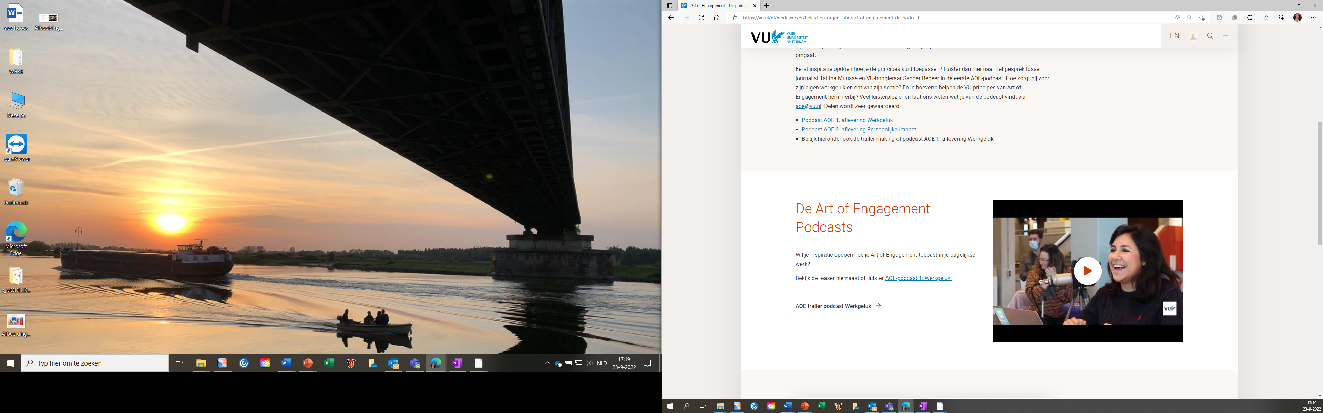
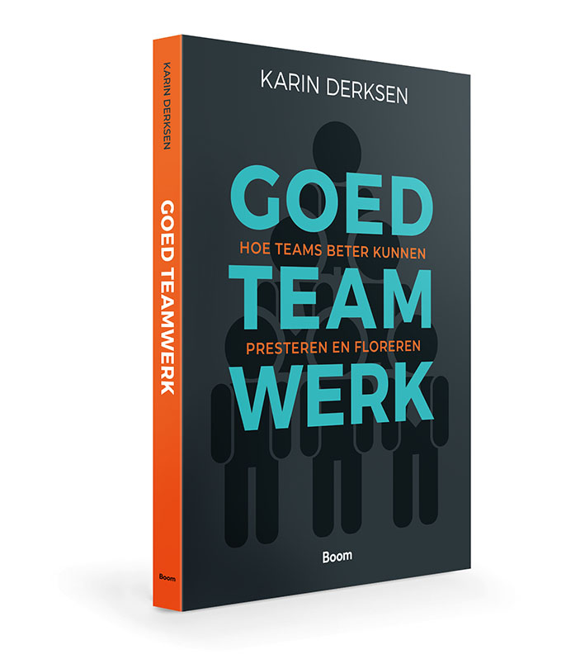
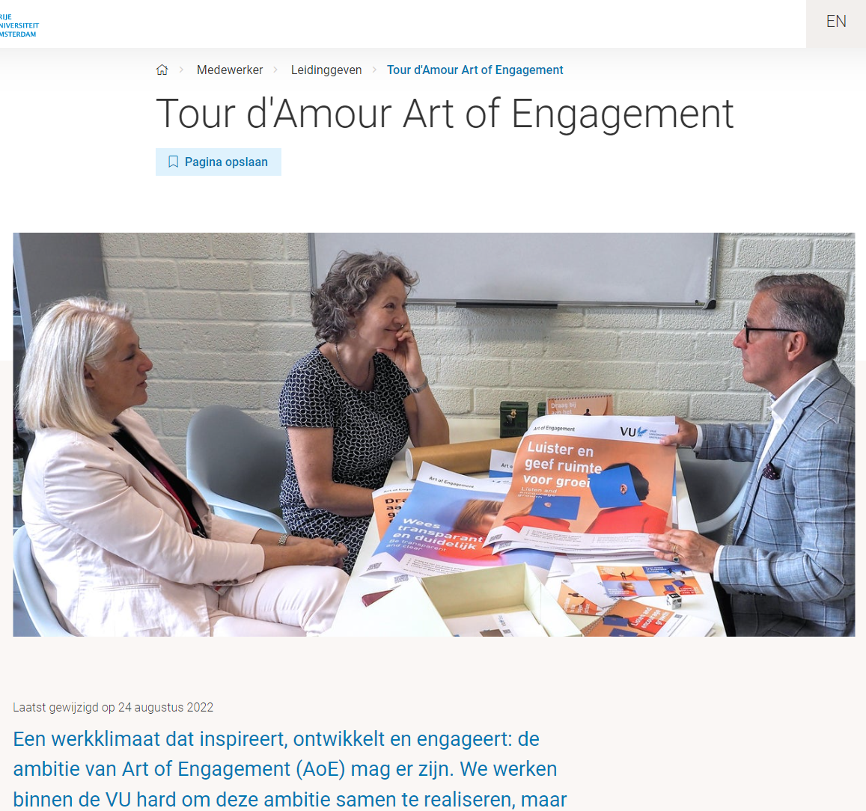
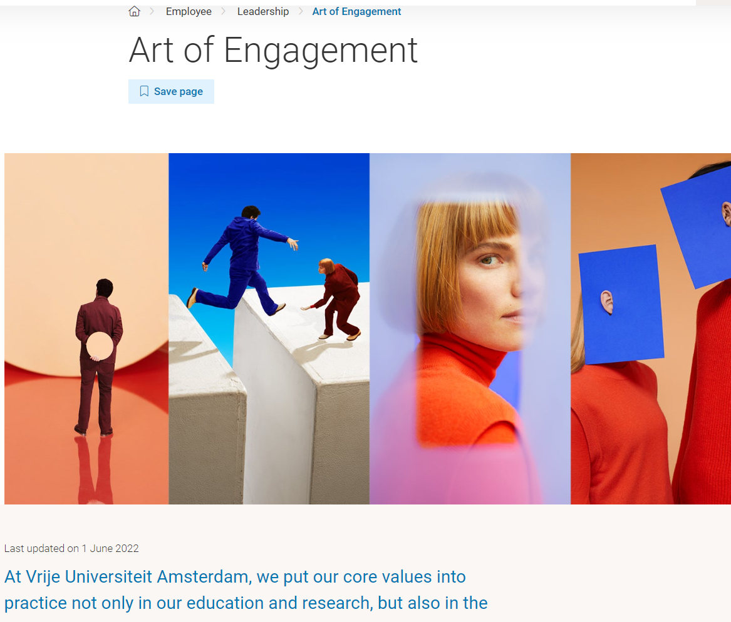
Good teamwork: Art of Engagement in practice

Slide 9

Personal leadership
Developing self-knowledge and reflective capacity by getting to know your strengths and weaknesses by:
Organising feedback and take seriously into account
Learning from your own mistakes
Being transparant on your ambitions, vision and decisions
Train yourself in difficult conversations (e.g. bad news)

Slide 10
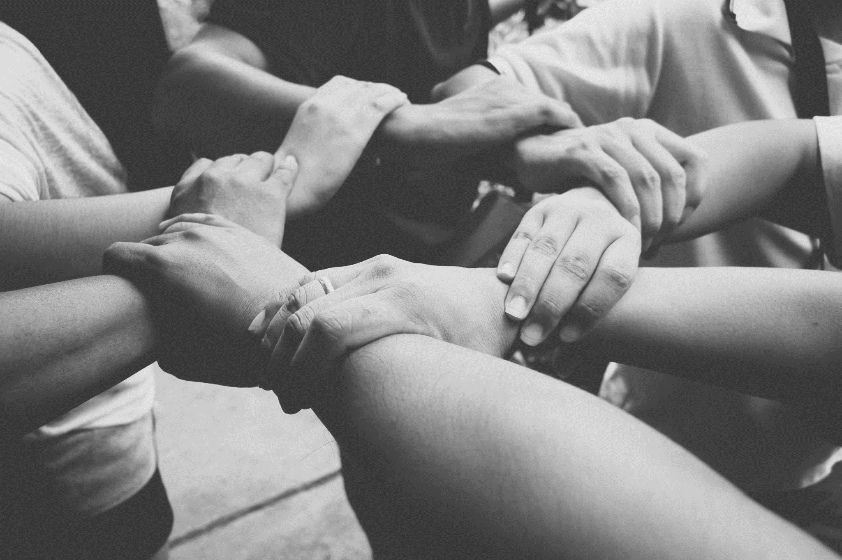
Why teamwork is important
Alone you go faster, together you go further.
Teamwork is one of the 5 key points of R&R.
Teamwork has become craftmanship. As a manager, encouraging good teamwork is one of your main responsibilities.
The price of poorly functioning teams is high; investing in good teamwork is crucial.

Slide 11
Teamscan as instrument to improve teamwork
For all managers at VU.
4 steps:
    Online knowledge-kickoff
    book Good Teamwork
    Scan (questionnaire) about your main team
    Workshop Teamscan
Goal: help and inspire managers with starting point to talk in team about HOW beside WHAT.

Slide 12
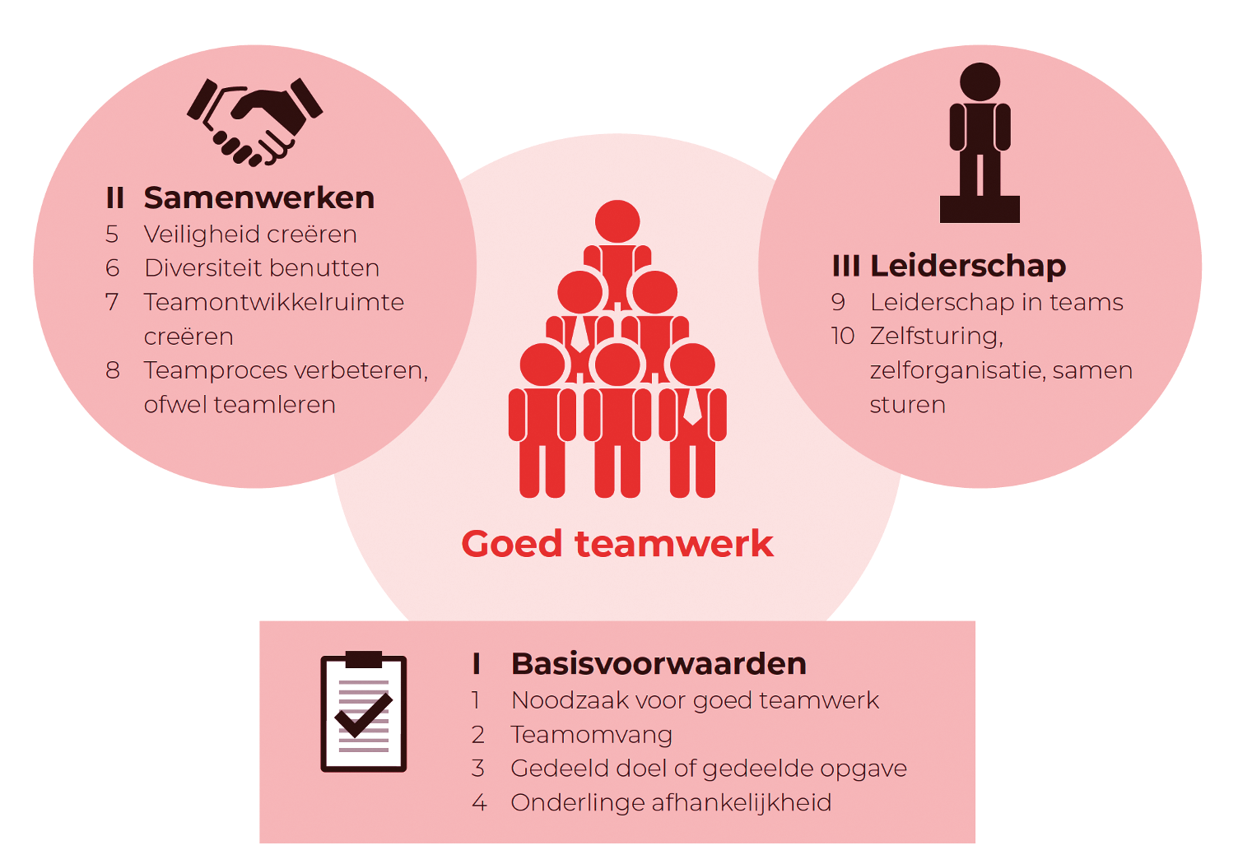
10 dimensions of good teamwork
II Collaboration
III Leadership & management
5 Psychological safety
6 Utilizing diversity
7 Creating development space
8 Improving the team process or teamlearning
9 Managing teams
10 Self-management, self-organization & shared leadership
Good Teamwork
I Basic conditions
1 Need for good teamwork
2 Team size
3 Shared goal
4 Interdependence

Slide 13
Academic / professional leadership
Propagating the vision of your discipline/expertise area
Inspire and stimulate (international) researchers, support staff teachers and students
This is important to position research, teaching and/or services in the academic and social environment to generate legitimacy, reputation, visibility and proper embedding of Open Science principles.

Slide 14
Framework Management – 4 levels
https://vu.nl/en/employee/leadership/management-framework

Slide 15
Task areas for management – insight in aspects

Slide 16

Thank you for visiting this workshop!
For more information: erkennenwaarderen@vu.nl https://vu.nl/en/medewerker/opleiding-ontwikkeling/teamscan-voor-vu-leidinggevenden https://vu.nl/nl/over-de-vu/meer-over/erkennen-en-waarderen
For contact, questions, suggestions: m.verbree@vu.nl b.r.walinga@vu.nl
@RecogRewards
#RecognitionRewards
#ErkennenWaarderen
Recognition & Rewards

