Slide 1
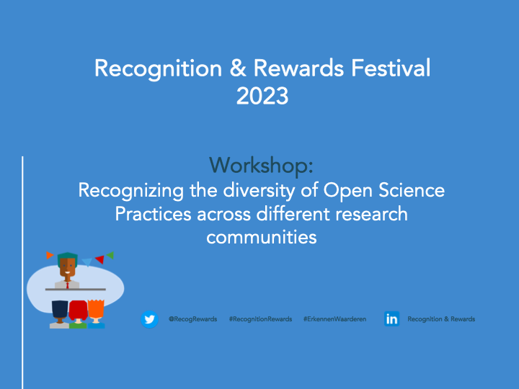

Slide 2
Outline Workshop
Introductions (15 mins)
  Please introduce yourself and tell us a bit more about your background
  What is your experience with Open Science?
  Have you already worked with (Open Science) Dashboards?
BUA Open Science Dashboards Project and discipline-specific Open Science Indicators (5 mins)
Assessing and discussing different OS Dashboards and Indicators in smaller groups (30 mins)
Plenary presentation of findings and discussion (20 mins)
Wrap-up (5 mins)

Slide 3






Project: Open Science Dashboards
Part of BUA Objective 3: Advancing Research Quality and Value
Gefördert im Rahmen der Exzellenzstrategie von Bund und Ländern durch die Berlin University Alliance
Objectives | Monitoring of Open Science practices across different disciplines Development of (semi)automated screening tools Visualisation of Open Science Indicators in Dashboards
Timeline | 10/2021—09/2023
Project Partners | BIH QUEST Center, Charité Open-Access-Büro Berlin

Slide 4
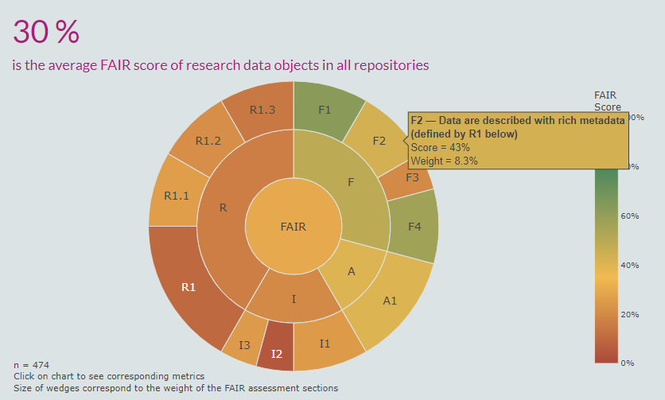
Project partner Charité: Recognizing Open Science Practices
in Biomedical Research
Charité Dashboard for Responsible Research
FAIR Data Dashboard
Berlin Science Survey Dashboard
Screenshot Charité FAIR Data Dashboard

Slide 5
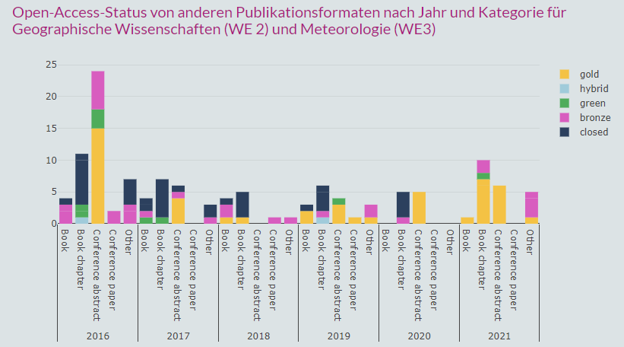
Under development: Open Science Dashboard
FU Geographical Sciences
Screenshot Dashboard Geographische Wissenschaften

Slide 6
Challenges
Finding project partners in a variety of disciplines (due to time constraints/lack of awareness)
Defining Research field/ Scientific discipline (heterogeneous and interdisciplinary)
Lack of and/or limited data available (diversity of research outputs, defining categories)
Quality of available data (incomplete metadata, no DOIs)
Time constraints (non-automated analysis)
Developing qualitative indicators (to value quality and avoid focus on outputs)

Slide 7
Discussion (30 mins, in smaller groups; 25 mins, plenary)
Dashboard Initiatives
Group 1: Country level
  French Open Science Monitor
Group 2: Country level
  Dutch Open Science Dashboard
Group 3: European level
  Open Science Monitor (EC)
Group 4: European level
  Open Science Observatory (OpenAire)
Group 5: Discipline level
  Charité Dashboard for Responsible Research
  FAIR Data Dashboard
Read more about commercial initiatives
  Dimensions
  PLOS
Discussion questions
What do you like/dislike about the dashboard? (Tips/Tops)
For what other OS practices can we develop meaningful indicators?
How do we avoid focusing on research outputs?
How can we ensure the diversity of Open Science Research Practices across different disciplines and communities is recognized and valued?
How can we ensure that the Open Science indicators we use to monitor the OS practices will not be used inappropriately and that Open Science is promoted as a positive research culture in all research disciplines?

Slide 8
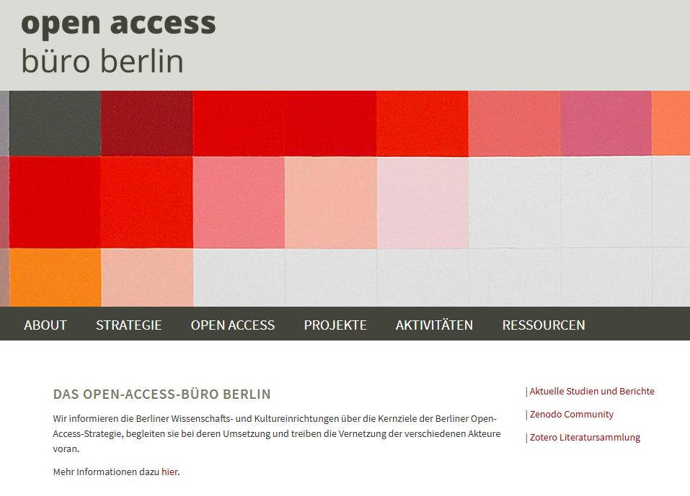
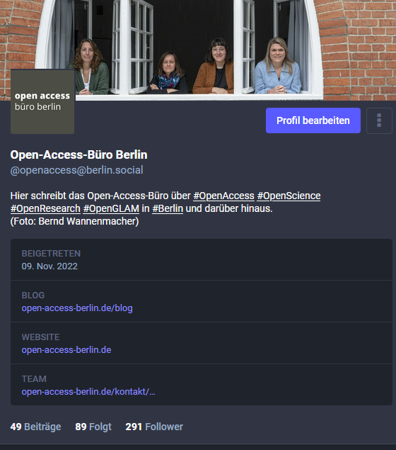

Thank you
for your
attention!
Website: http://www.open-access-berlin.de
Mastodon: https://berlin.social/@openaccess
Blog: https://open-access-berlin/blog
Maaike Duine
0000-0003-3412-7192
maaike.duine@open-access-berlin.de
Content is licensed under a Creative Commons Attribution 4.0 International License.

Slide 9


