Slide 1



Recognition & Rewards Festival
2023
Room 0.22
Recognizing open science in research assessments: Issues, challenges and opportunities
@RecogRewards
#RecognitionRewards
#ErkennenWaarderen
Recognition & Rewards

Slide 2
Recognizing open science in research assessments: Issues, challenges and opportunities
Hans de Jonge, NWO, Alex Rushforth & Sarah de Rijcke, CWTS, Leiden University
Session 2.1, Room 0.22
Recognition and Rewards Festival 2023, Utrecht
13 April 2023

Slide 3

Movers and shapers in responsible research assessment over the past decade (Curry et al 2020)
Notes:
Obviously the landscape has been changing over the past ten years, or at least there are many varied efforts to transform these systems. This is taken from 2020, so is in fact already out of date – there are many more initiatives and interventions one could add to this image. Multiple statements, agreements, concordats, best practice principles and so on – these really seem to be growing exponentially.

Slide 4

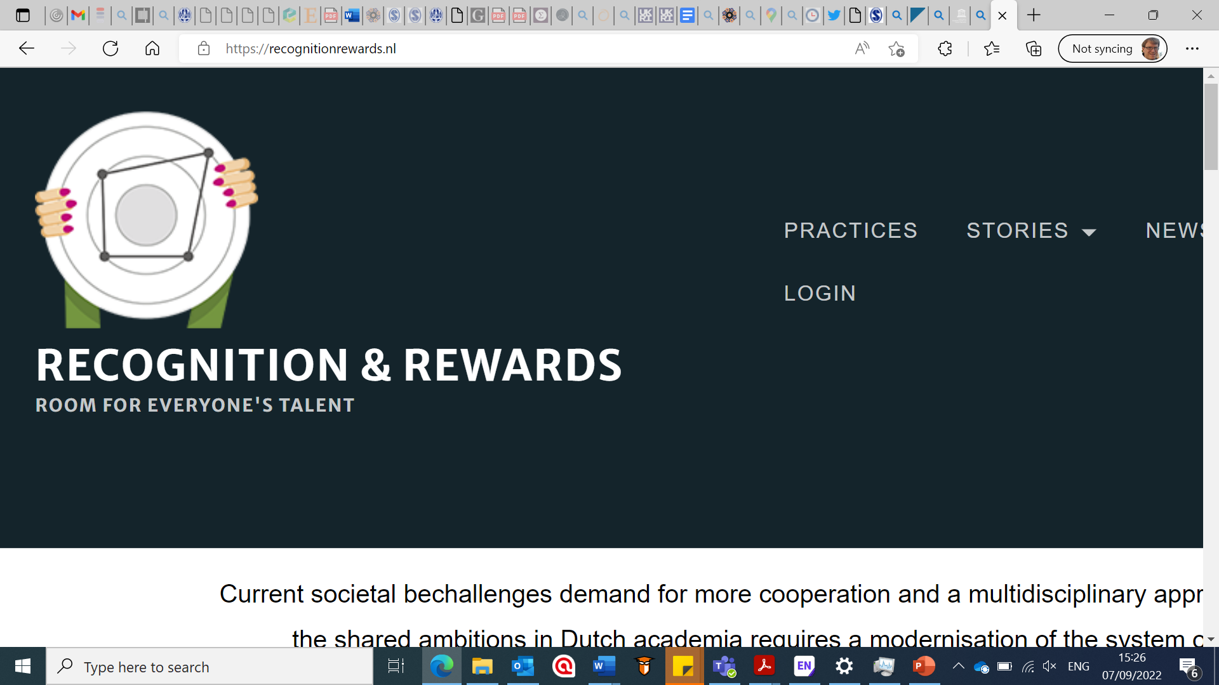

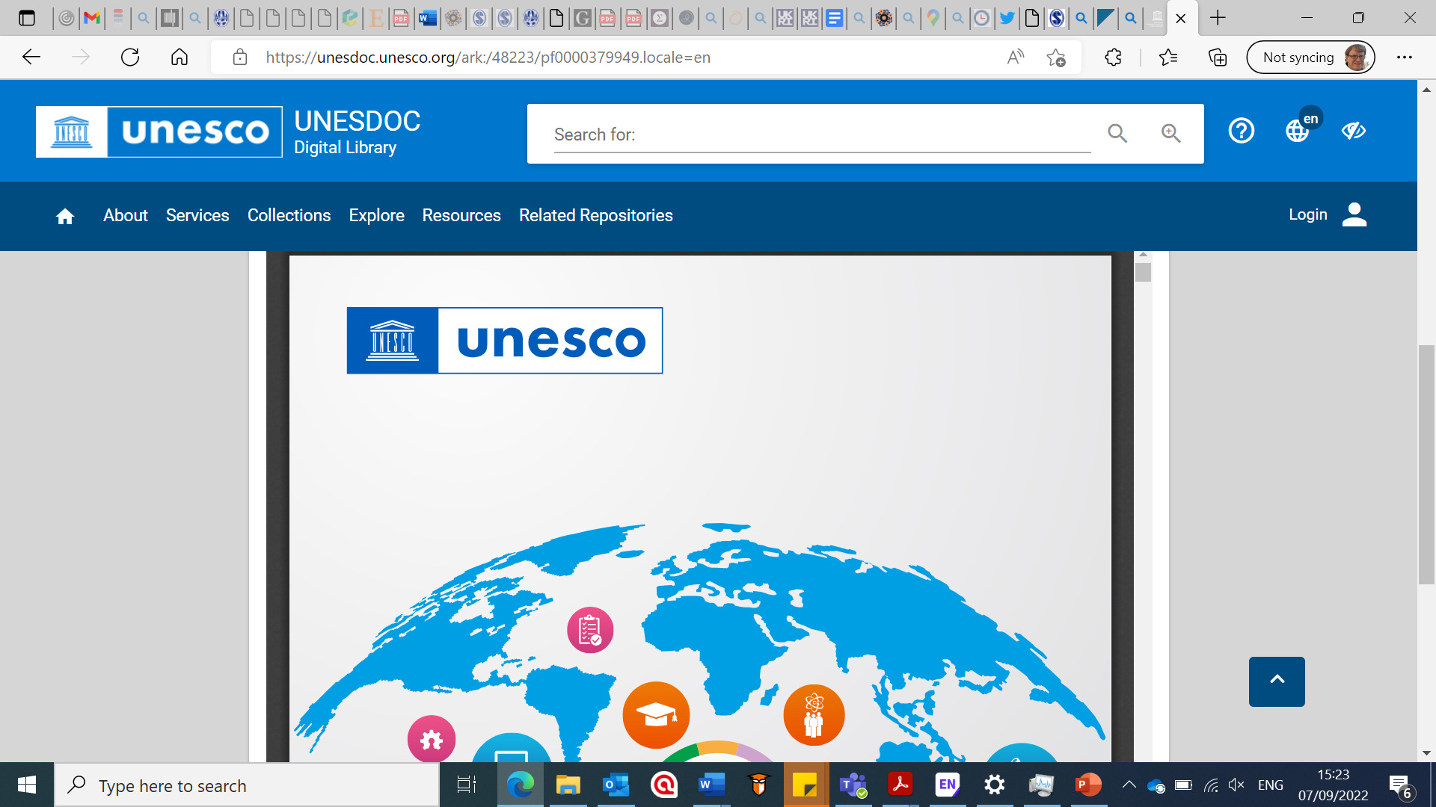
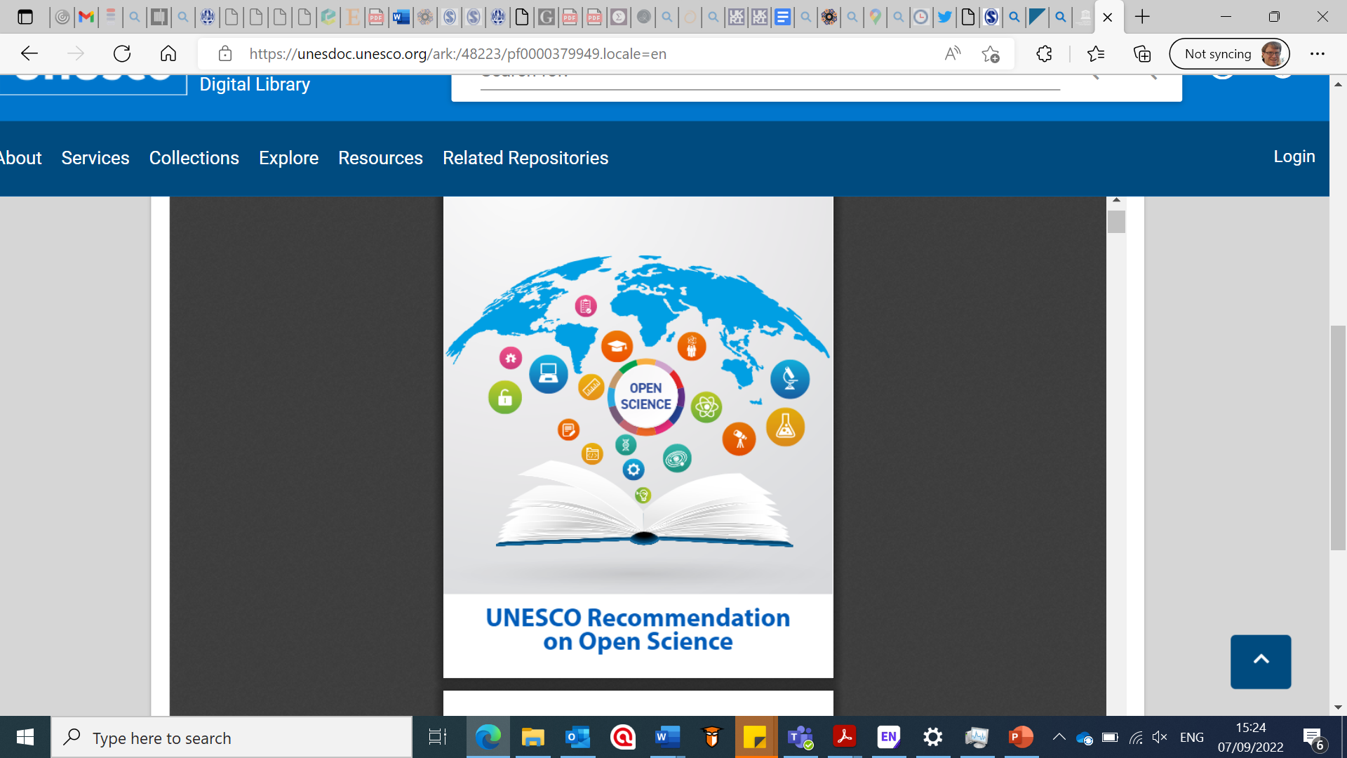
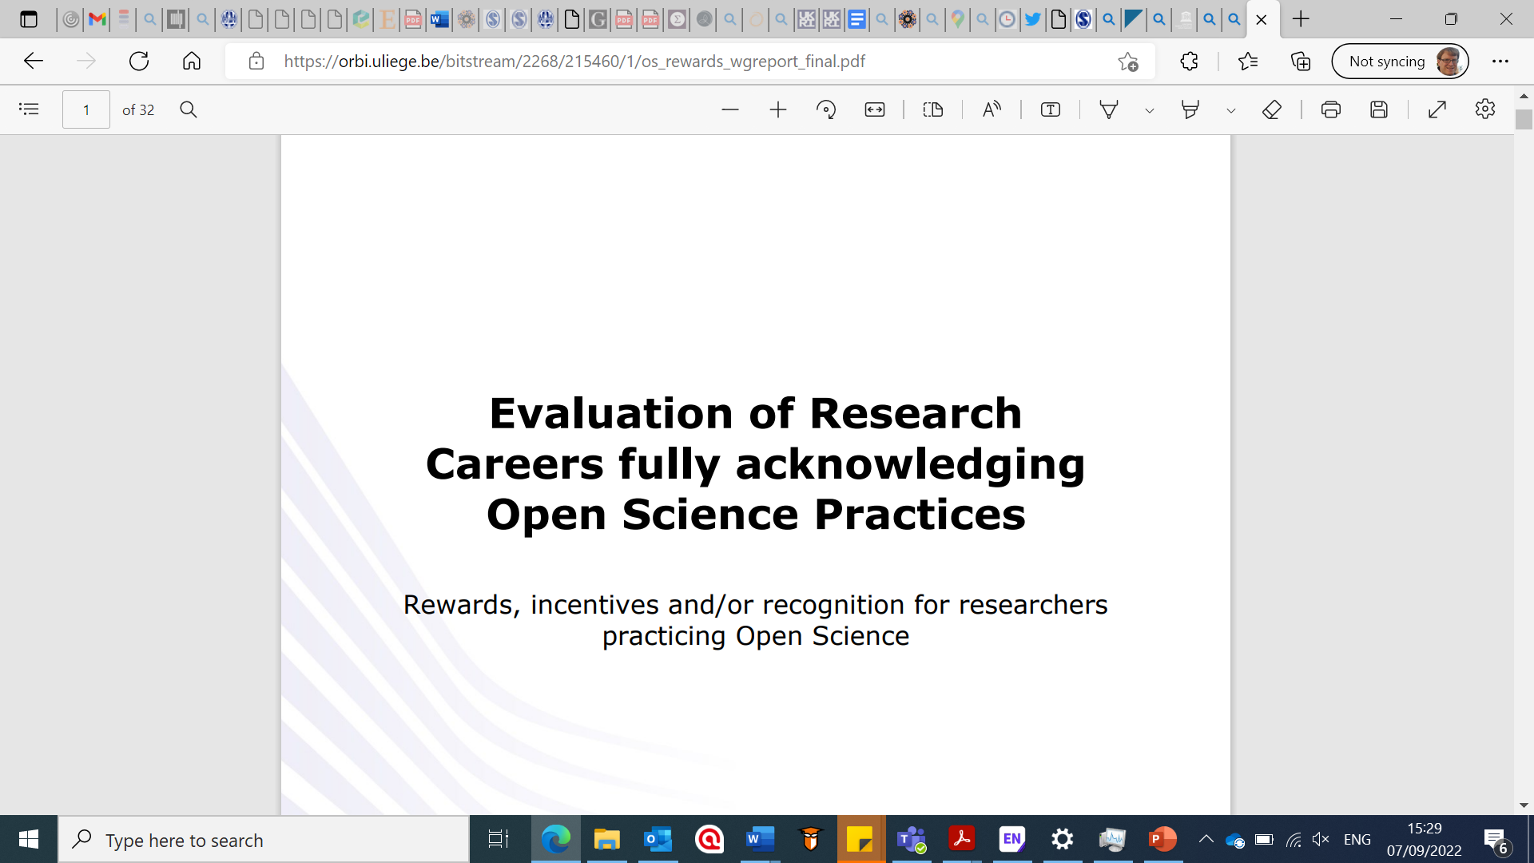
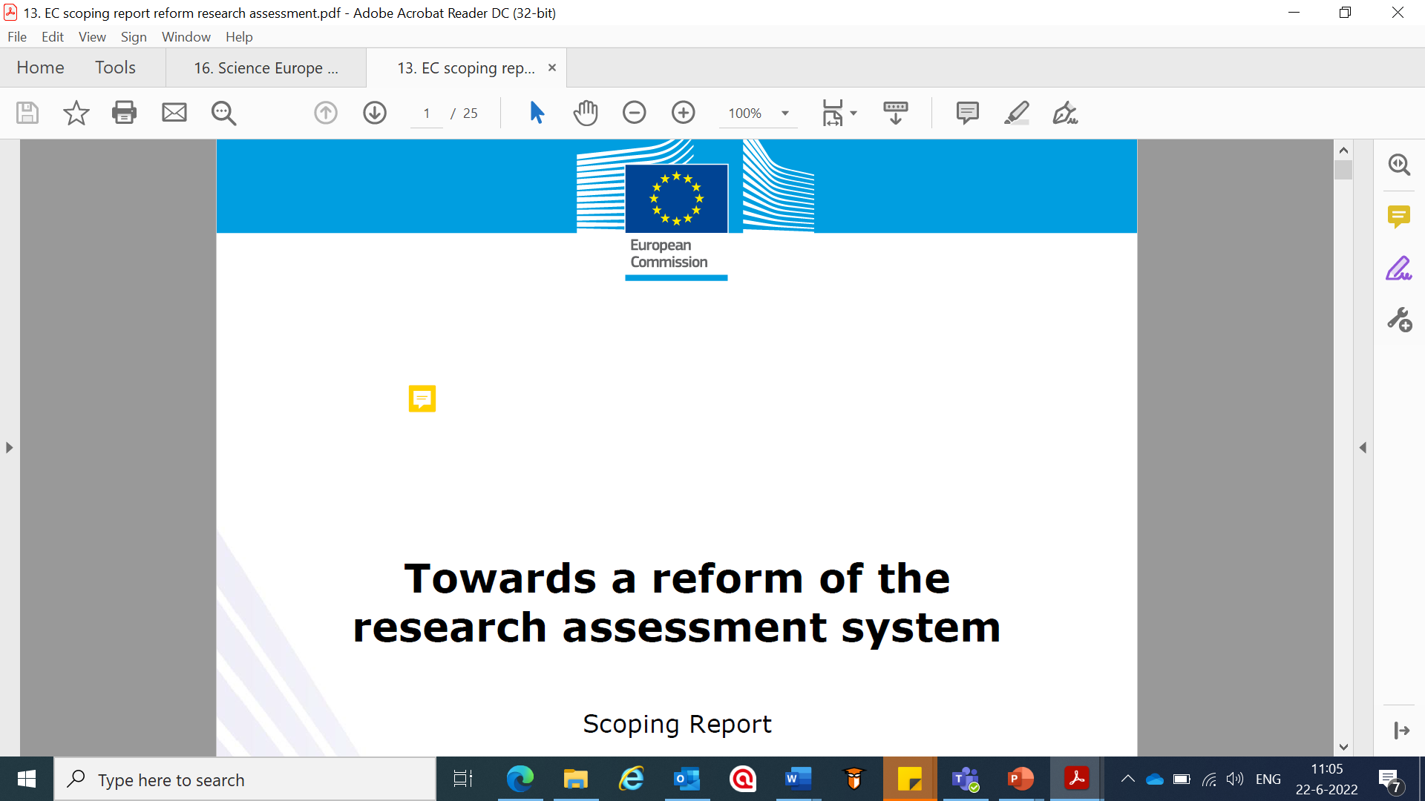


Notes:
I’ve added here some more recent examples – one of the notable features of these recent statements and initiatives is how open science has become amplified – and there’s been a growing sense of alignment between the responsible assessment movement and the open science movement – many advocates of open science have been persuaded that to get to where they want to go – whereby open science is completely mainstream – then a reform of research assessment systems is needed.

Slide 5
Calls to recognize and reward open science
Notes:
And if we look specifically at open science - There are multiple calls among open science advocates to better incentivize openness practices in academic reward systems. Obviously it’s easy to say these things…

Slide 6
Notes:
February 2023 – a roadmap produced to hurry along the recognition and rewards reforms and move to a phase of implementation – so saying now is the time for action.
Point 4 especially is pertinent – it says that next year it will clarify how issues relating to open science will be considered and/or prioritized in relation to staff development, appointment, assessment and promotion.

Slide 7

Change isn’t easy
Notes:
It’s still a live issue – and some things are being worked out. It’s not always easy to know where to start – there are some ambiguities…

Slide 8
Queries we often hear
What is meant by openness and which practices to reward?
What forms of information and evidence is needed to assess openness?
How much weight to give openness as an assessment criteria?
Openness isn’t an achievement
Accounting for differences in openness practices (e.g. epistemic practices)
Skills, infrastructure, administrative routines need building
Today we’ll zoom in on data sharing practices as a dimension of the open science umbrella
Notes:
Back of an envelope set of questions arise about this topic – a kind of reflex reaction – these are of course quite legitimate concerns and questions

Slide 9
Breakout fun
Notes:
We are going to split you into four groups – please find a space.
We will provide you with a fictional vignette of a scenario of an organization experimenting with a new assessment format – and a question or tension that comes up.
We’ll be asking you to discuss among your group whether you have experiences that are comparable or recognizable to the scenario and how it is the issues might be negotiated.
Now these are only short vignettes – and they are simplified examples – so context is missing. We invite you to suspend your disbelief and use the vignettes as a tool for opening up tensions, ambiguities, paradoxes etc.
We will call you back after 15 minutes and we also ask for one or two people from each breakout group to report back on what they found.

Slide 10
Vignette 1
A university faculty announces it is to test a pilot scheme introducing new hiring and promotion criteria to recognize and reward data sharing – by putting data sets on an equal footing to peer reviewed journal publications. They introduce a scoring system to rate the ‘quality’ of data sharing contributions provided by applicants (e.g. FAIRness + uniqueness/effort of dataset) and adopt indicators for measuring ‘impact’ the dataset has had on the applicant’s community (e.g. # downloads, dataset citations).
But a group of professors in the faculty protest that openness is not as important as excellence and state that the new procedure is too burdensome – they threaten to boycott serving on hiring and promotion panels and a couple of them complain about the scheme to the media.
Can you relate to this situation from your own experiences?
Which, if any, party do you sympathize with, and why?
How would you advise the faculty to proceed?

Slide 11
Breakout 2

Slide 12
Vignette 2
A national funding agency provides large grants to individuals as part of its flagship scheme. Its application and selection process falls into two parts: firstly submission of a research proposal along with the applicant’s CVs; followed by invitation of shortlisted applicants for an interview with the peer review selection panel.
The agency’s leadership is passionately supportive of open science and has decided to make the data sharing track records of candidates a criteria in selecting successful proposals.
The leadership appoints a taskforce to make this happen. The taskforce however are soon split down the middle: half want all applicants to provide a narrative statement about their individual track records on data sharing, to be submitted alongside other application documents (proposal, CV, cover letter etc.); whereas the other half wish for this to be an oral interview question given to shortlisted candidates.
Can any of you relate this scenario to your own experiences?
Which, if either, position can you most sympathize with and why?
How would you advise the taskforce to proceed?

Slide 13
Wrapping up

Slide 14
THANK YOU FOR YOUR ATTENTION!
Feedback or questions? Please contact:
Email: a.d.rushforth@cwts.leidenuniv.nl
Mastodon: @alexrushforth@social.cwts.nl
You can also leave your comments on the RRView webpage for this session: https://rrview.nl/thoughts/1899

Slide 15

Thank you for visiting this workshop!
@RecogRewards
#RecognitionRewards
#ErkennenWaarderen
Recognition & Rewards

