Slide 1

Academic Career Track (ACT)
13-04-2023
Meike Blokland & Evan van de Leur

Slide 2
List of content
Evaluation of Tenure Track policy (2020)
Academic Career Track policy
Transitionary Policy for the Academic Career Track policy
ACT Development Programme

Slide 3

01
Tenure Track Evaluation (2020)

Slide 4
Evaluation of the Tenure Track policy (2020)
Conclusions
TU Delft is attractive for young academic talents, and the Tenure Track plays a role in that;
Two things heed attention:
  Reducing the stress of Tenure Trackers;
  Drafting better criteria and expectations an improve communication.
Advice
Repositioning the Tenure Track as a career perspective to attract talents;
Invest in the quality of supervision;
Improve the Tenure Track development programme, with a focus on leadership development;
Reducing stress amongst Tenure Trackers due to their temporary employment contract.

Slide 5
02
Academic Career Track Policy

Slide 6
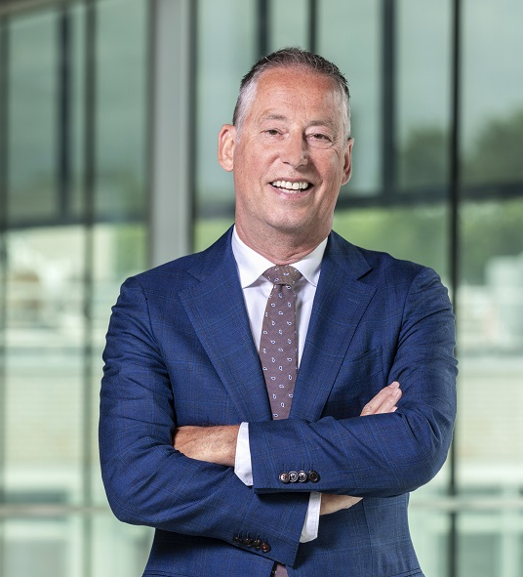
‘’We expect that the Academic Career Track will offer an attractive career perspective for a large group of excellent scientists. We want to offer them an inspiring environment where development and trust are key.’’
Tim van der Hagen - Rector magnificus of Delft University of Technology

Slide 7

Academic Career Track – In short
The Academic Career Track (ACT):
  Is a development track for talented, early career academics;
  Spans from the academic position of assistant professor to associate professor;
  Offers the opportunity to make tailor-made arrangements and to place accents;
  Focusses on academic and personal development through a ACT Development Programme.
The timeline for the track is as follows:
  Initial temporary contract of 18 months, which is then converted to a fixed appointment after a light evaluation;
  Within a maximum of 4 years the ACT-er is promoted from Assistant Professor 2 to Assistant Professor 1;
  After a maximum of 8 years the ACT-er is promoted from Assistant Professor 1 to Associate Professor 2.

Slide 8
Tenure Track vs Academic Career Track
Tenure Track | Academic Career Track
Temporary employment contract of 6 years | Temporary employment contract for 18 months, to be converted in a permanent employment contract after a positive evaluation based on confidence in results and development
Track towards a permanent employment contract | Track towards an associate professor position
Track lasts up to 5+1 years | Track lasts in principle a maximum of 8 years
To support personal and professional development, the Personal Development Programme is offered | To support personal and professional development, the ACT Development Programme is offered in all areas of the academic career throughout the track
Faculty Career Committee implicitly responsible for decision on permanent employment contract | Manager/supervisor explicitly responsible for decision on permanent employment contract

Slide 9
Four phases of the Academic Career Track
Phase 1: Start (0-3 months)
Getting to know the TU Delft, department and colleagues;
Drafting a first version of the ACT Personal Development Plan.
Phase 2: Start-term (3-18 months)
Getting started with (following training modules on) education, research, valorisation and leadership;
Working towards light evaluation, ending with a permanent employment contract.
Phase 3: Mid-term (18 months – max. 4 years)
Getting familiar with education, research, valorisation and leadership (through training modules);
Working towards the mid-term review and promotion to Assistant Professor 1.
Phase 4: End-term (Max. 4 years – max. 8 years)
Drafting a long-term, sustainable vision on education, research, valorisation and leadership;
Working towards the end-term review and end of the track with a promotion to Associate Professor 2.

Slide 10



Timeline of the Academic Career Track
Start ACT
Start-term review
Mid-term review
End-term review
Development plan
(0-3 months)
Permanent contract
(1,5 years)
Assistant Professor 2 → Assistant Professor 1
(max. 4 years)
Assistant Professor 1 → Associate Professor 2
(max. 8 years)
Time (in years)
0
1
2
3
4
5
6
7
8
Continuous dialogue
Development monitoring
(R&D cycle)
Development talks
Head of Department & Manager
Faculty Career Committee or
MT department & 1 or 2 members Faculty Career Committee
Faculty Career Committee
Advice
Decision
Manager
Dean
Head of Department
Dean

Slide 11
03
Transitionary Policy for the Academic Career Track policy

Slide 12
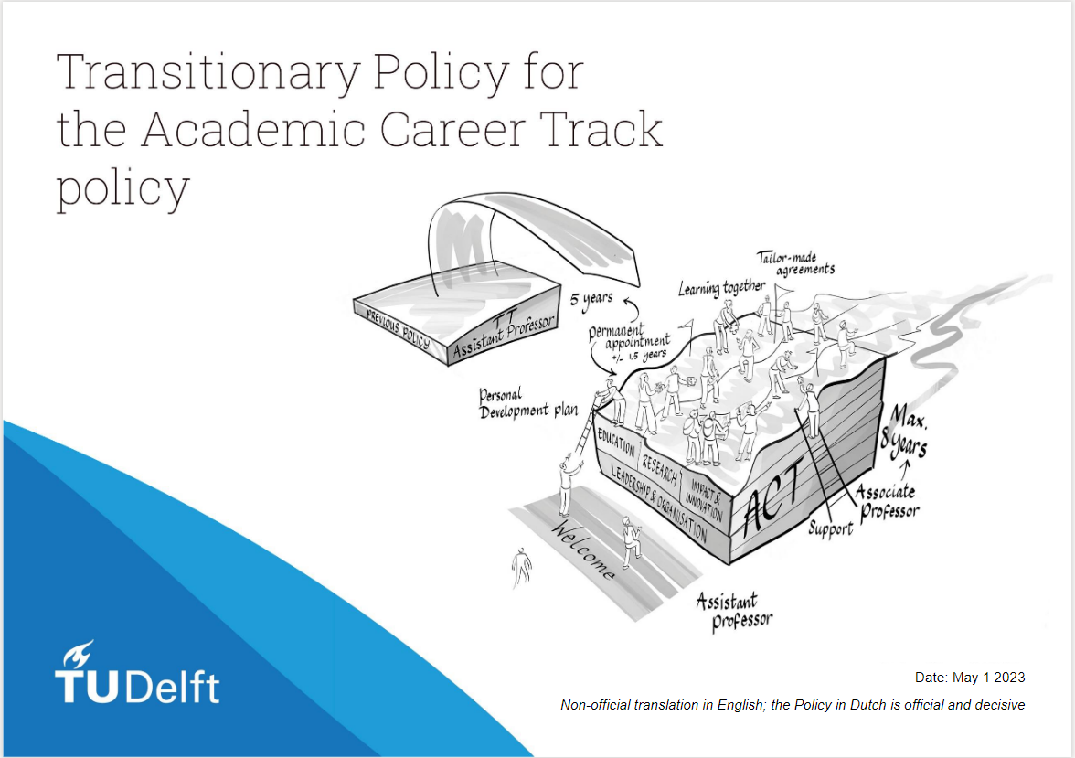
Transitionary Policy
Goal of the transitionary policy is to:
  Ensure equal treatment for current Tenure Trackers;
  Convert as many Tenure Trackers to the Academic Career Track (and thus a permanent employment contract).
Conversion to the Academic Career Track depends on:
  How many years a Tenure Tracker is in the Tenure Track;
  Achieved results and development so far;
  Potential for future results and development.

Slide 13
04
ACT Development Programme

Slide 14

ACT Personal Development Plan
To be provided at the start of the track;
Document in which to write down goals on development, vision and strategy for the entire Academic Career Track and the coming year on the result areas of:
  Education
  Research
  Societal Impact & Innovation (valorisation)
  Leadership & Organisation
Room for placing and replacing accents;
To be discussed with one’s manager/supervisor and updated at least once a year during the Results & Development conversation.

Slide 15
ACT Development Programme
The Academic Career Track Development programme supports the ACT-er in their personal and professional development during the entire track towards the position of Associate Professor:​
  Based upon the four result areas: Education, Research, Societal Impact & Innovation (Valorisation) and Leadership & Organisation;
  Balanced over the years;
  Taking into account competencies and expertise acquired elsewhere;
  Required, recommended and in-depth training courses and instruments;
  Modular structure for flexibility;
  Incorporating training courses that already exist (Onboarding, University Teaching Qualification, Language, Grant workshop) and developing new training courses;
  In cooperation with all centres of expertise of the TU Delft;
  Facilitating peer group supervision and peer practice groups, a mentor and buddy.
Make your own learning journey!

Slide 16

ACT Development Programme
Phase 1 | Onboarding
0 – 3 maanden
Phase 2 | Mid Term
Max. 4 years
Phase 3 | End Term
Max. 8 years
UD2 new at TU Delft
UD2 to UD1
UD1 to UHD2
Onboarding TU Delft
Education
Research
Societal Impact & Innovation
Leadership & Organisation
The basis: Peer practice groups and supervision (with fellow ACT-ers)
Continuous dialogue with supervisor
Contiu
6-4-2023

Slide 17
Better TUgether

