Slide 1




Are narrative CVs proving effective in achieving desired outcomes of recognition and reward initiatives?
Recognition & Rewards Festival 2023
13 April, 2023
Noémie Aubert Bonn, James Morris, Sean Sapcariu, Karen Stroobants

Slide 2



Who is performing well?
Who should be rewarded?
Who should move up?
Who should not continue?
Professor
Research
institutions
Tenure Track
Who should receive the money?
PostDoc
PhD Student
Research funders
Notes:
KS

Slide 3
How can we assess researchers?
What are their accomplishments?
Support?
Collaboration?
Community involvement?
Services to academia?
Impact to practice?
Mentoring and supervision?
Outreach?
Collegiality?
Published papers?
Skills?
Method and material building?
Notes:
KS

Slide 4
How can we assess researchers?
What are their accomplishments?
Support?
Collaboration?
Community involvement?
“Number of papers”
“H Index”
Services to academia?
Impact to practice?
Mentoring and supervision?
Outreach?
“Journal impact factors”
Collegiality?
Published papers!
Skills?
Method and material building?
How many?
→ Sounds good!
Are they high quality?
→ Too long!
Who cites them?
→ Too slow!
Which journal?
→ Too many options!
Publication and impact metrics
→ OK, that’s easy!
Notes:
KS

Slide 5
≠
What makes a
Successful career?
What makes
Good research?
Publishing a lot of papers
High quality research
In high JIF journals
Shared openly
Exceptional, ground breaking
Reproducible, robust findings
Individual achievements
Collaborative achievements
Standard career path
Diverse skills and team work
Aubert Bonn, N., Pinxten, W. (2021) https://doi.org/10.1186/s41073-020-00104-0 and https://doi.org/10.1186/s41073-020-00105-z
Notes:
KS

Slide 6
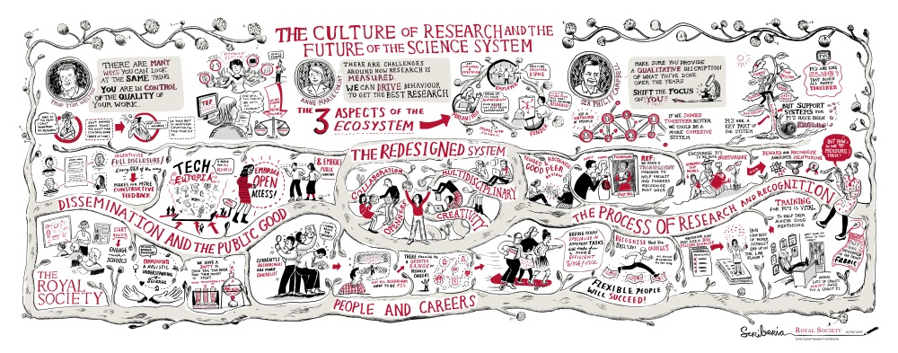


Addressing issues and improving culture
‘Highly competitive environment combined with the very narrow definitions of success’
‘Research culture encompasses the behaviours, values, expectations, attitudes and norms of our research communities. It influences researchers’ career paths and determines the way that research is conducted and communicated.’

Slide 7
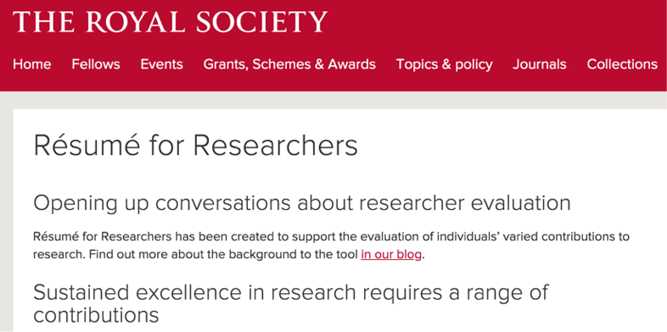



Making space for broader contributions

Slide 8
Are other funders adopting narrative formats?
Notes:
Informal survey – 21 responses received – at least one funder from each continent though majority of answers from European funders
Why not? = Which of the following options, if any, most accurately explains your decision not to implement a narrative CV format?

Slide 9
Range of reasons for adopting narrative CVs

Slide 10
Development of narrative CV formats
Where development processes were specified, they usually included the following elements:
Inputs from international funders
Inputs from assessors
Inputs from researchers (either in the development or pilot phase)
Evaluation and refinement

Slide 11
Are narrative CVs achieving their goals?

Slide 12

Narrative CV Implementation and Feedback results (2021)
Goal: To understand if we are achieving our goals with the Narrative CV, and to get a temperature check
Report and Raw Dataset with quantitative and free-text responses (anonymized)
Feedback from applicants, reviewers, panel members
Second report from 2022 coming soon, preliminary data in next slides!
https://www.fnr.lu/narrative-cv-implementation-and-feedback-results/

Slide 13
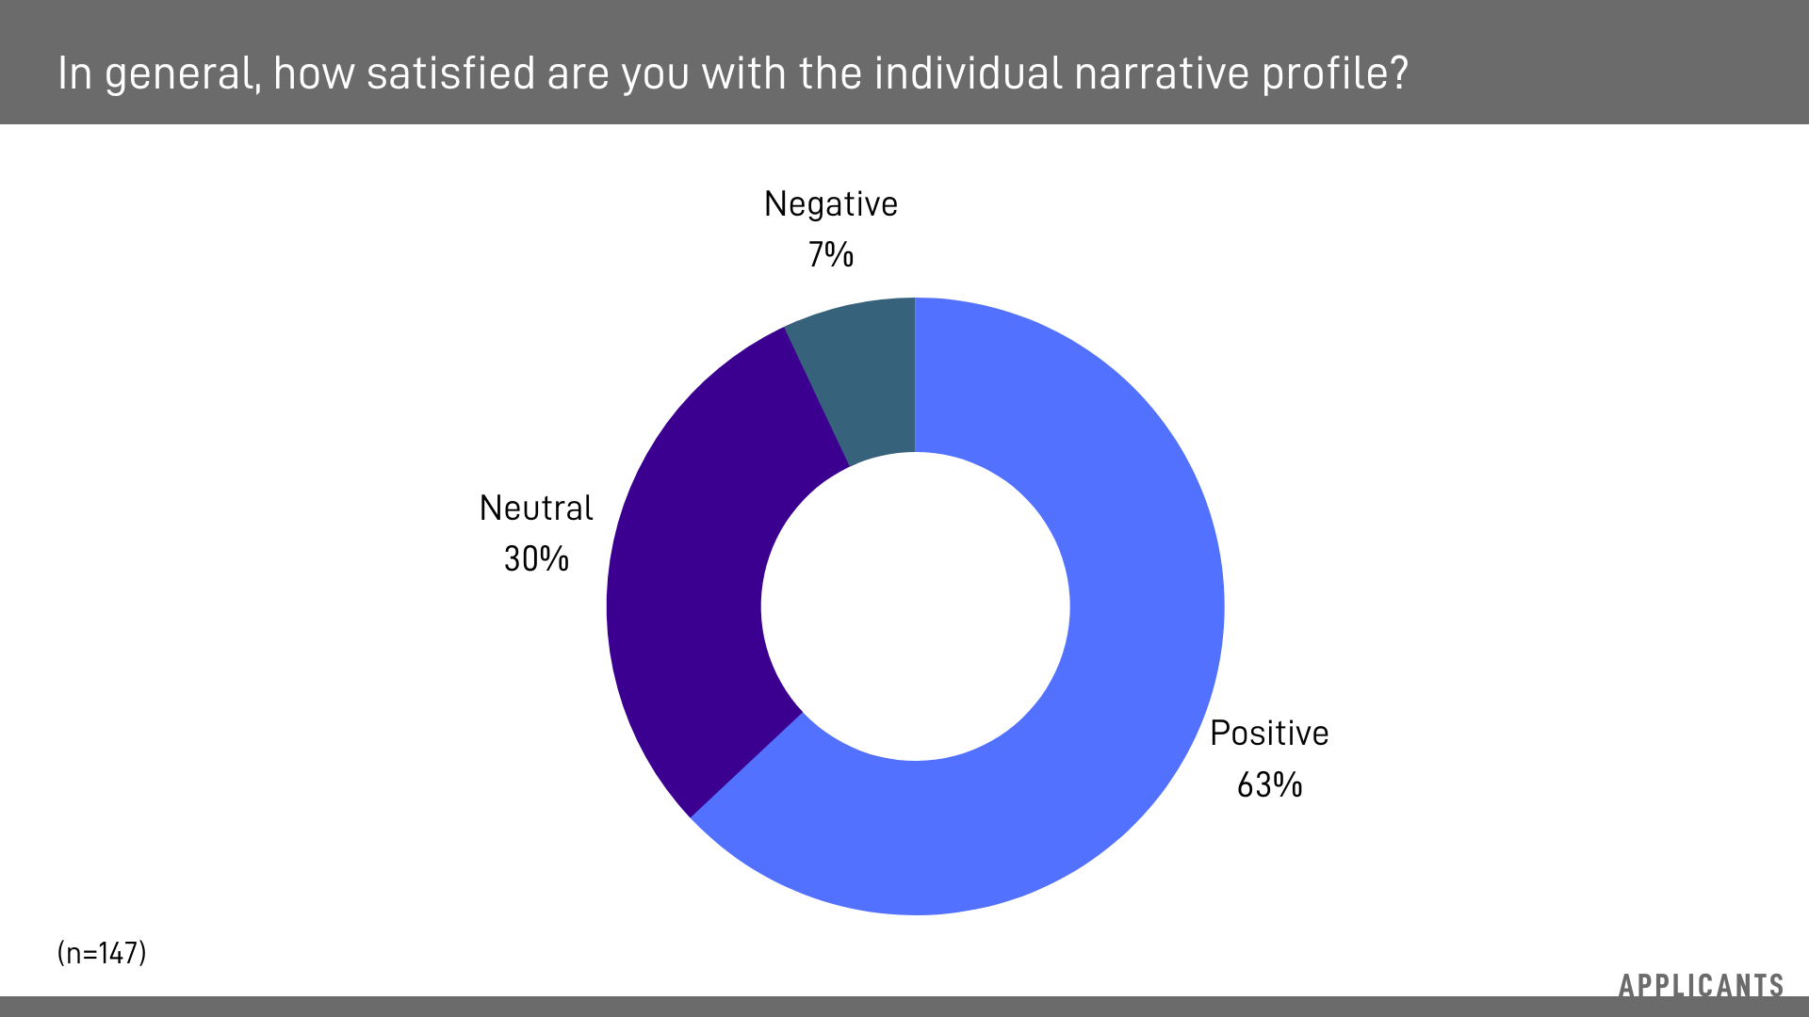
Satisfaction Results – Applicants

Slide 14
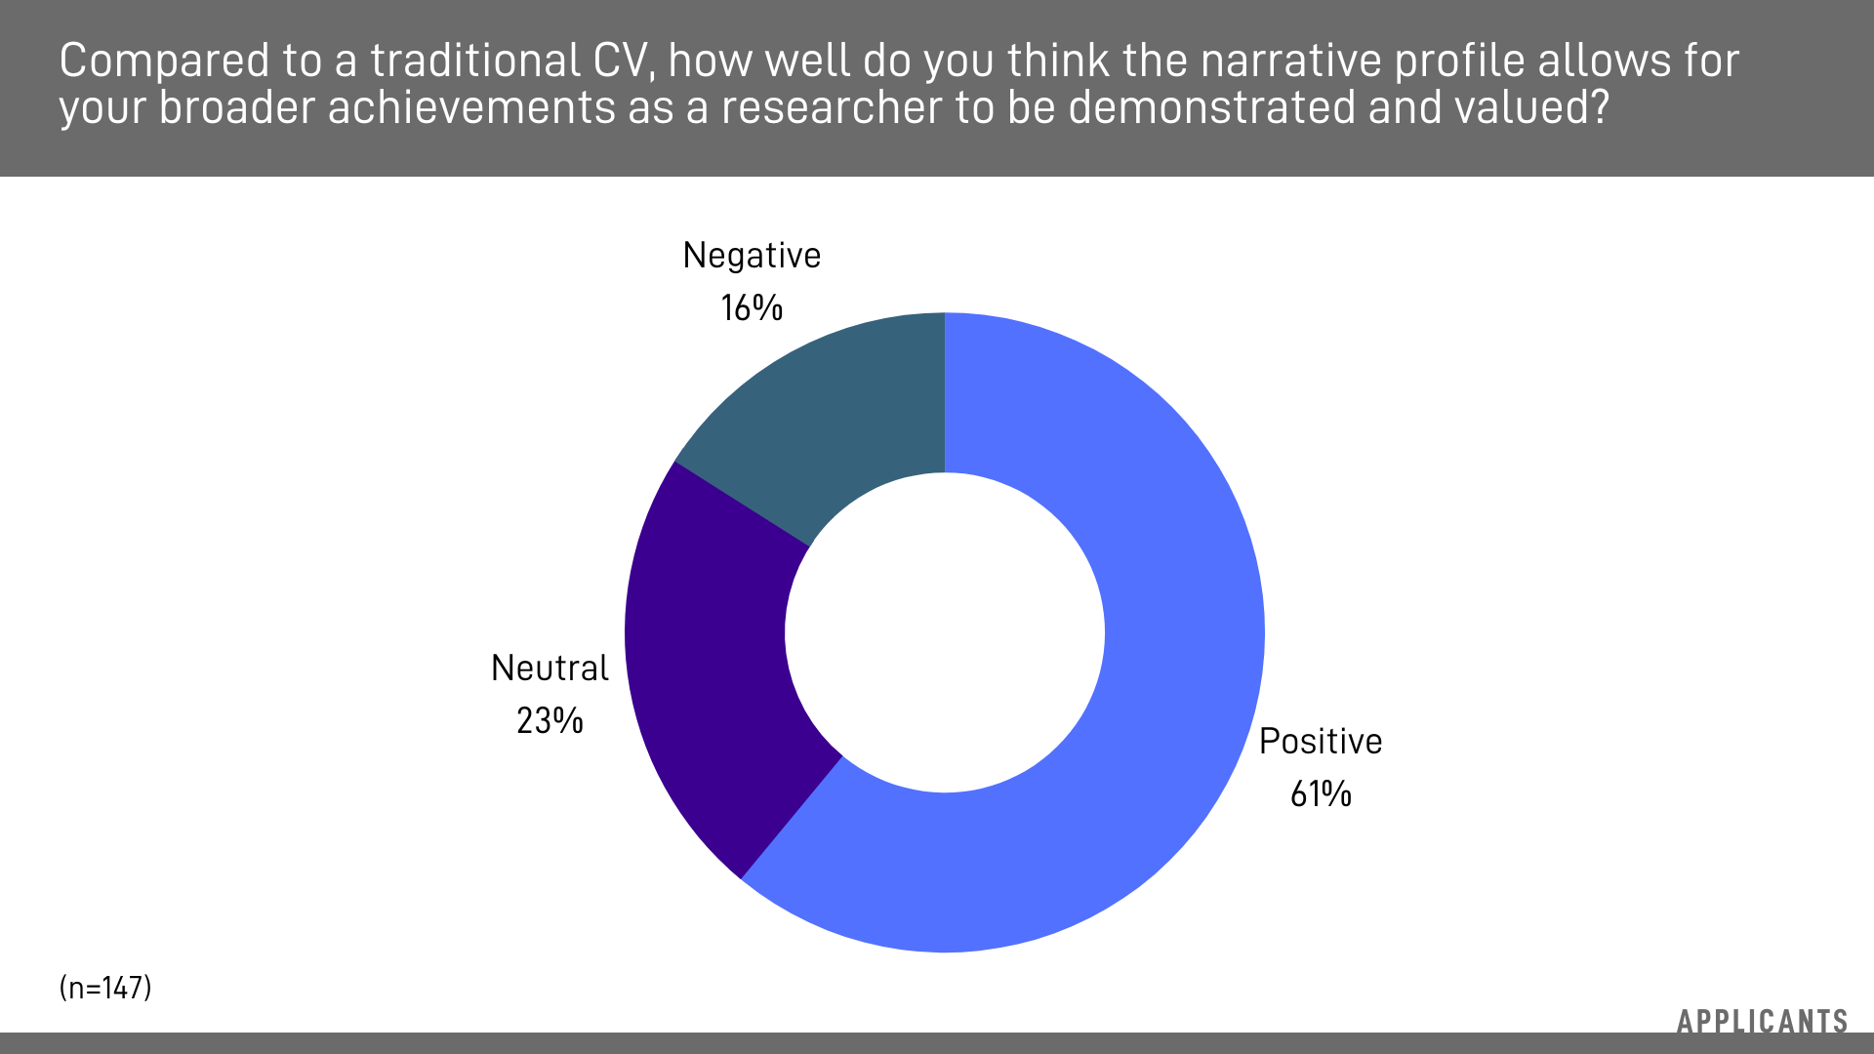
Satisfaction Results – Applicants

Slide 15
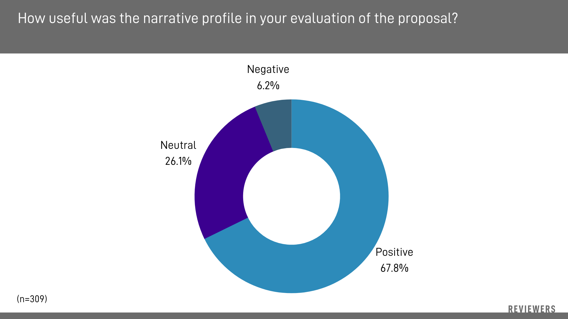
Usefulness Results – Reviewers

Slide 16
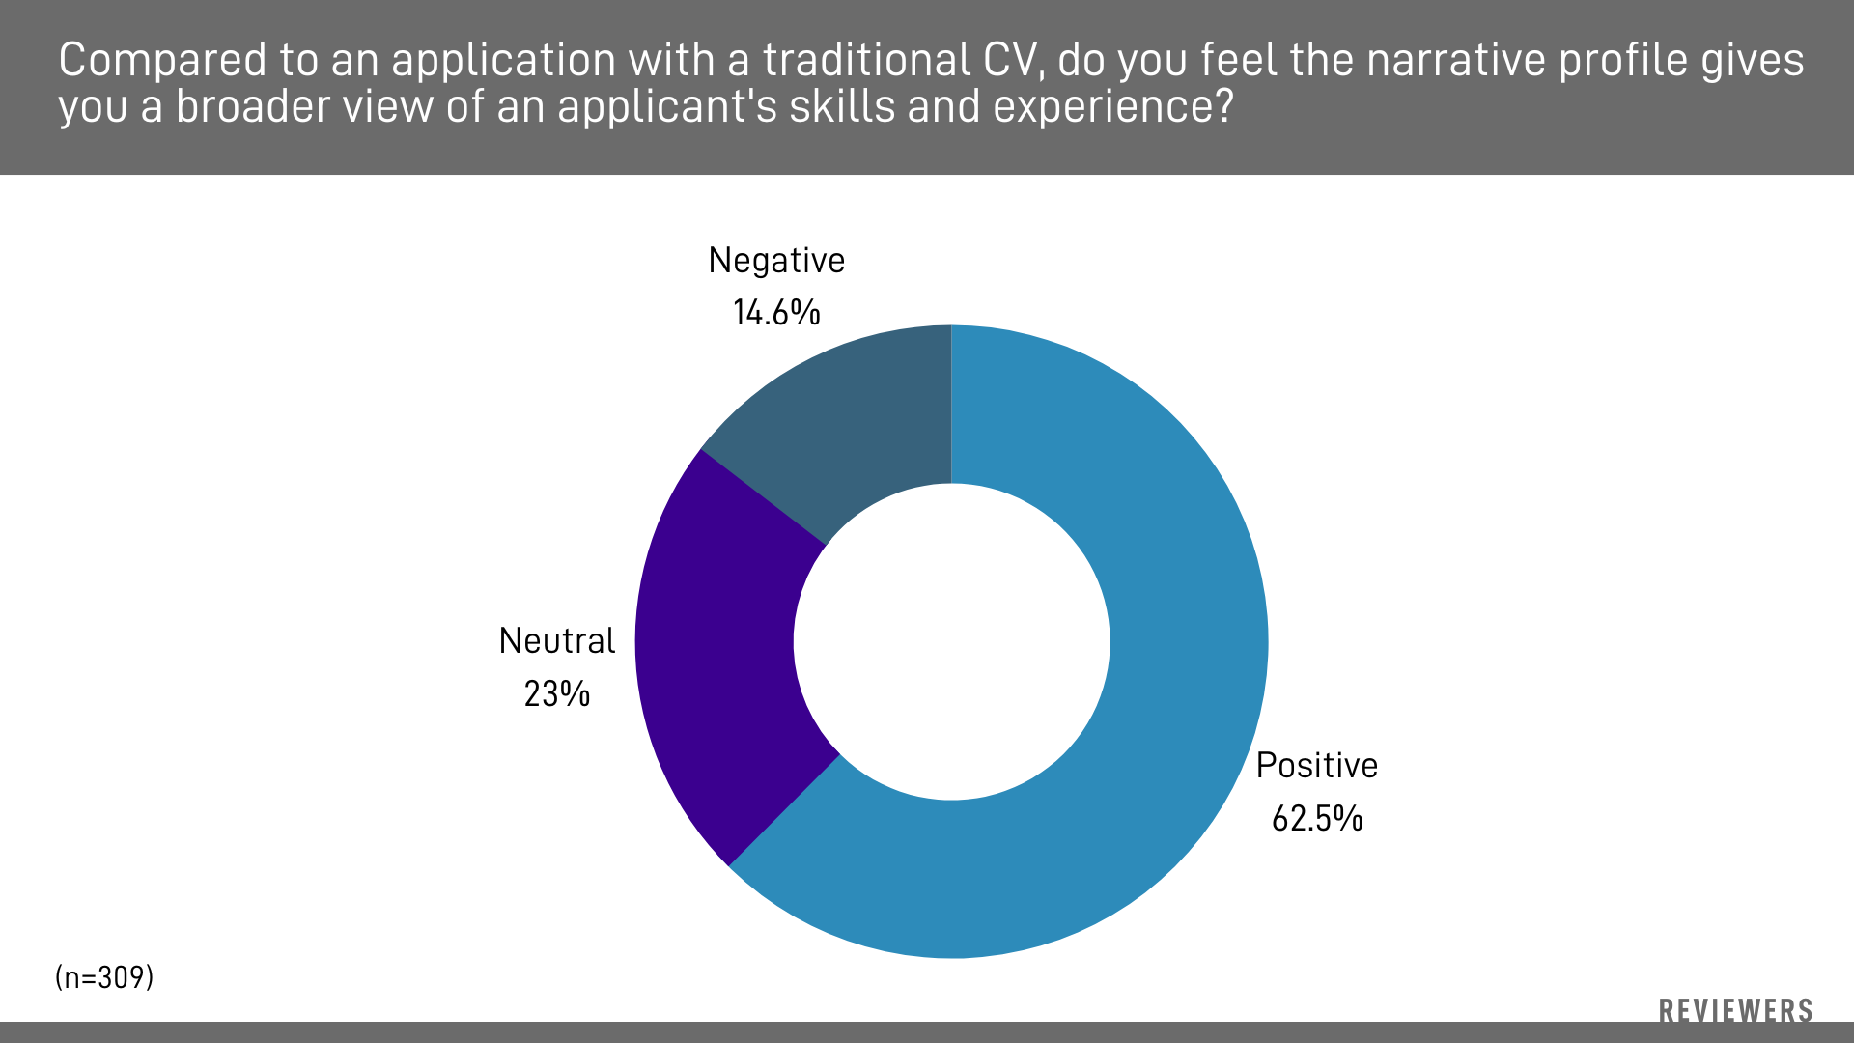
Usefulness Results – Reviewers

Slide 17
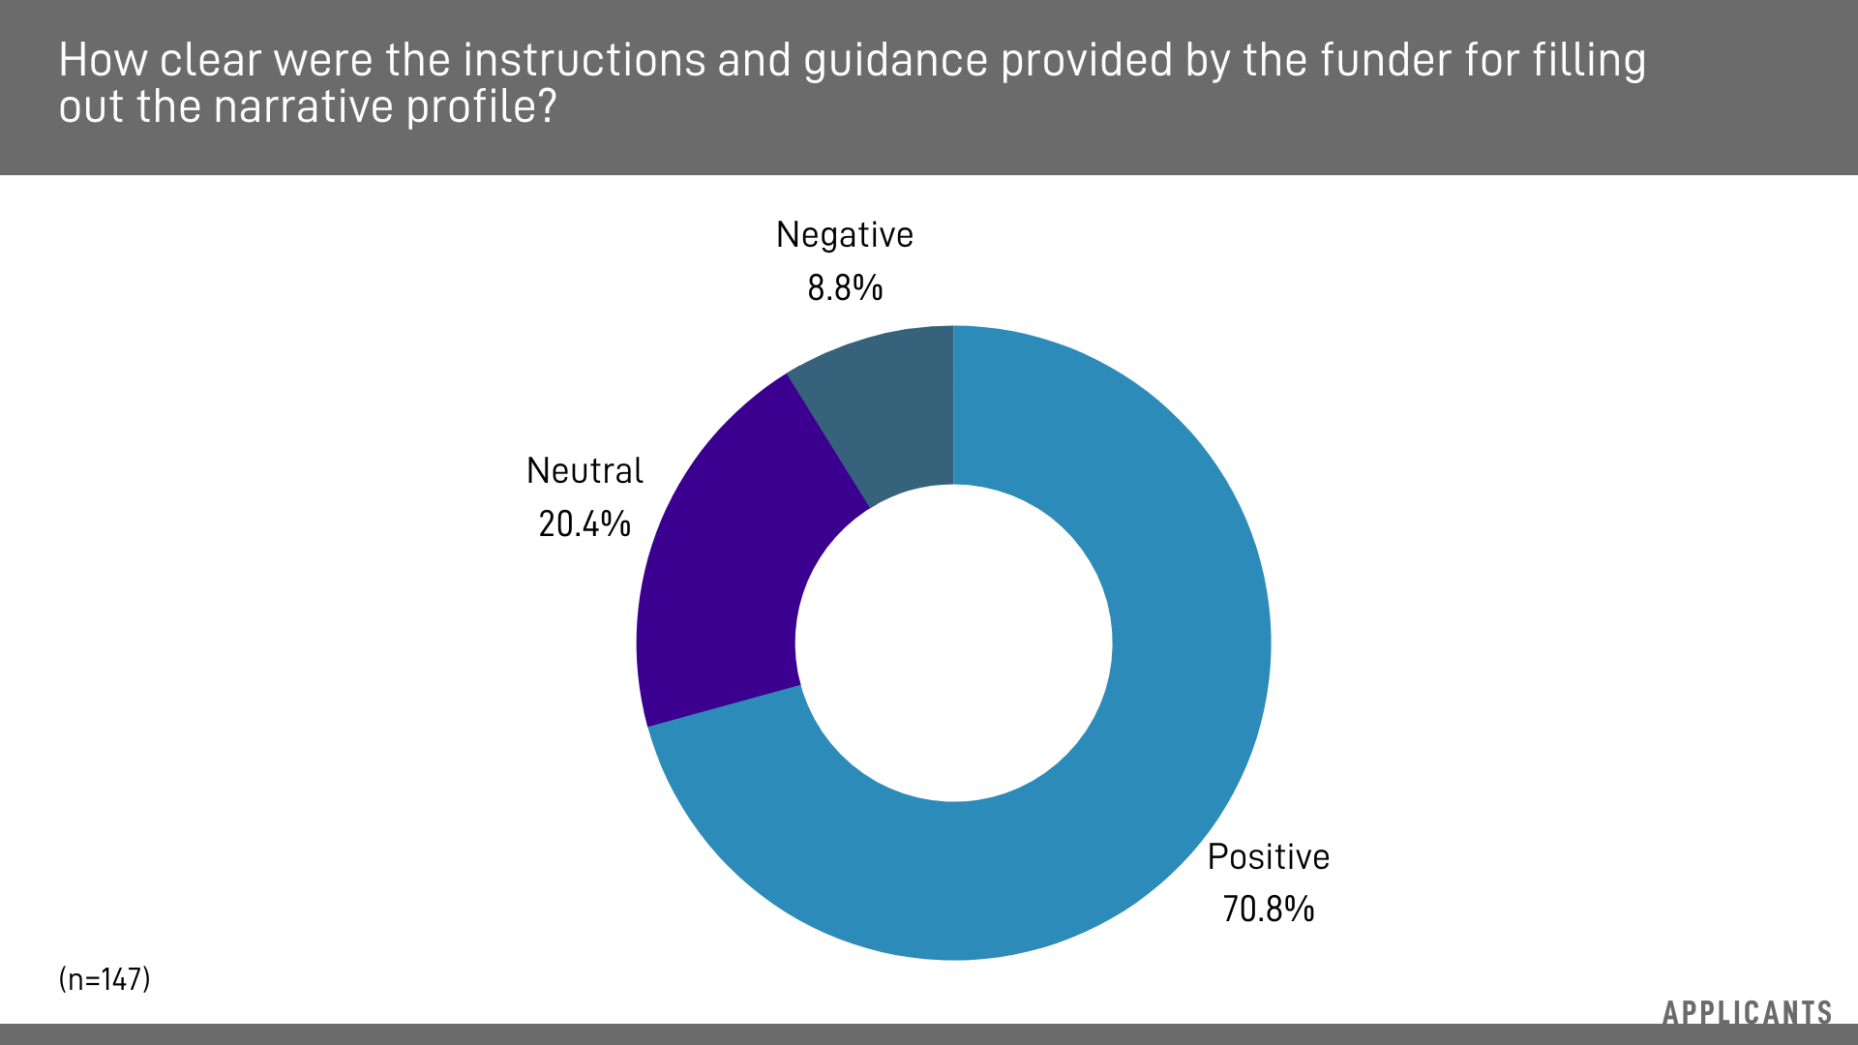
Guidance Results – Applicants

Slide 18
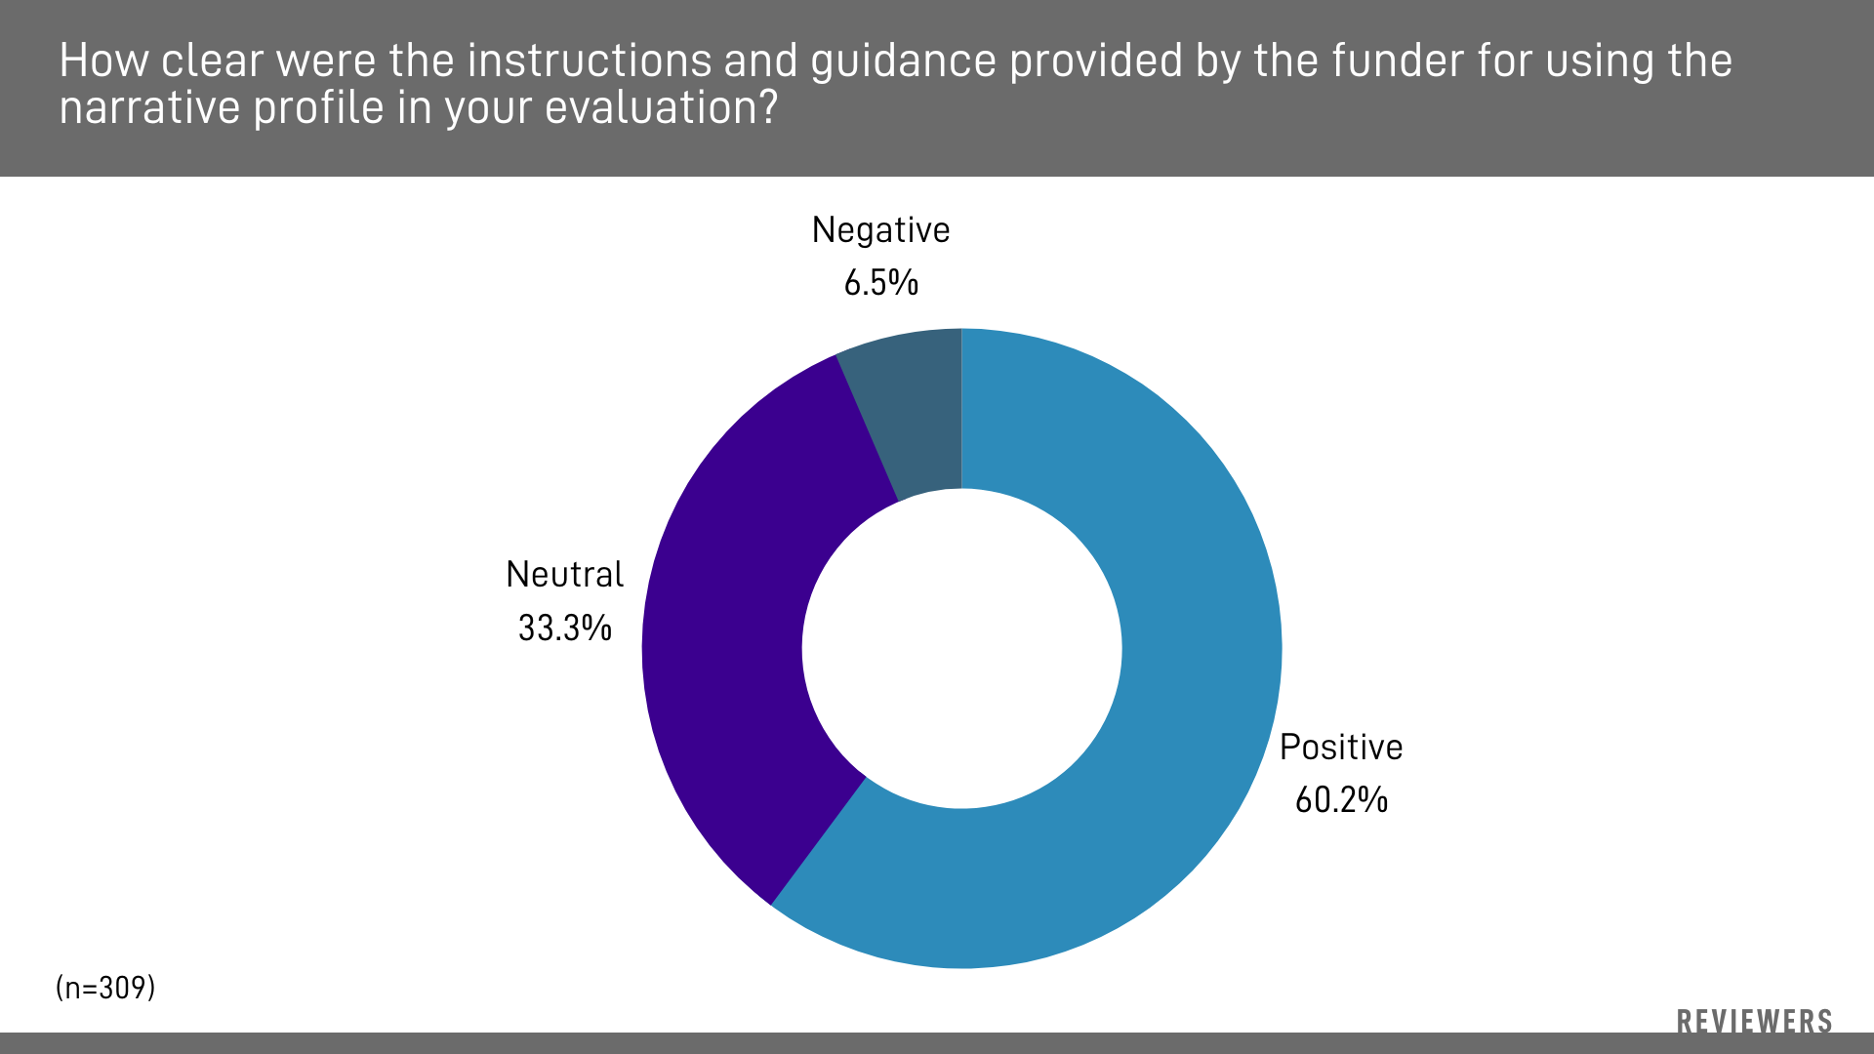
Guidance Results – Reviewers

Slide 19
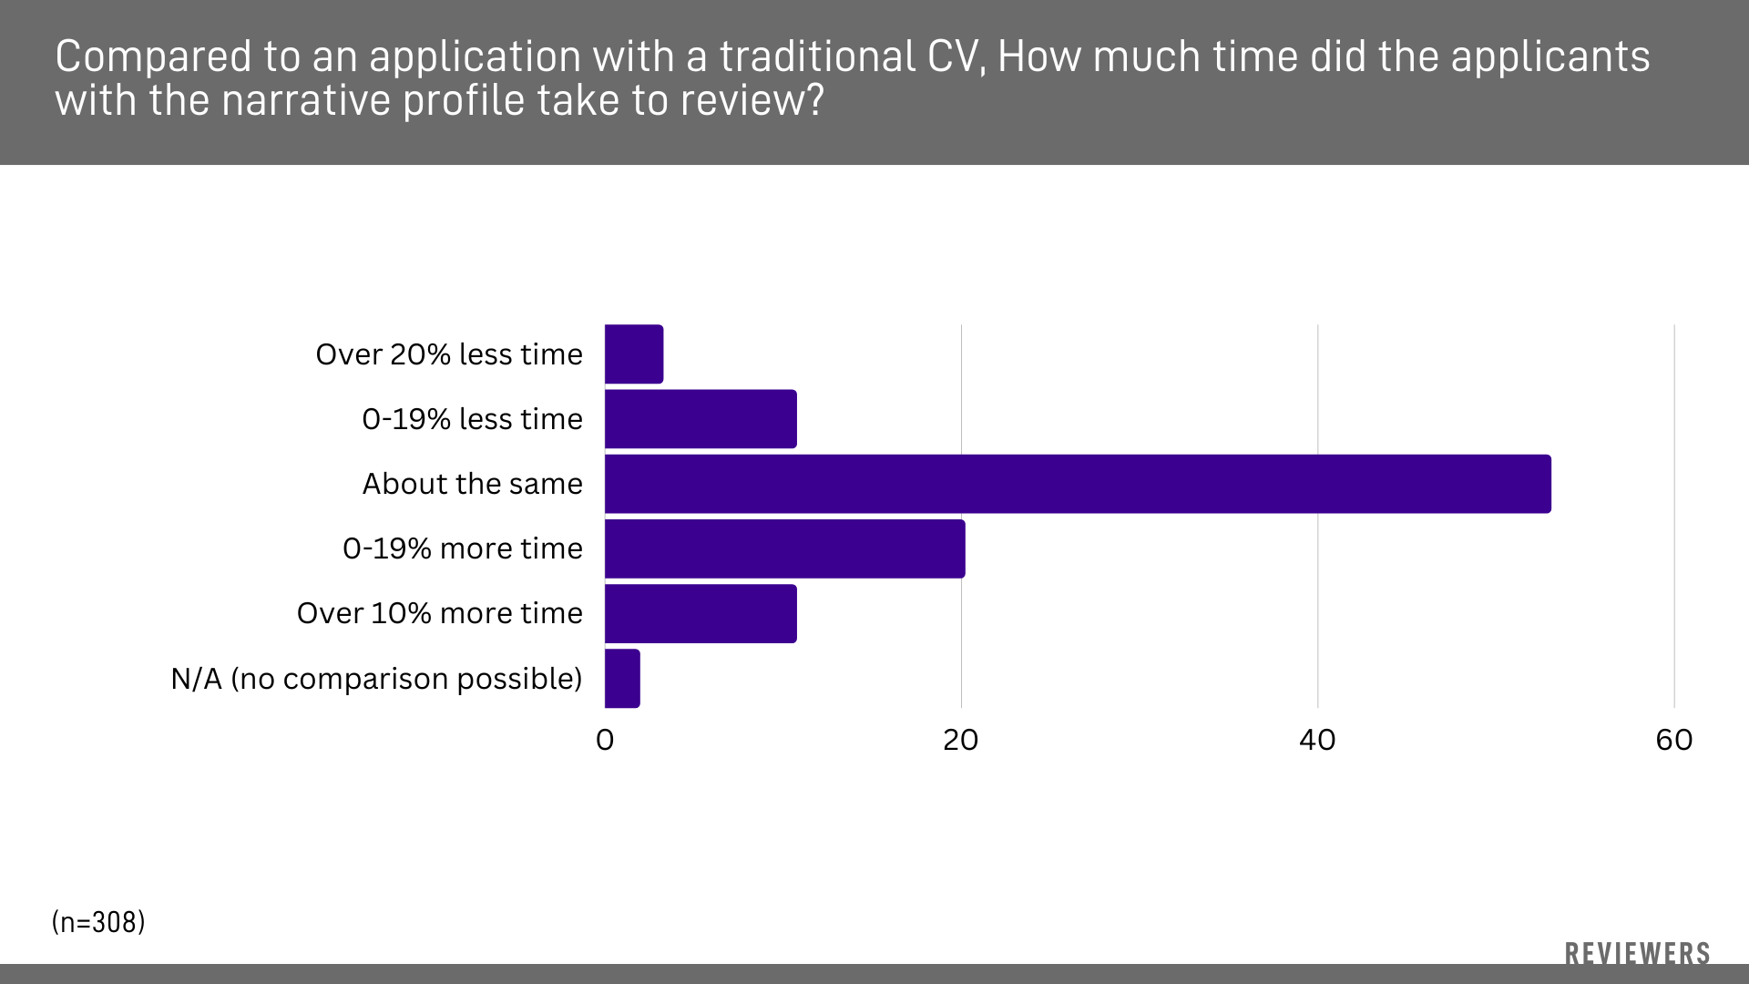
Time to Review Results - Reviewers

Slide 20
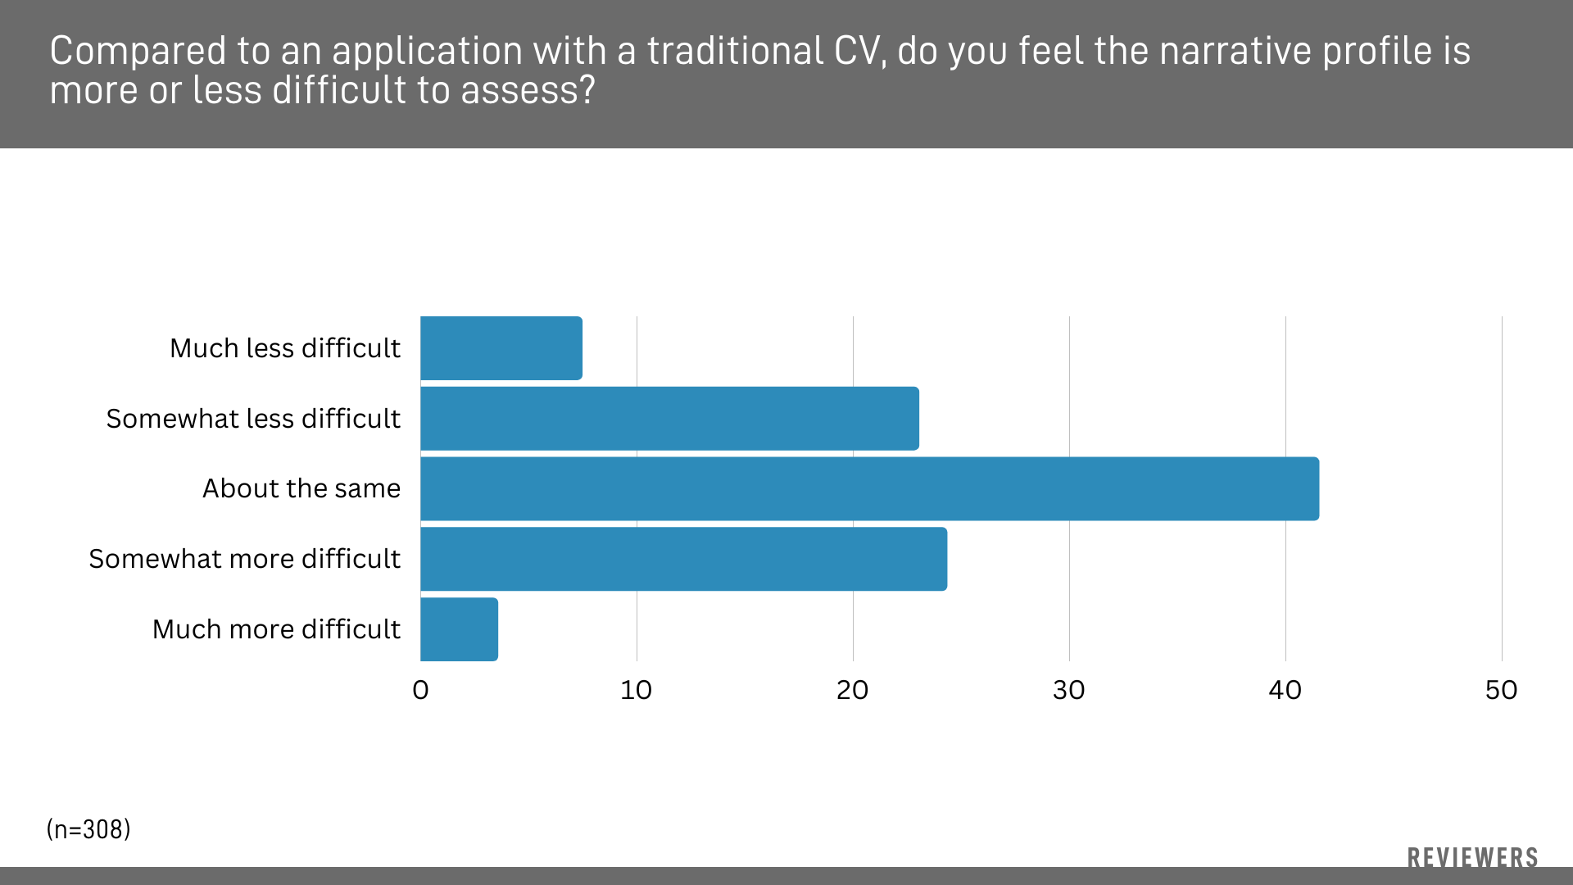
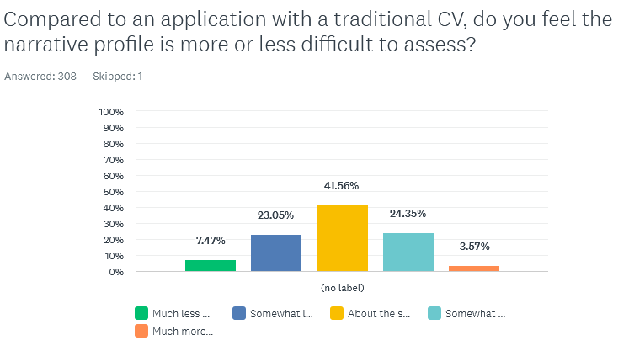
Difficulty to Review Results - Reviewers

Slide 21
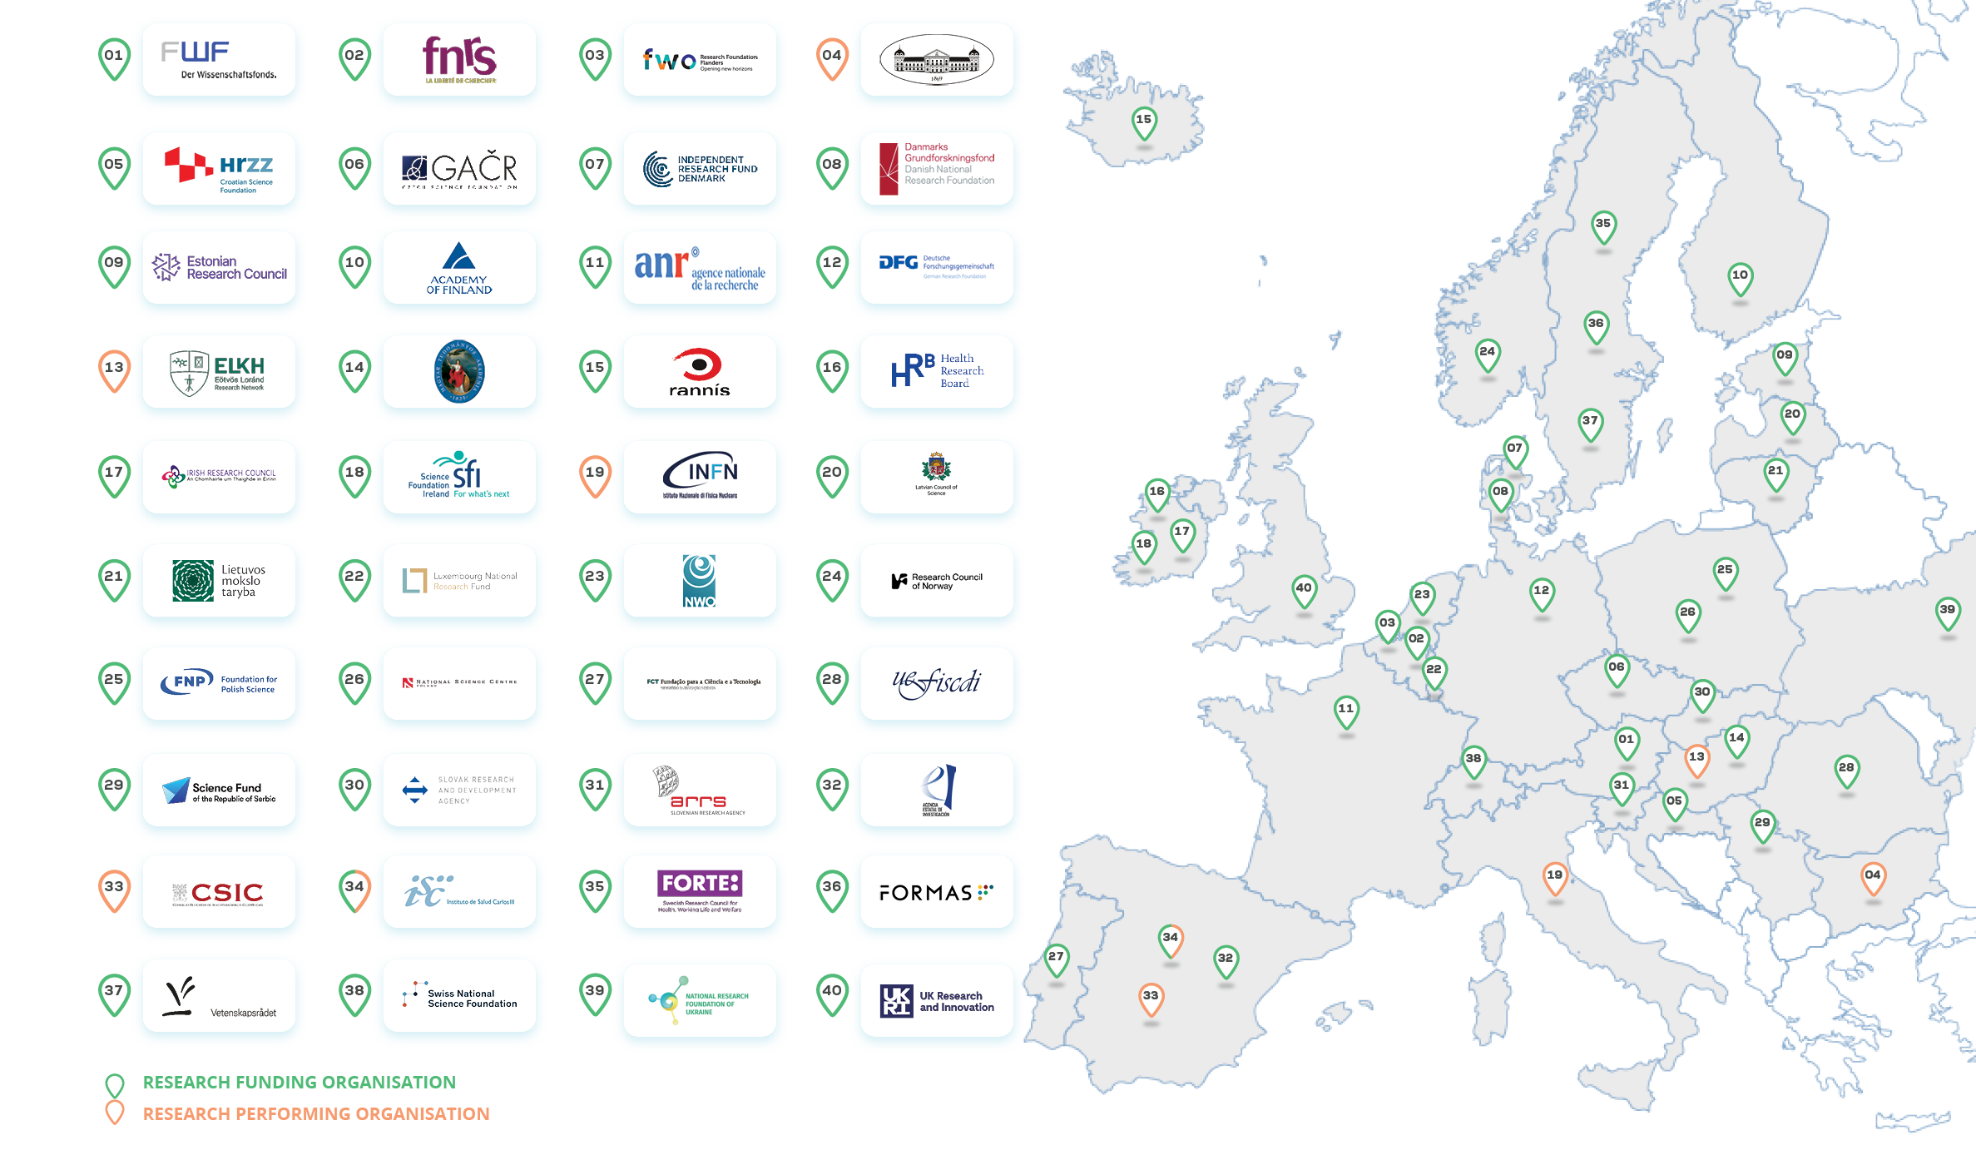
https://scienceeurope.org

Slide 22


What do we mean by research culture?
…a broad topic that can encompass the behaviours, values, expectations, attitudes, and norms of research systems.
Research culture is an important consideration for all policies and practices that related to the research sector.
https://royalsociety.org/topics-policy/projects/research-culture/

Slide 23
Which contributions?
‘publish or perish’
???
Who contributes?
Focus on first authors and principal investigators
???
What is quality?
Publishing in prestigious journals
???

Slide 24

Shared values
https://scieur.org/values-frame

Slide 25






Which contributions?
‘publish or perish’
???
Who contributes?
Focus on first authors and principal investigators
???
What is quality?
Publishing in prestigious journals
???
25

Slide 26
Which contributions?
‘publish or perish’
Focus on the content of research / integrity / open science
Who contributes?
Focus on first authors and principal investigators
Teams / collaborative efforts / leadership / collegiality
What is quality?
Publishing in prestigious journals
All values contribute to quality

Slide 27
https://scieur.org/values-frame

Slide 28
Sounds amazing! But…
Will narrative-style CVs really…
Will narrative CVs really enable diverse activities, outputs, and outcomes to be recognised?
What’s missing in application processes?
What will Narrative CVs change for you? What are your perceived/desired outcomes?
…create space for the recognition of activities, outputs, and outcomes that were previously under-recognized?
…contribute to improving research culture?
What can we expect from narrative CVs and associated changes on a broader scale?
Will they really have an influence on the way researchers are being assessed and contribute to improving research cultures?
Do they risk penalizing researchers?
We want to know what you think!

