Slide 1






Recognition & Rewards Festival
2023
Workshop 2.8:
Recognizing and rewarding scientists: Time for bias-free assessments
@RecogRewards
#RecognitionRewards
#ErkennenWaarderen
Recognition & Rewards

Slide 2
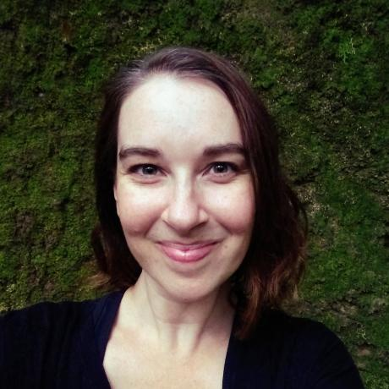

Who are we?

Slide 3
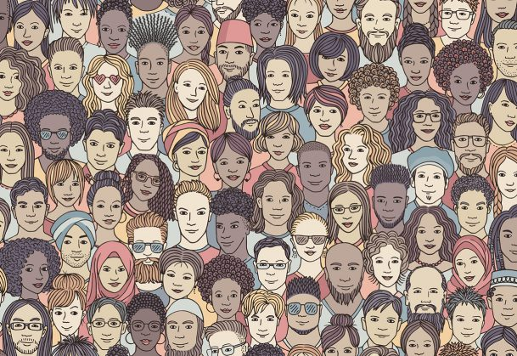
Who are you?
Notes:
Who of you is a scientist? Or a student?
Who of you is involved in policy making?
Who of you is working in HR?
Who of you has a different background?

Slide 4
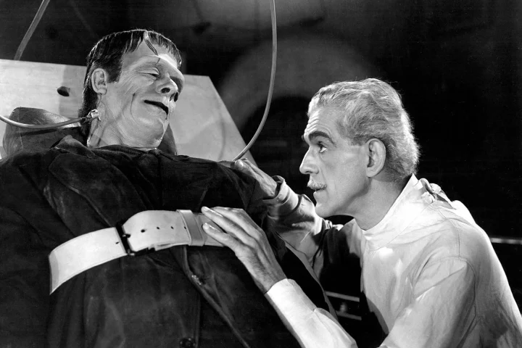
Disclaimer:
Notes:
Leek me goed om vooraf even aan te geven dat we oorspronkelijk twee verschillende sessies zijn en we hebben getracht het beste van beiden samen te voegen.

Slide 5
Goal of this session:
Universities and UMCs are reorganizing their scientific systems;
In this process they will need to reconsider the way they want to recognize and reward their researchers;
During this workshop we will also try to reimagine the current scientific system using a thought experiment.

Slide 6
So, why would we want to reimagine the research system and thereby the way we recognize and reward scientists?

Slide 7
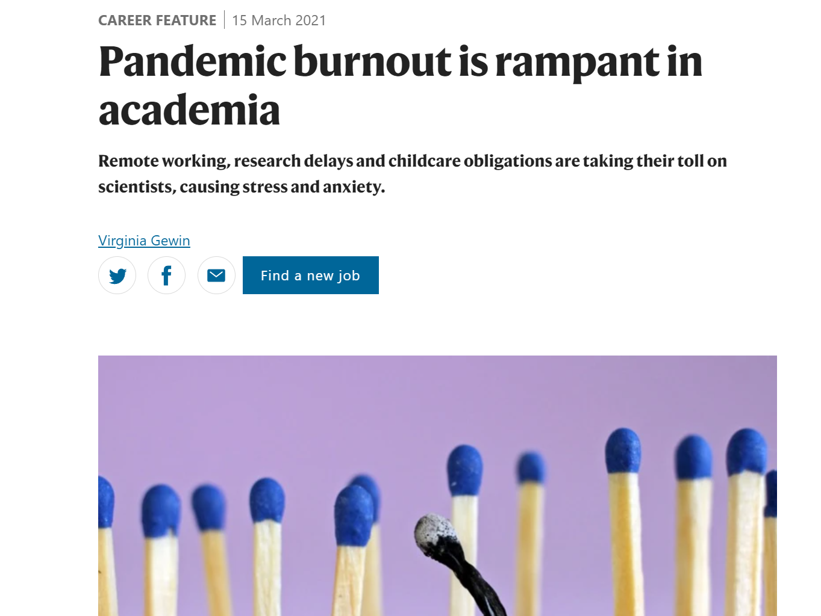
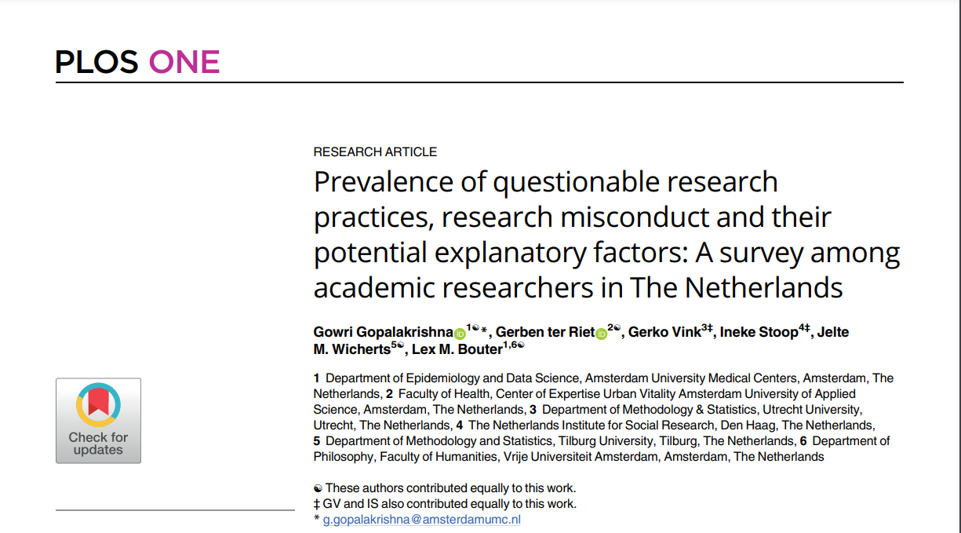
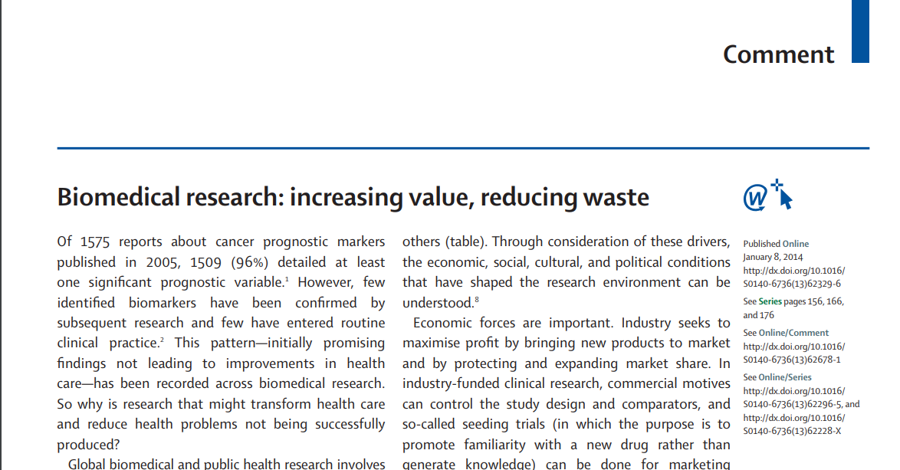
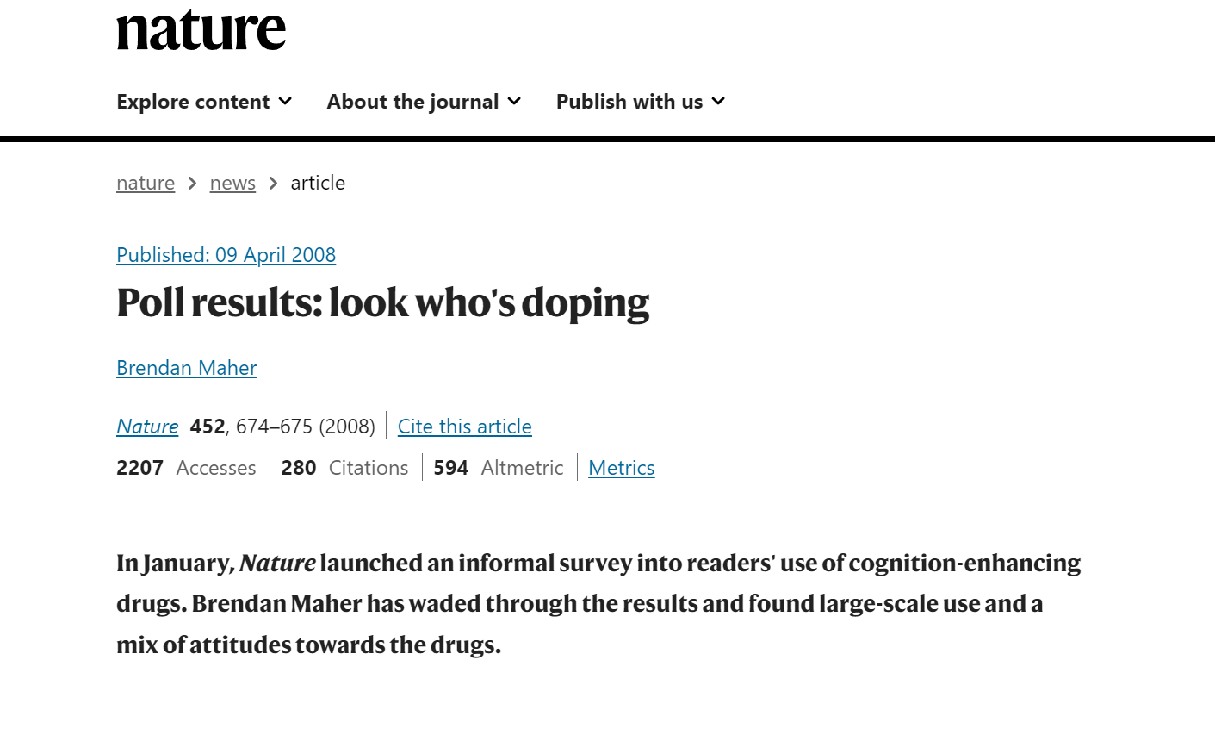
Notes:
Bijna 5% heeft in een survey aangegeven data te hebben gefabriceerd of gefalsificeert.
Een op de twee heeft zich in gelaten met sloppy science..

Slide 8
Outline of this session:
Understanding the thought experiment
Understanding why the current scientific system is not fair
Undertaking the thought experiment
Comparing our findings
Tips and tricks for bias free assessments

Slide 9
Let’s start with a thought experiment

Slide 10
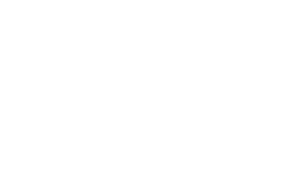
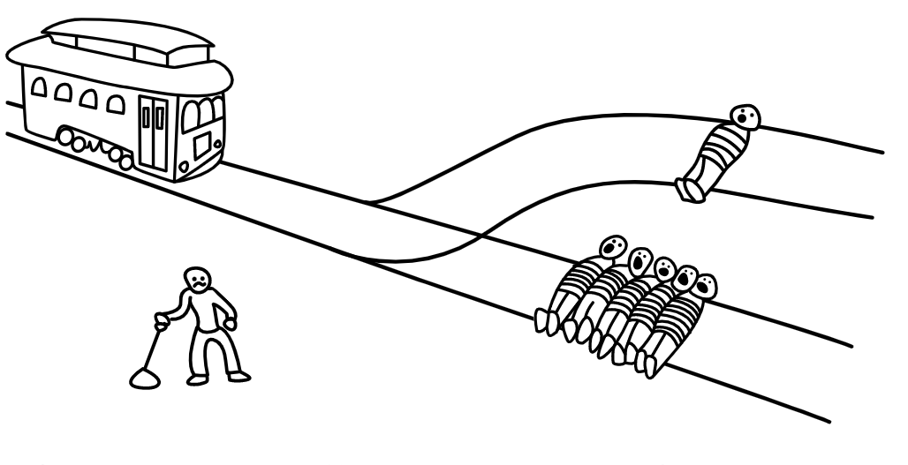
Imagine: You can pull the lever to divert it to the other track and stop the trolley from killing the five scientists. The one scientist on the other track will die.
Would you pull the lever?
https://neal.fun/

Slide 11
So, what does this thought experiment have to do with the recognition and reward system?

Slide 12
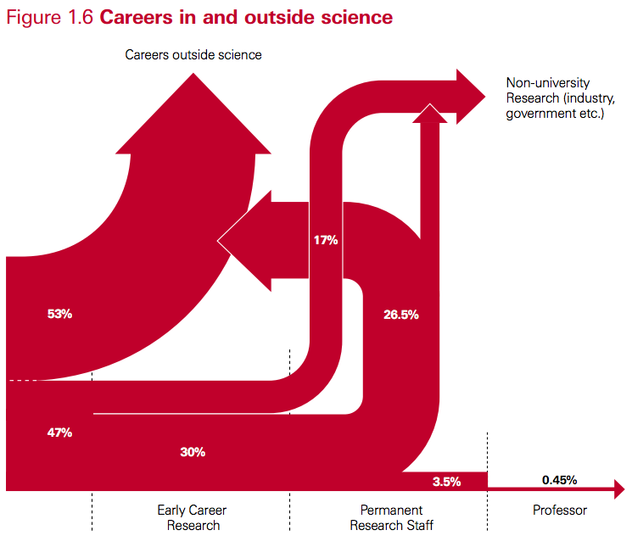

Well, not pulling the lever might be a very smart strategy to make it in academia

Slide 13
https://neal.fun/

Slide 14
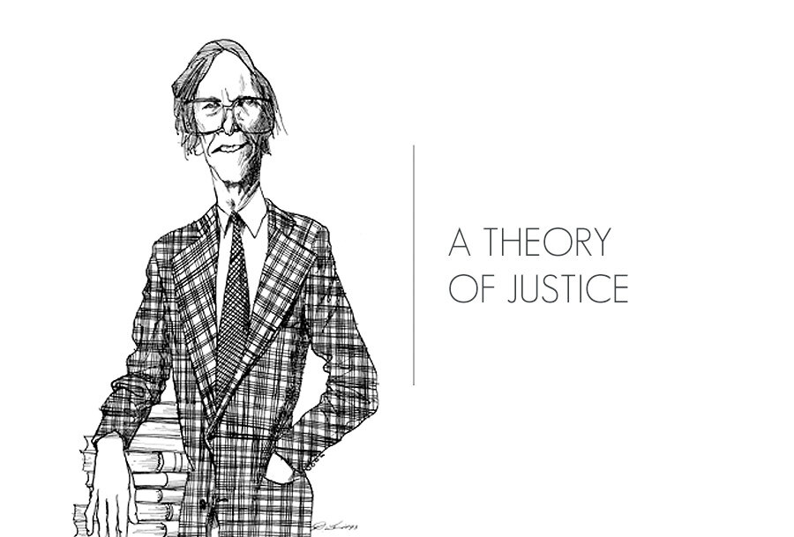

Slide 15

Veil of Ignorance

Slide 16
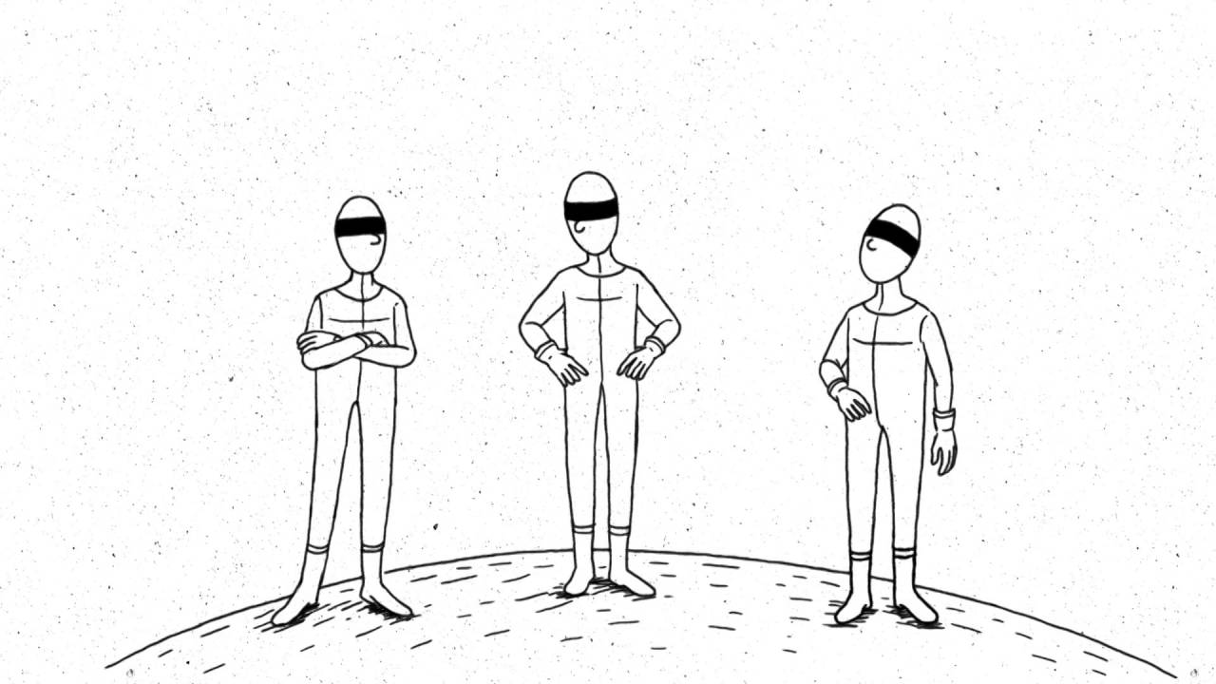
Time for another perspective..

Slide 17
Imagine: You have equal odds of being one of the 6 scientists affected by the decision: the 5 scientists on the tracks and the sixth scientist who is on the other track.

Slide 18
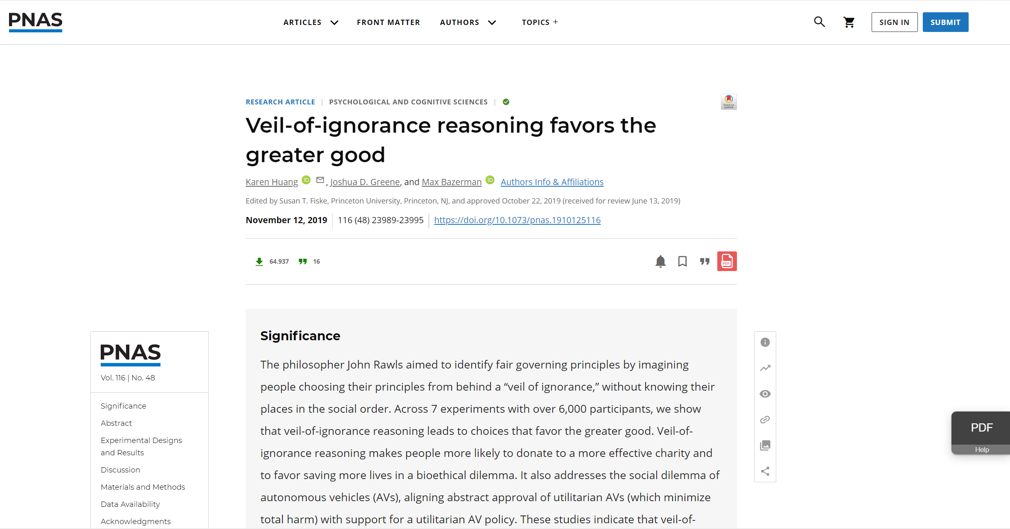

Slide 19
In this workshop we want to explore whether reasoning from behind the veil of ignorance can help us think up a fairer and more inclusive scientific system.

Slide 20
Isn’t the current scientific system already fair?

Slide 21
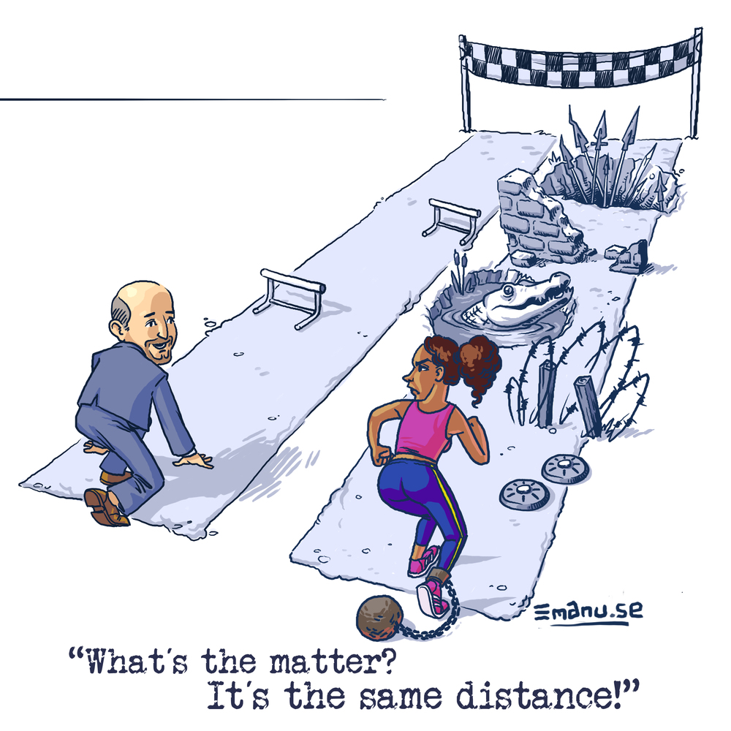
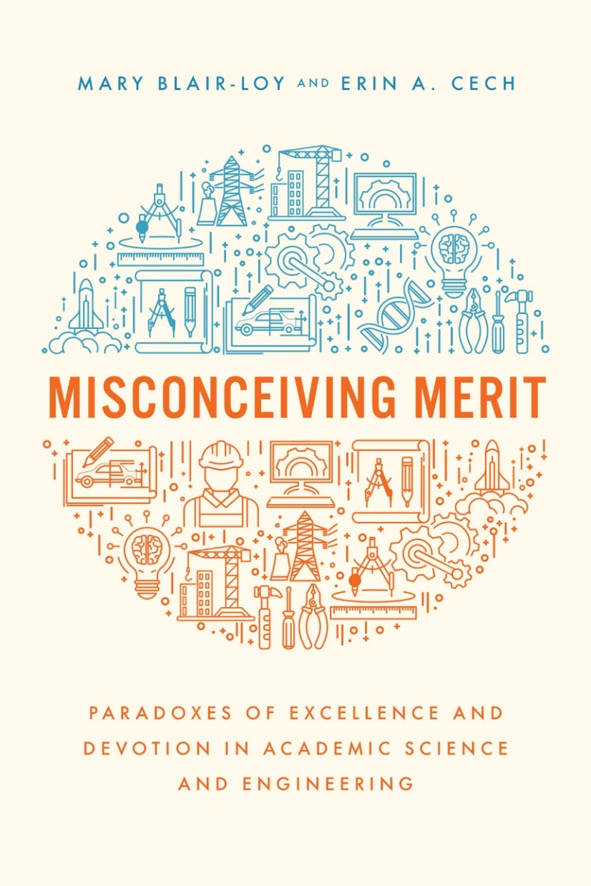
It should be quality that counts

Slide 22
Current appraisal of scientists is flawed due to, among other things:
Bias in metrics
Stereotyping

Slide 23
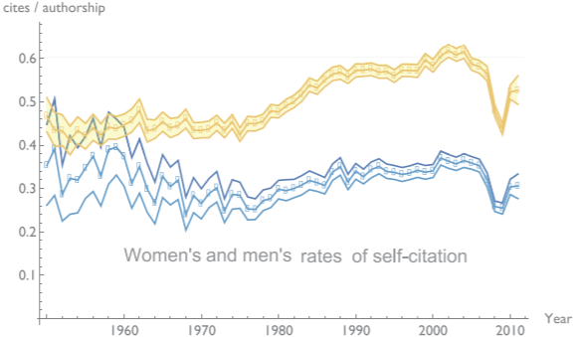
Bias in metrics
King, et al. 2017
Notes:
Men self cite 56% more→ 70% more in the last two decades of the study
10% of citations are self citations→ each citation leads to 4 new ones
Women (of colour) more backlash (williams 2014)
First and last authorship disproportionally more men west et al, 2013)

Slide 24
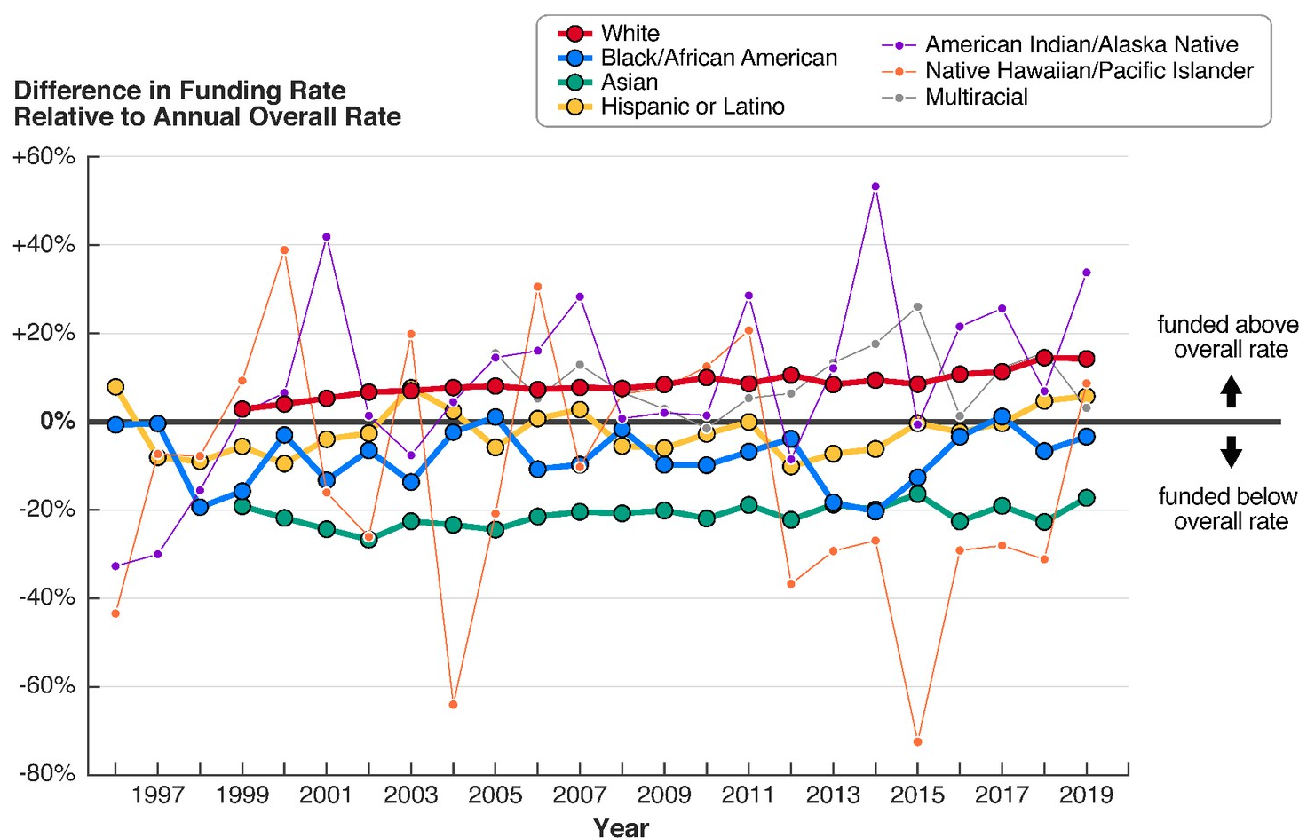
Grants
Chen et al, 2022

Slide 25
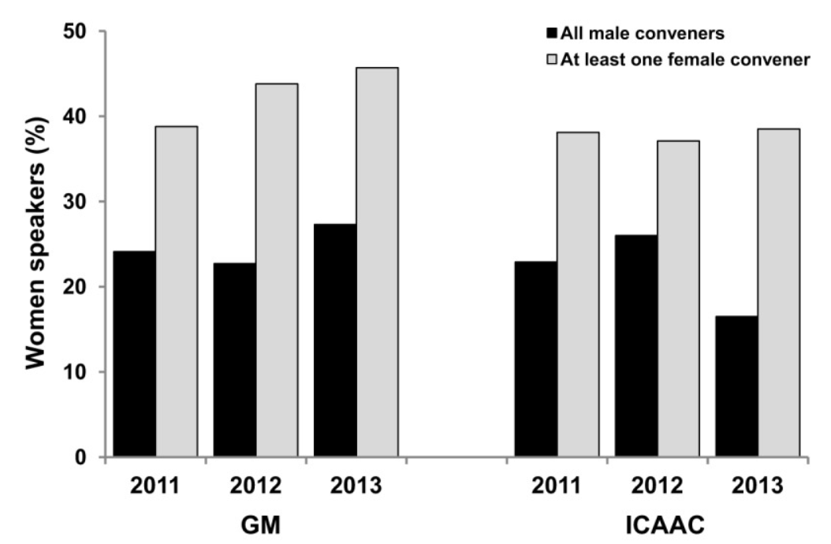
Invitations to conferences
Casadevall &Handelsman, 2014

Slide 26
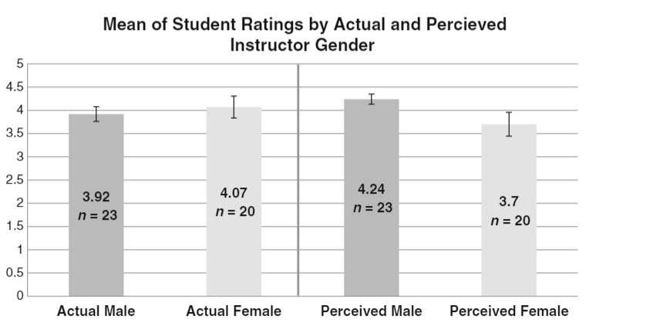
Student evaluations teaching
MacNell et al., 2014
Notes:
2014 small sample size
Kreitzer & Sweet-Cushman, 2021
Mengel et al 2017,2019→ gender bias, graded on for example self study hours or grades not diff

Slide 27
Stereotyping

Slide 28


Slide 29
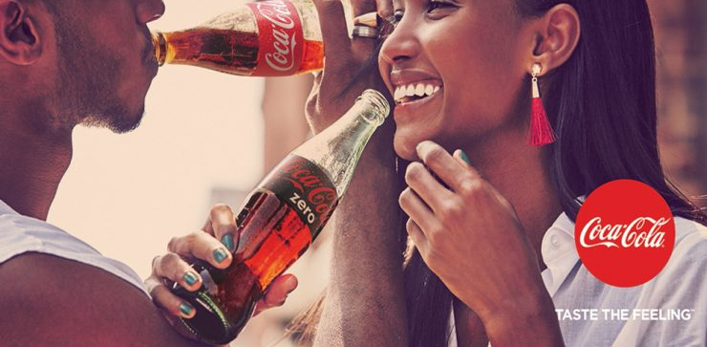

Slide 30
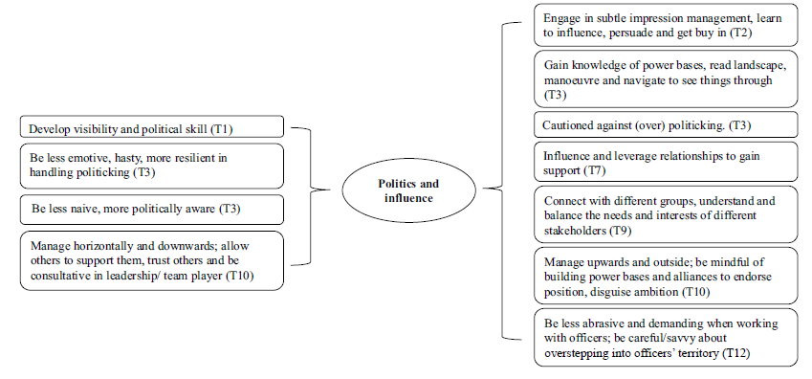
Type of evaluations
Given to men
Given to women
(Doldor et al, 2019)

Slide 31
Begeny et al, 2020

Slide 32
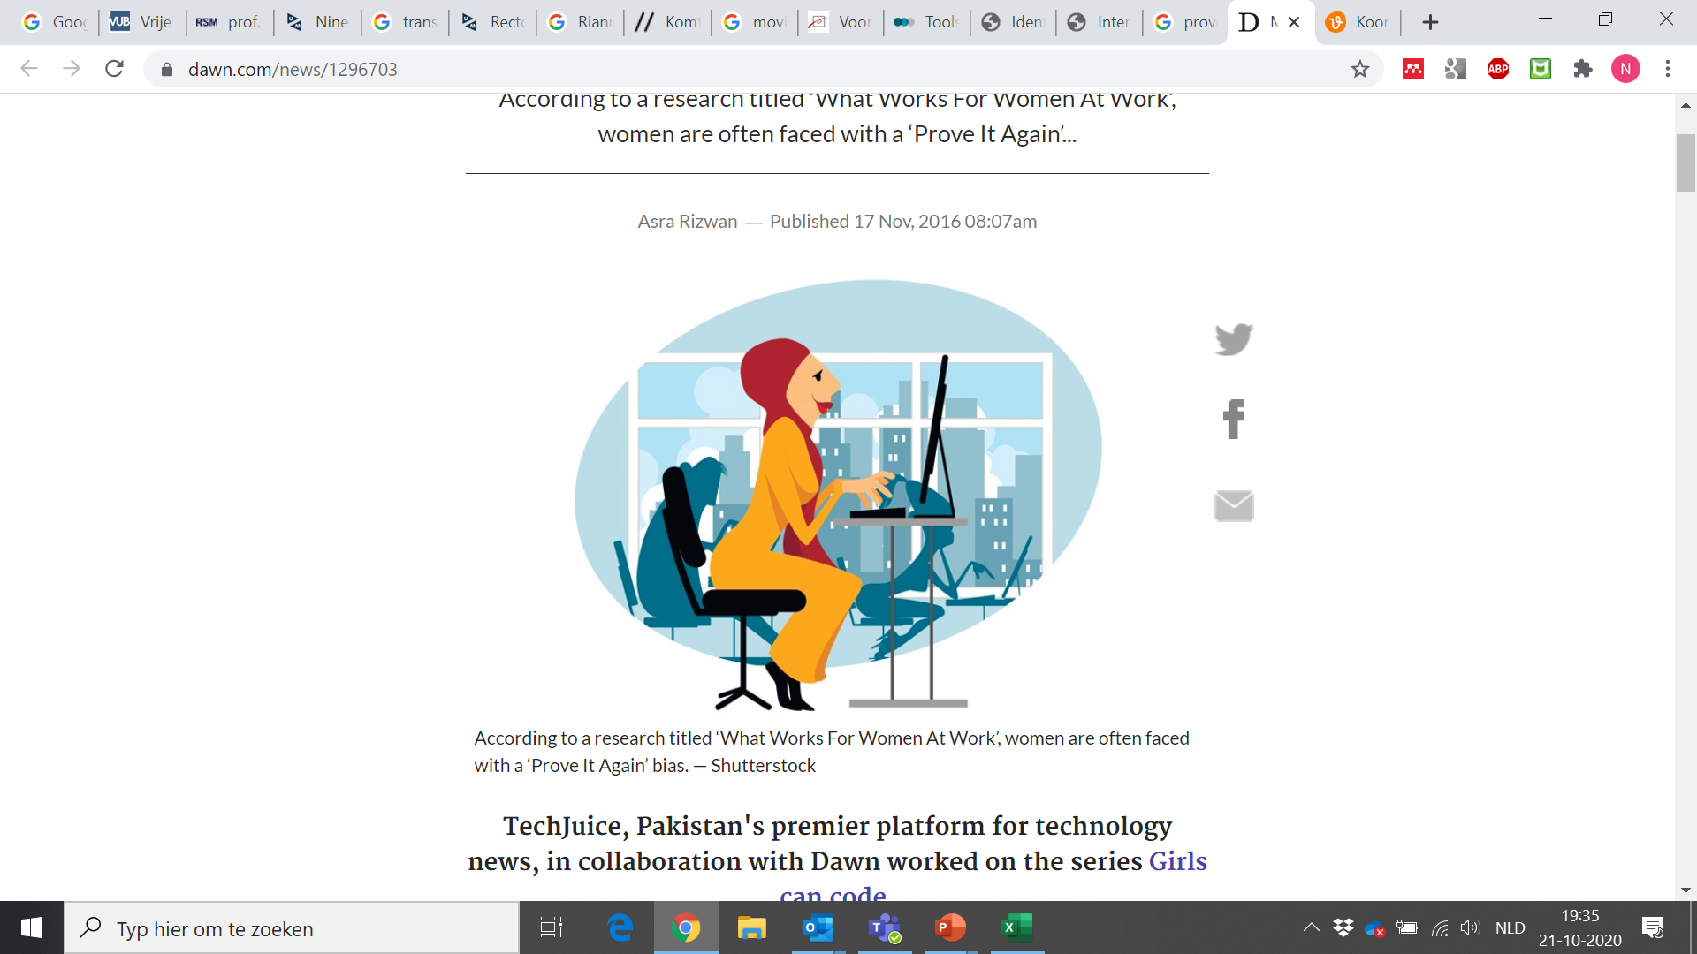
Prove it again!!!
Biasinterruptors.org
Notes:
Women, People of colour, People with a handicap, Older people, People from the lgbtqi+ comm, People with a low socio-economic status

Slide 33
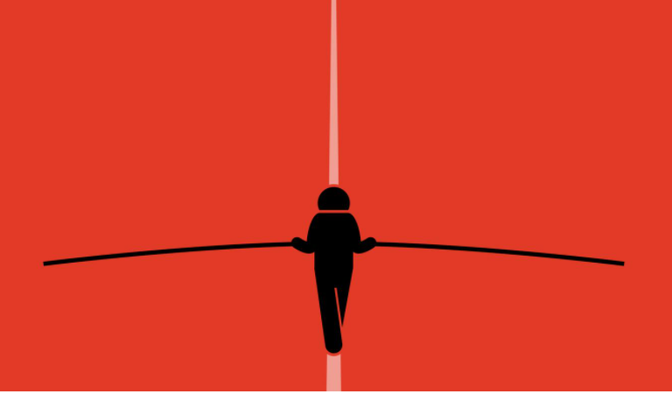
The tightrope
Biasinterruptors.org
Notes:
vrouwen, mensen van kleur, mensen met een lage sociale-economische status, introverte/ verlegen mannen

Slide 34
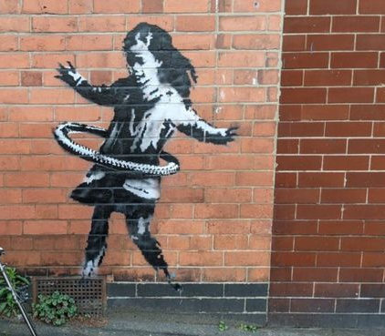
The parental wall
Biasinterruptors.org

Slide 35
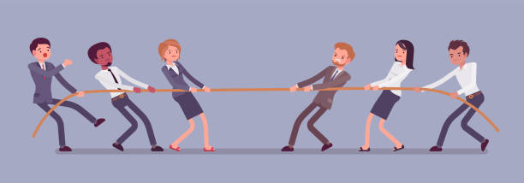
Tug of war
Biasinterruptors.org

Slide 36
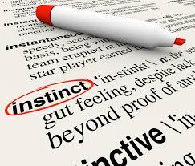

Slide 37
How do we reward and recognize scientists?

Slide 38
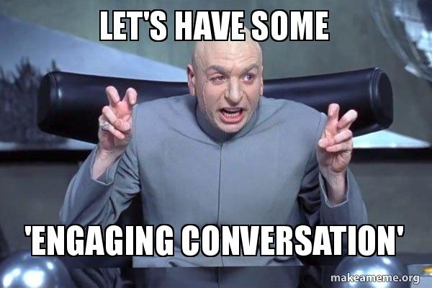

Slide 39
In the Radboudumc we used to have a system that assessed the quality of researchers on:
Number of publications in high impact papers
Amount of grant money accrued
International esteem
Societal impact

Slide 40
So now they are aiming to create a new scientific system that is characterised by inclusiveness, diversity, intergrity, team science, safe environment, etc.
To do this, they promoted all the ‘winners’ of the previous system to research group leaders.

Slide 41
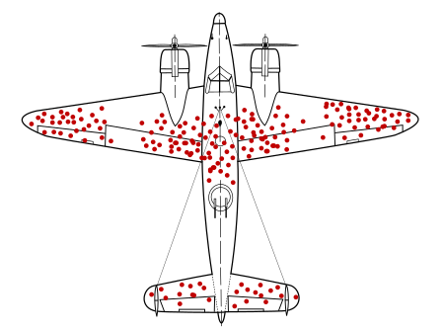
Survivorship bias

Slide 42
Can we improve upon this strategy?

Slide 43



Slide 44
Imagine that are allowed to rethink how we recognize the quality of a scientist. But you do not know who you are when are being assessed (female/non binary/male, being transgender/cisgender, a person without/with a handicap, with/without young children, speaking Dutch/not speaking Dutch, being brown/Black/ white , etc) in the system you designed. What elements do you think should be assessed to determine a researchers’ quality?
Veil of Ignorance
Thought experiment (under the veil of ignorance):
How do we reward and recognize scientists?

Slide 45
Briefly discuss this question in groups of 4-5 people
Write your most important insights down
We will plenarary discuss your ideas and perspectives

Slide 46
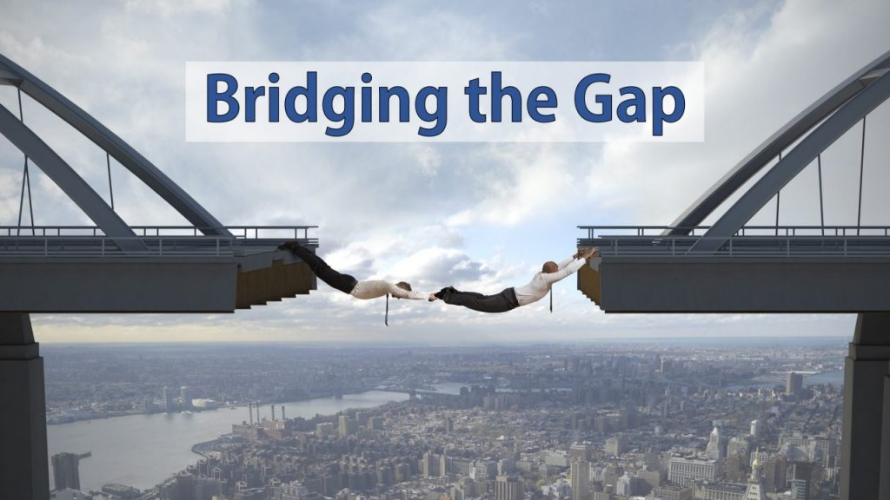

Slide 47
Things to avoid
Avoid metrics that are biased, but keep quantitative measures
Don’t mix performance and potential evaluations, keep them separate
Not everyone needs the same goals/ criteria
Don’t keep performance criteria too vague or too hard to reach
Don’t use student evaluations as a way to measure teaching performance
Kreitzer & Sweet-Cushman, 2021
Biasinterruptors.org

Slide 48
Practical things to do:
Formulate team goals with the team
Start with clear, specific, measurable performance criteria directly related to job requirements that were agreed on together
Communicate performance criteria with the team
When returning from leave adjust the requirements immediately
Train reviewers to be aware of their own biases
Use metrics to study the evaluations
Notes:
Metrics like:Do your performance evaluations show consistently higher ratings for majority men than for women, people of color, or other relevant groups?
Keep metrics by: 1) individual supervisor; 2) department; and 3) the organization as a whole.

Slide 49


Thank you for visiting our workshop!
@RecogRewards
#RecognitionRewards
#ErkennenWaarderen
Recognition & Rewards

